Slide 1
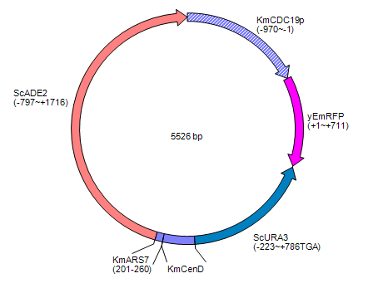
Figure S1

Slide 2
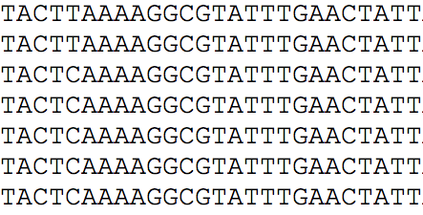
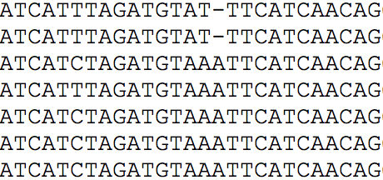
19,066
19,117
DMKU3-1042
CBS 6556
CBS 397
CBS 608
NCYC 111
CBS 712
CBS 7858
Figure S2

Slide 3
Figure S3

Slide 4
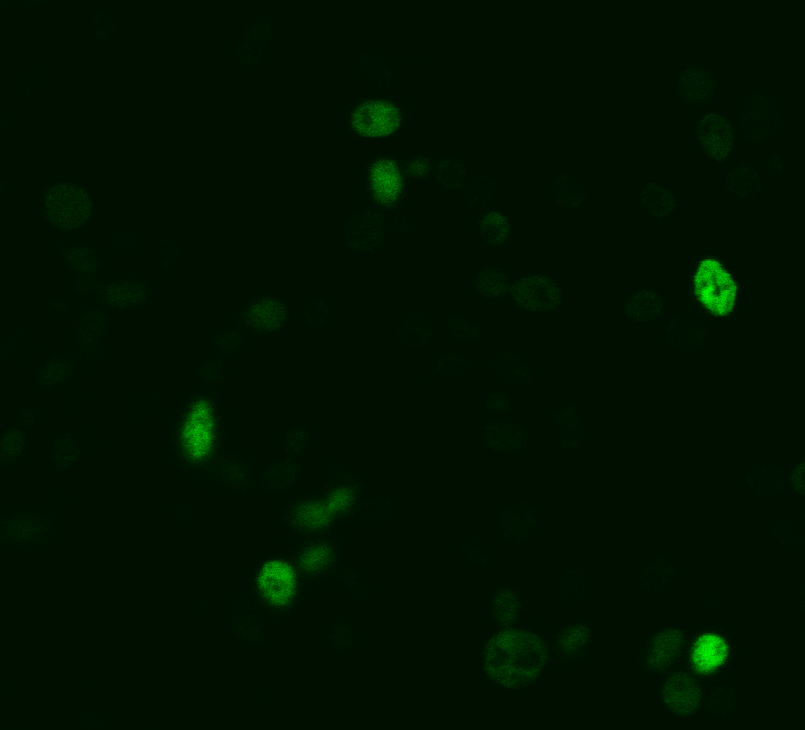
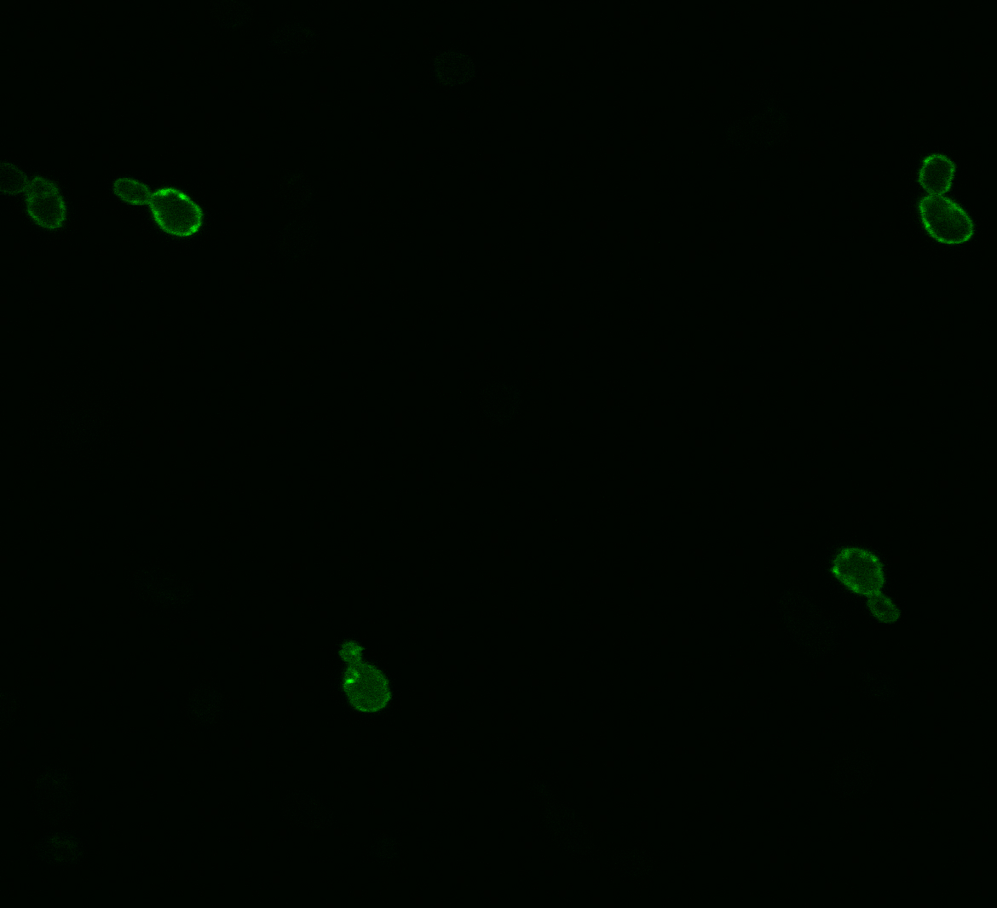
A
B
Figure S4

Slide 5
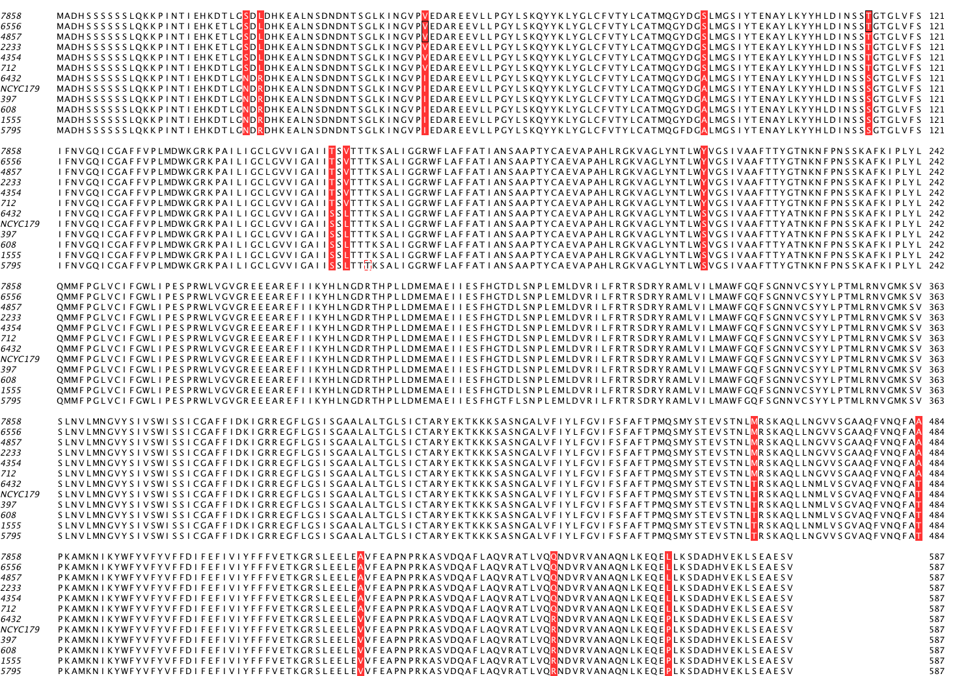
Figure S5

