Slide 1



Partnerships Involving Stakeholders in the Celtic Sea EcoSystem (PISCES):
Translating EU maritime policy into practical outputs for multiple sectors spanning Ireland, the UK, France and Spain.
Sarah Twomey
Coastal and Marine Research Centre
University College Cork

Slide 2
Contents
Rationale, aims and structure of PISCES.
Current progress:
  Guideline development,
  Stakeholder engagement.
Learning, Benefits and Opportunities.
Notes:
PISCES, a three-year project funded by the European Commission LIFE+, is enabling sectors as diverse as shipping, aggregates, fishing and tourism to come together in order to create a set of guidelines to manage their activities in a sustainable way. These stakeholders will be considering how their activities have an impact on the ecosystem and will share perspectives from multiple countries and industries to find consensus on how to look after the Celtic Sea. PISCES aims to translate policy into real action and to set an example of how important legislation such as the EU Marine Strategy Framework Directive might be rolled out in practice.

Slide 3
PISCES - rationale
EU Marine Strategy Framework Directive and Common Fisheries Policy state that an ‘ecosystem based approach’ should be used.
But what does it mean to people (stakeholders) who are active in the marine environment?
And can their ideas be used to inform policy implementation?
Notes:
Driver/ Basis of this research:
Maintaining the ecological health and integrity of the sea and its coastal areas is key to the development of a sustainable future for the Celtic Sea.
The MFSD is significant in proposing an EA and environmental management of European seas on a regional basis.
Kidd et al. (2011): Much has been done to elaborate what EA entails and understanding is developing. The time has come for us to shift the focus of debate from conceptualising EA to issues related to its implementation.

Slide 4
Ecosystem Approach
Convention on Biological Diversity:
“The ecosystem approach is a strategy for the integrated management of land, water and living resources that promotes conservation and sustainable use in an equitable way.”
Notes:
EA is embedded in the concept of sustainable development and puts emphasis on a management regime that maintains the health of the ecosystem alongside appropriate human use of the marine environment, for the benefit of current and future generations.

Slide 5
PISCES project
LIFE+ funded, 2009-2012, €2.1M.
WWF UK with WWF Spain, The Environment Council and country leads Coastal and Marine Research Centre (UCC) and SeaWeb (France).
Study Area: The Celtic Sea.
Notes:
We want to introduce an ecosystem approach to marine management across a number of countries, cultures and sectors that will be relevant and useful to people operating within and around the Celtic Sea. The European Commission has funded over €1 million towards this project. The funding comes from LIFE+ which is the European Unions financial instrument to support environmental and nature conservation projects.

Slide 6
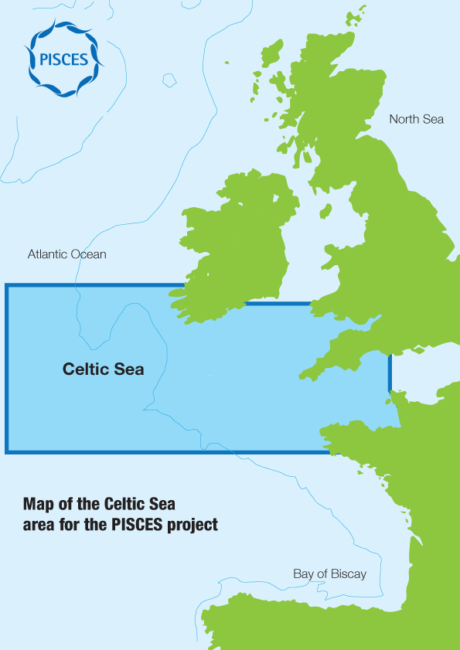
Celtic Sea
ICES VIIf-k / Western Channel VIIe.
High use area in NE Atlantic, multiple countries, replicable.
Bringing together stakeholders from main activities in the area.
Notes:
When we talk about the Celtic Sea, we mean the area shown in the map below which extends to include some of the exceedingly busy English channel and also west of Ireland in the deeper waters. There are a number of different Celtic Sea boundaries but we have chosen to follow the one set out by the International Council for the Exploration of the Sea.
The (ICES) and OSPAR have identified the Celtic Seas Ecoregion as having similar biological, physical and socio-economic conditions. The Celtic Sea area identified for the PISCES project is a subdivision of the wider Celtic Seas Ecoregion and includes the fishing area known as the Celtic Sea (ICES subarea VIIf-k) and the western part of the English Channel (VIIe). This can be seen as a distinct area within the wider ecoregion. There are similarities in physical conditions and marine species found throughout the area. There are also similarities in the conditions experienced by different activities, including fisheries, tourism and recreation and there are stakeholders that share common interests across the political and geographical boundaries.
This is a huge area covering the coasts of three different countries, shallow and deep waters. Although we do not cover the Spanish coast, Spanish fisheries operate in these waters and are therefore contributing to the project as stakeholders.
The Celtic Sea is an important habitat for rare birds, sharks, seals, dolphins and whales as well as commercially important fish stocks.
People from across Europe heavily use this region as it is vital for their livelihoods and well-being. Key influences include: fisheries, mariculture, chemical pollution, shipping, aggregate extraction, construction, dredging, coastal development, and recreation & tourism. Individually these activities might be sustained by the ecosystem but collectively, they pose a threat to marine biodiversity and our future economy

Slide 7
PISCES aims
To develop a common understanding of the Ecosystem Approach with stakeholders.
To produce a set of stakeholder-led guidelines for implementing an Ecosystem Approach which can be disseminated and applied throughout other maritime regions in the EU.
To challenge existing and test new creative methodologies and processes for stakeholder engagement.
Notes:
Project goal: To develop stakeholder-led guidelines for an ecosystem approach (EA), using innovative stakeholder engagement methodologies, that are advocated and communicated to wider stakeholders, policy and decision-makers and the project is accepted as a model for implementation of the EA.
To provide an invaluable test-drive as to how other marine regions may be managed in the future, as emerging policies are put into practice.
We will maintain close interactions with industry, government, agencies and related projects across the UK, Ireland, France and Spain as well as reaching wider into the European Union and beyond.

Slide 8
PISCES structure
Steering group
PISCES management team
Advisory group
Core stakeholder group
Wider stakeholders
Notes:
The PISCES project is putting people who use the sea (stakeholders) first.
Through a series of workshops, these stakeholders will be defining an ecosystem approach and building a common level of understanding of the risks and opportunities facing the multiple sectors that operate in the Celtic Sea. It will be up to the stakeholders to deliver the final guidelines to managing the marine environment more sustainably.
To enable this to happen, PISCES has a core management team and also an advisory team to provide stakeholders with specialist knowledge and support

Slide 9
Stakeholder group
27 core stakeholders.
Main sectors: Fishing & Mariculture, Aggregates, Undersea Cables, Marine Renewables, Ports, Shipping, Coastal Tourism and Recreation.
Ireland, the UK, France and Spain.
Notes:
The core stakeholder group will act as ambassadors for their sector, helping to spread news about PISCES, lessons learnt and the final guidelines to wider stakeholders in their sector and beyond.

Slide 10
Advisory Group
Group to provide advice and review stakeholder outputs.
Expertise in policy, science and stakeholder engagement:
David Johnson (OSPAR), Fanny Douvere (UNESCO), Laurence Mee (SAMS), David Reid (Marine Institute), Diana Pound (Dialogue Matters), Sian Prior (consultant), Simon Walmsley (WWF International).
Notes:
The PISCES Advisory group consists of a small group of experts in marine stakeholder engagement, marine policy, climate change and the ecosystem approach.

Slide 11
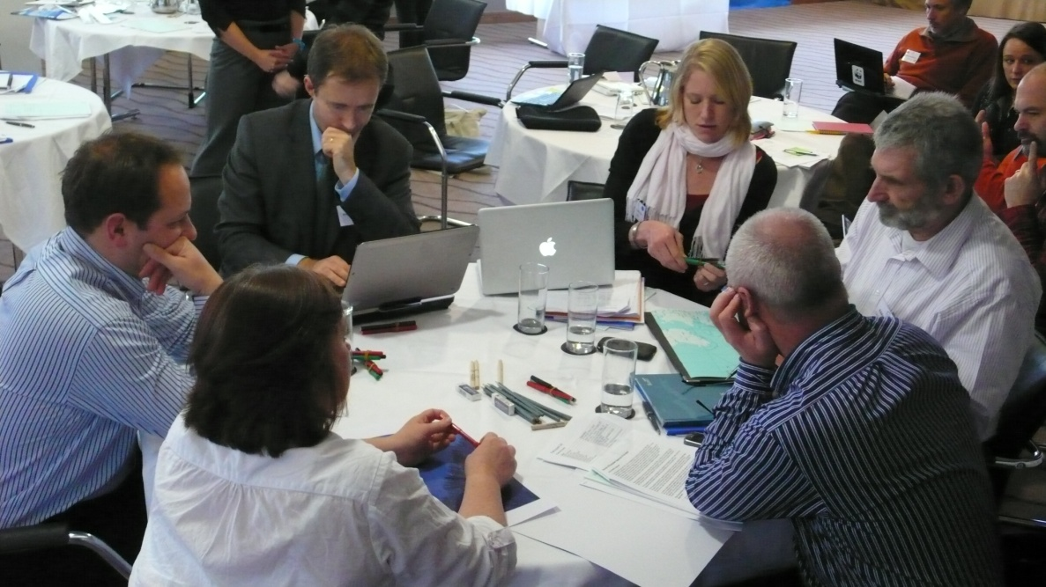
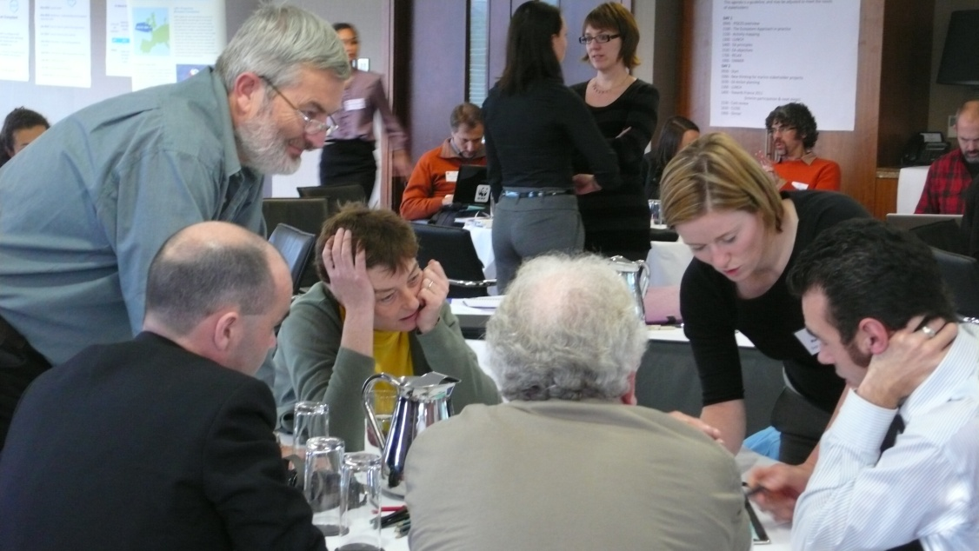
Workshops

Slide 12
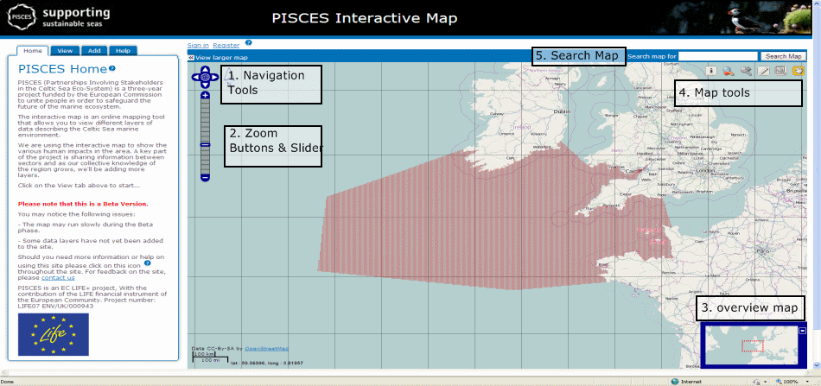
Interactive Map
Notes:
An online mapping tool that allows you to view different layers of data describing the Celtic Sea marine environment. We are using the interactive map to show the various human impacts in the area. A key part of the project is sharing information between sectors and as our collective knowledge of the region grows, we'll be adding more layers

Slide 13
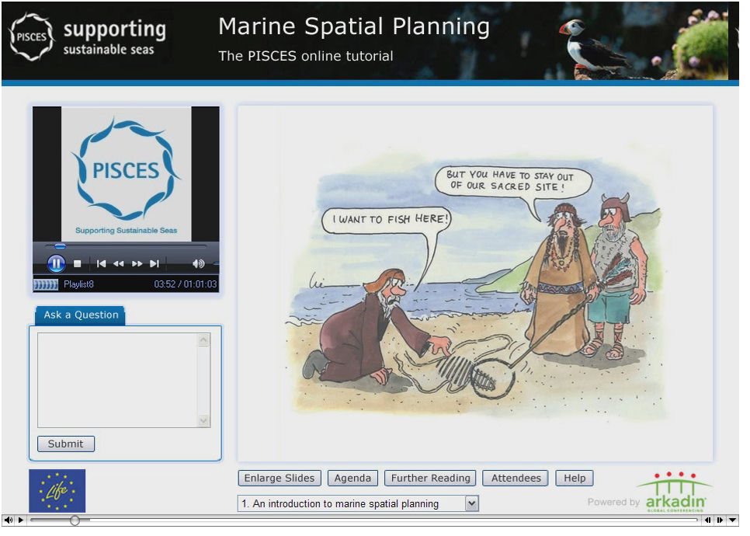
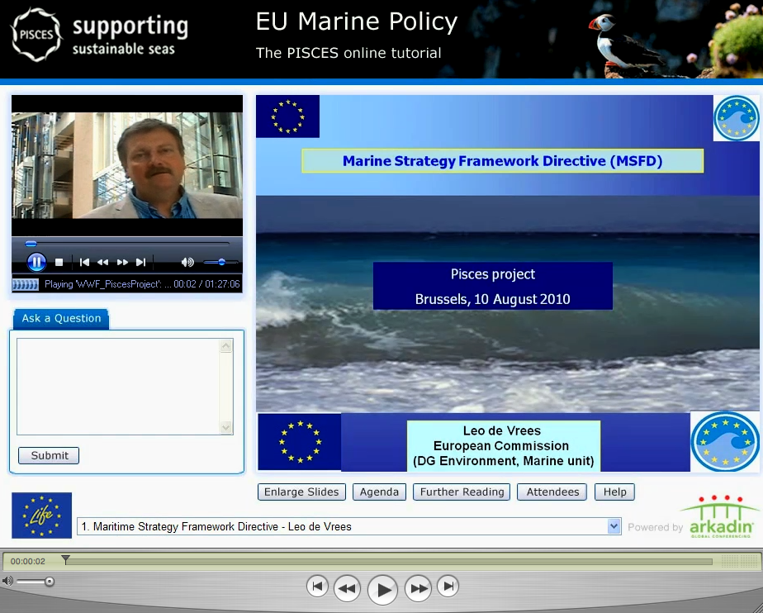
Online tutorials
Notes:
We held two online tutorials in September and October 2010 covering marine spatial planning and European marine policy. Participants watched video presentations and submitted their questions to leading marine figures in a virtual setting.

Slide 14
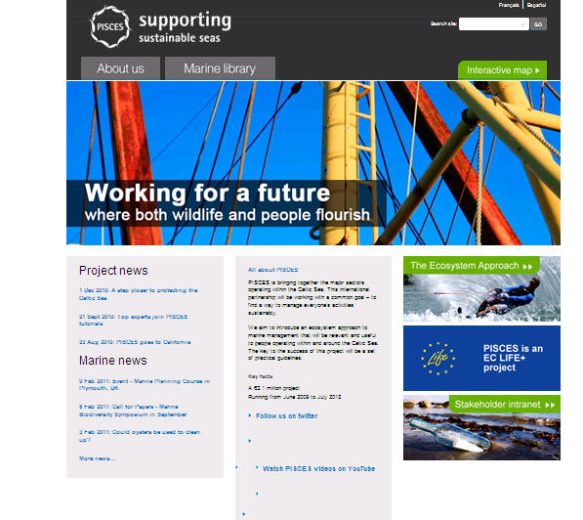
Website: www.projectpisces.eu
Notes:
PISCES website available in English, French and Spanish

Slide 15
Guidelines development
Cork workshop started process of stakeholder-led guidelines.
Agreed definition, principles and started objectives and actions.
Workshop in June 2011: St. Malo, France.

Slide 16
Principles
Objectives
Action plans (regional)
Action plans
(sectoral)

Slide 17
Next steps
To involve those not in attendance and a wider 200 stakeholders.
Requires detailed understanding and review of sectors including communication channels, requirements and networks.
Wider 3000 aware of guidelines.
Workshop in June 2011: St. Malo, France.

Slide 18
MSFD timeline and scope for influence
Spatial protection measures identified
Determine what GES means
Programme of measure for GES
Achieve or maintain GES
Entry into MS legislation
2010
2012
2013
2014
2015
2016
2020
PISCES
Target and indicators for each region
Establish& implement monitoring programme
Programme of measures operational
Notes:
Stages set out. Member States need to decide targets & indicators therefore want an idea of what programme of measure is before they tie themselves to these targets. Therefore will be considering all in 2012. Coincides with results of PISCES which should inform the types of things that could appear in a Programme of Measures

Slide 19
Stakeholder engagement
Truly stakeholder-led/ bottom-up approach.
Neutral facilitation.
Consultation and engagement – difference.
Time-consuming and challenging.
Notes:
The MSFD has utilised traditional consultation processes, focusing predominantly on traditional methods such as online questionnaires, invitations to comment on documents, and via dialogue at conferences. It is clear that traditional methods and processes applied have been based on preconceived ideas and material, retaining a ‘top-down’ approach.
Stakeholders have been selected that are well linked to networks within their sectors and have indicated a willingness to communicate PISCES to wider stakeholders.

Slide 20
Challenges
Stakeholder fatigue (involvement in many projects).
Specific sectoral needs for engagement vary between sectors.
Challenges of working in a diverse group.
Lack of economic incentive to be involved.
Cost of being involved (loss of earnings/time).
Policy drivers vary across countries.
Lack of a perception of a crisis or specific problem.
Previous experience with stakeholder engagement projects is not always favourable.

Slide 21
Learning
Don’t underestimate the challenge of stakeholder engagement (e.g. in marine spatial planning).
Requires huge resource for mapping, understanding and engaging sectors.
Consensus V’s dynamic approach.

Slide 22
Benefits
Roger Cook, WFSA:
"It’s great to be here with stakeholders who have a lot of information and knowledge of what’s going on, and we’re all coming here to share the objective that there are real advantages to us all if we can get this ecosystem based management thing right.”

Slide 23
Benefits
Francois Huber, Blue H Group:
“It [the workshop] was a unique opportunity to interact with other stakeholders in a free environment where you can really express your views, and there is nothing at stake but just to try and work better together."
Notes:
Stakeholders with very different interests and expertise from different sectors and disciplines are brought together to share knowledge and develop common understanding. In this way, mutually acceptable and sustainable ways forward to manage coastal and marine ecosystems can be achieved

Slide 24
Opportunity through PISCES
Established stakeholder group that is cross-sectoral and multi-national.
Regional co-ordination and implementation of MSFD and marine planning.
Wider network.
Notes:
PISCES will provide an invaluable test-drive as to how other marine regions may be managed in the future, as emerging policies are put into practice.
We will maintain close interactions with industry, government, agencies and related projects across the UK, Ireland, France and Spain as well as reaching wider into the European Union and beyond.

Slide 25
After PISCES
Model for ecosystem approach guideline development and stakeholder engagement that can be replicated in other areas.
Involved in proposals in North Sea and Celtic Seas to replicate and build on PISCES.
Notes:
Ultimate output:
The project is accepted as a model for implementation of the EA.

Slide 26

If you would like to be involved, please contact: s.twomey@ucc.ie http://www.projectpisces.eu/
This is an EC LIFE+ project with the contribution of the LIFE financial instrument of the European Community.
Project number: LIFE07 ENV/UK/0009

