Slide 1
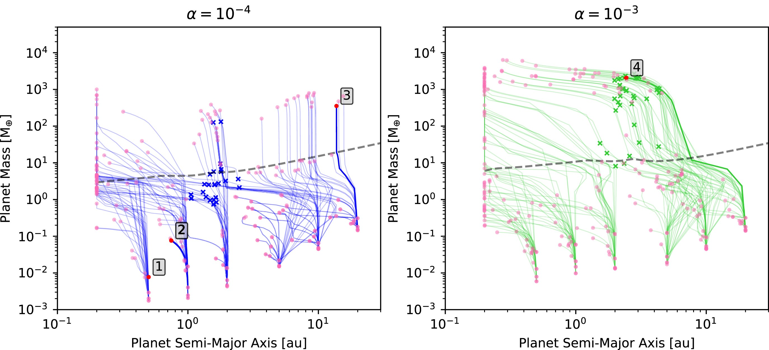

Figure A1. Same as Fig. 2 for with planet trajectories drawn only up to 1 Myr, the time at which the pebble fluxes ...
Notes:
Figure A1. Same as Fig. 2 for with planet trajectories drawn only up to 1 Myr, the time at which the pebble fluxes reported in Fig. 4 are evaluated.
Unless provided in the caption above, the following copyright applies to the content of this slide: © The Author(s) 2026. Published by Oxford University Press on behalf of Royal Astronomical Society.This is an Open Access article distributed under the terms of the Creative Commons Attribution License (https://creativecommons.org/licenses/by/4.0/), which permits unrestricted reuse, distribution, and reproduction in any medium, provided the original work is properly cited.

