Slide 1
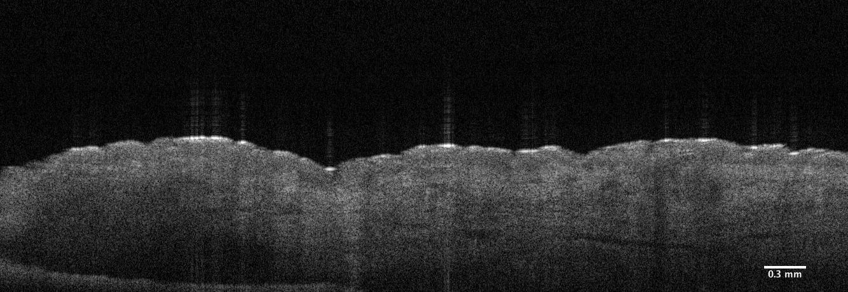
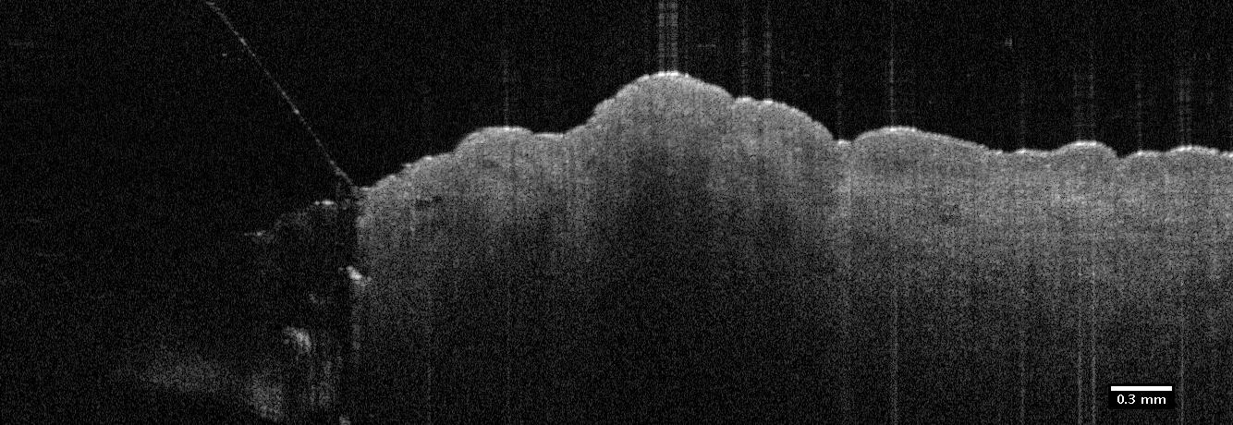
Movies for supplemental file
A
B
Notes:
Suppl. Figure 1
Representative OCT movies showing bleb formation and tissue disruption during (A) a conventional 50µl intradermal injection using a 26-gauge hypodermic needle or (B) a 50µl microneedle injection with MicronJet 600µm. (C) An OCT movie of the bleb immediately after a 50μl microneedle injection of methylene blue using MicronJet 600µm needles. Following treatment of the skin tissue using the MicronJet 600µm, multiple mechanical disruptions can be viewed in the upper region of the skin. Donor skin was obtained from 70 and 69 year old females.

Slide 2
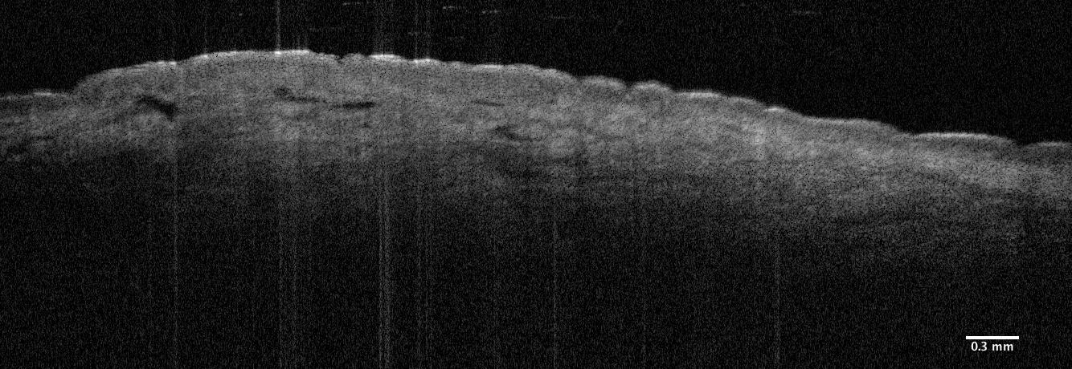
C
Notes:
Suppl. Figure 1
Representative OCT movies showing bleb formation and tissue disruption during (A) a conventional 50µl intradermal injection using a 26-gauge hypodermic needle or (B) a 50µl microneedle injection with MicronJet 600µm. (C) An OCT movie of the bleb immediately after a 50μl microneedle injection of methylene blue using MicronJet 600µm needles. Following treatment of the skin tissue using the MicronJet 600µm, multiple mechanical disruptions can be viewed in the upper region of the skin. Donor skin was obtained from 70 and 69 year old females.

