Slide 1
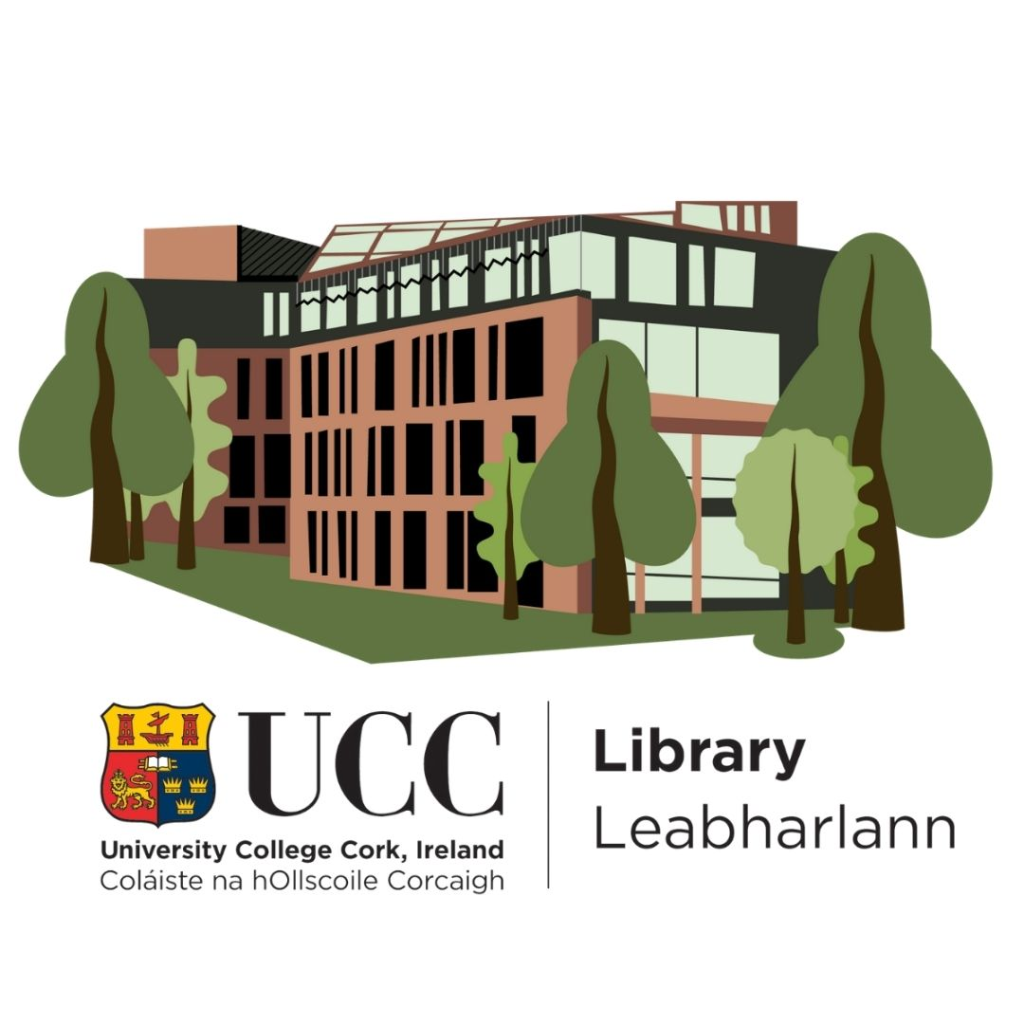
Being creative in making your (special) collections available through innovative tools and technology
Stephanie Chen
Digital Learning Specialist
UCC Library

Slide 2
Today’s Presentation
Introduction and context
Overview of 4 projects
Summary

Slide 3
Introduction & context

Slide 4
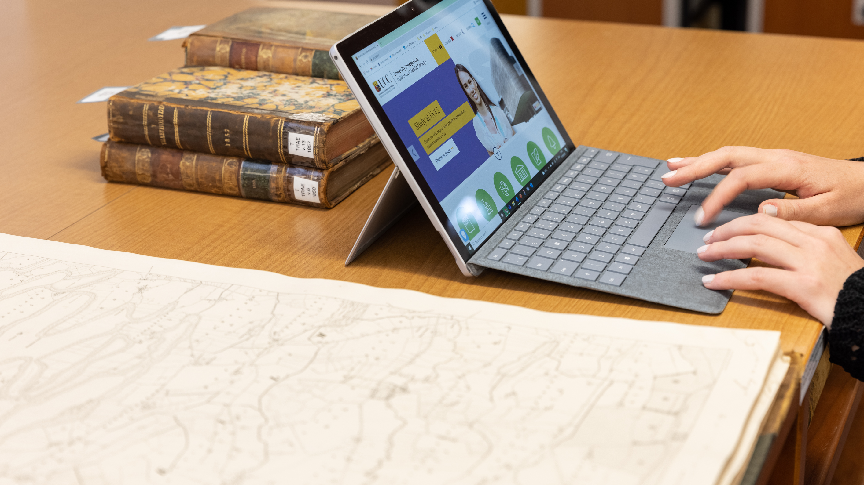
Special Collections
& Archives

Slide 5
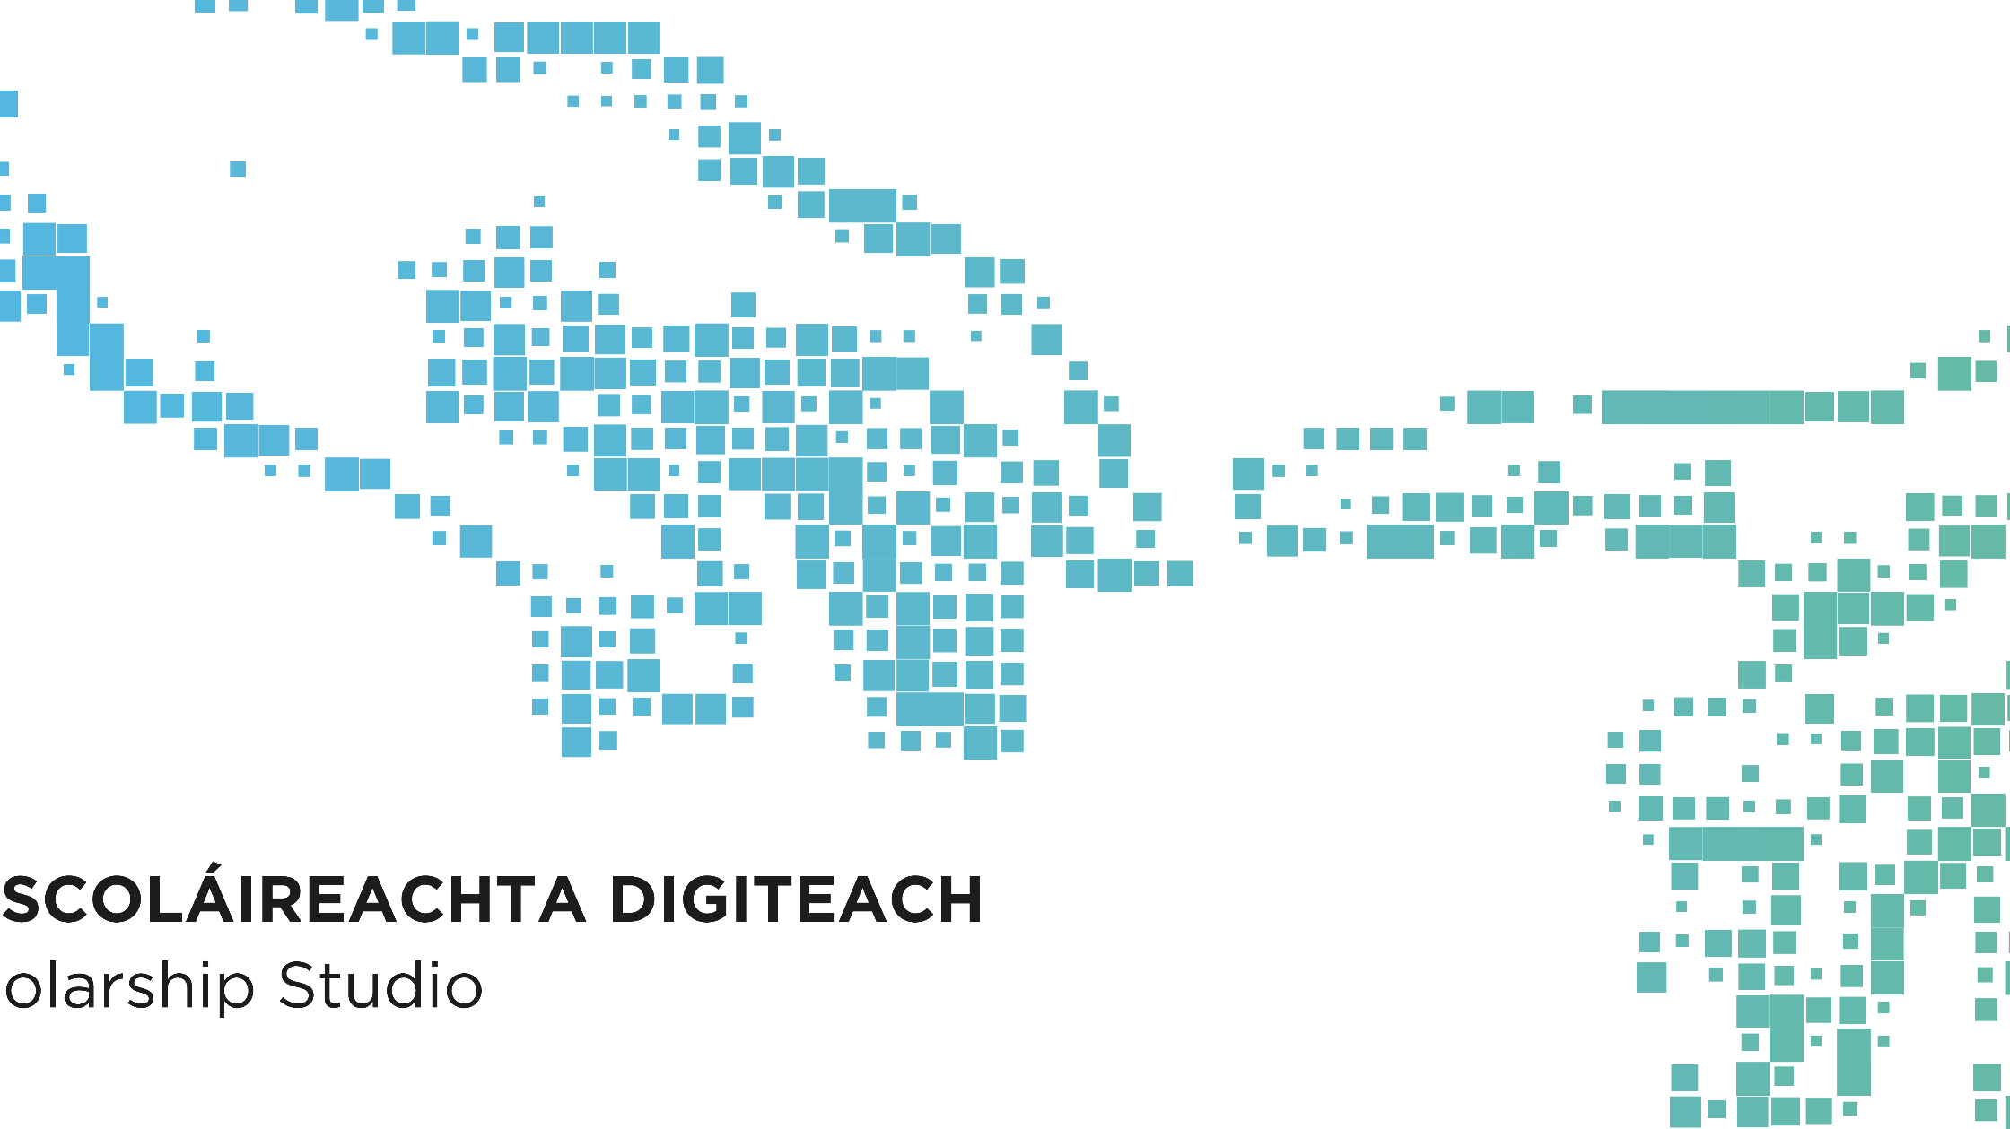
Digital Learning Services

Slide 6
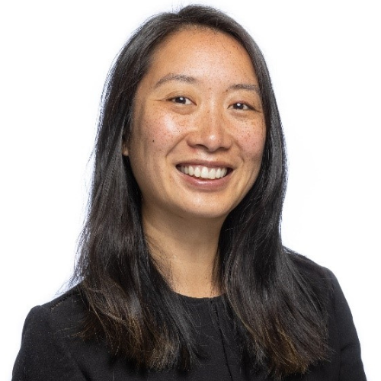

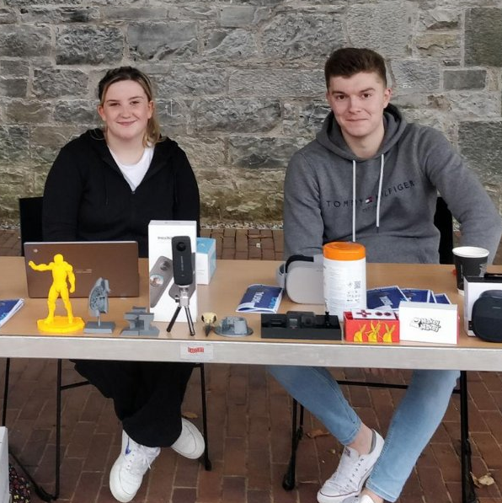
People involved

Slide 7
4 projects
(2021/2022 Academic Year)

Slide 8
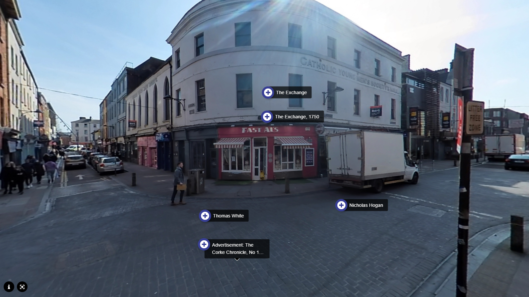
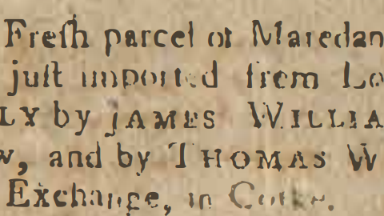
(1) a virtual tour of Cork city based on historical newspaper advertisements

Slide 9
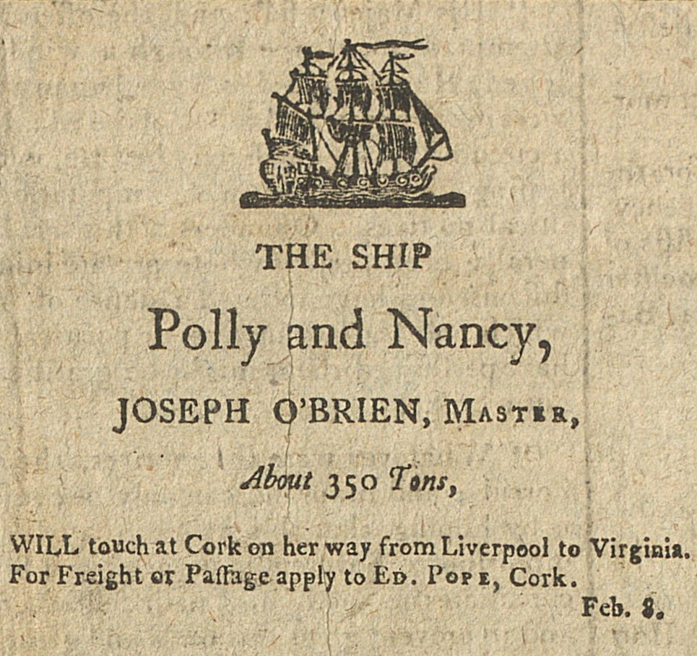
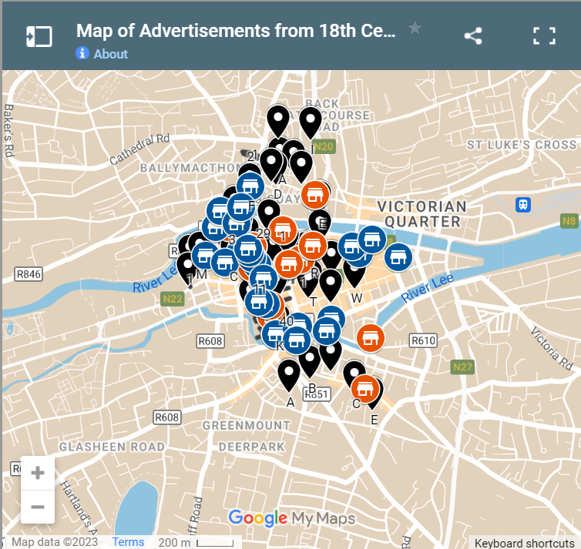
Advertisement from The Cork Gazette, 14 April 1792.
Google Map of Advertisements from 18th Century Cork Newspapers

Slide 10
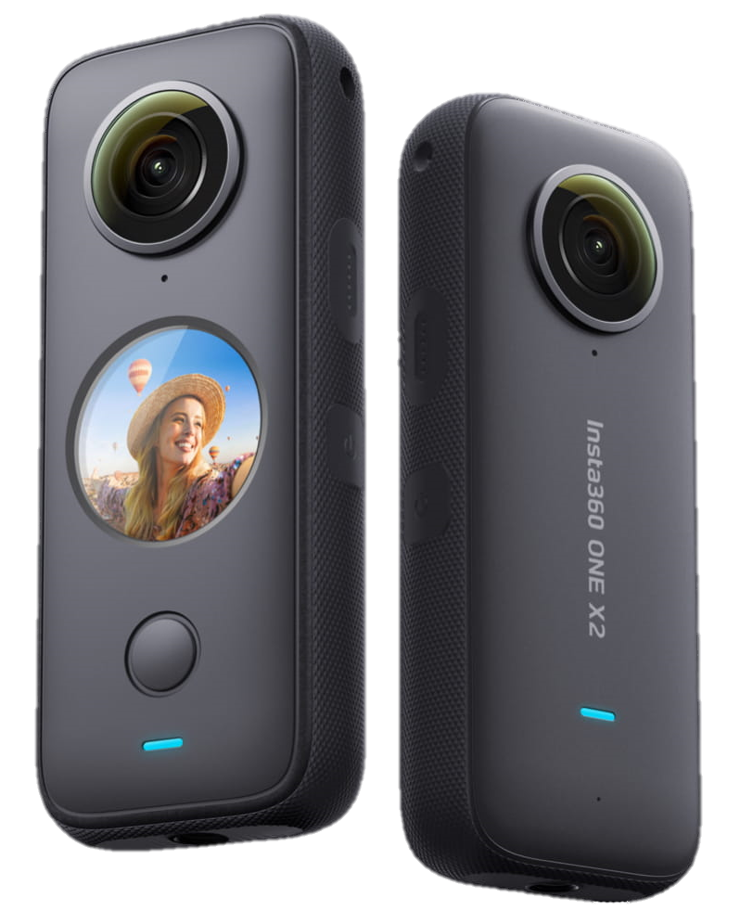
Workflow
Insta360 ONE X2
Tour created using H5P (Virtual Tour content type)

Slide 11
360° Tour

Slide 12
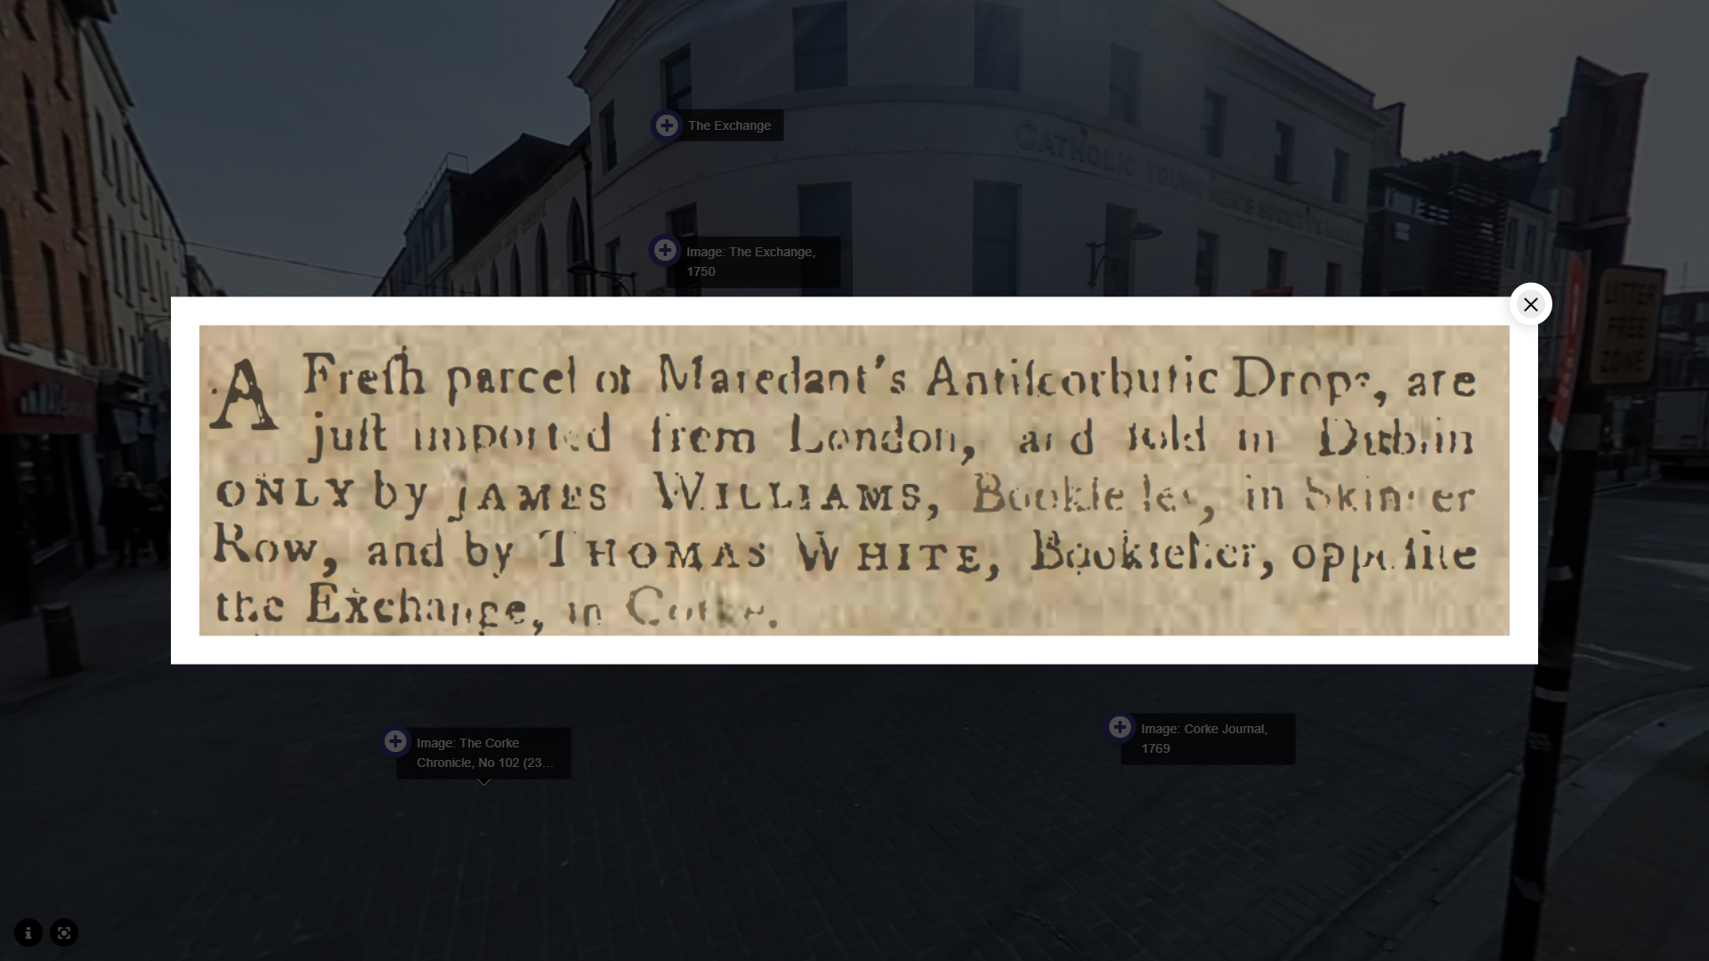

Slide 13
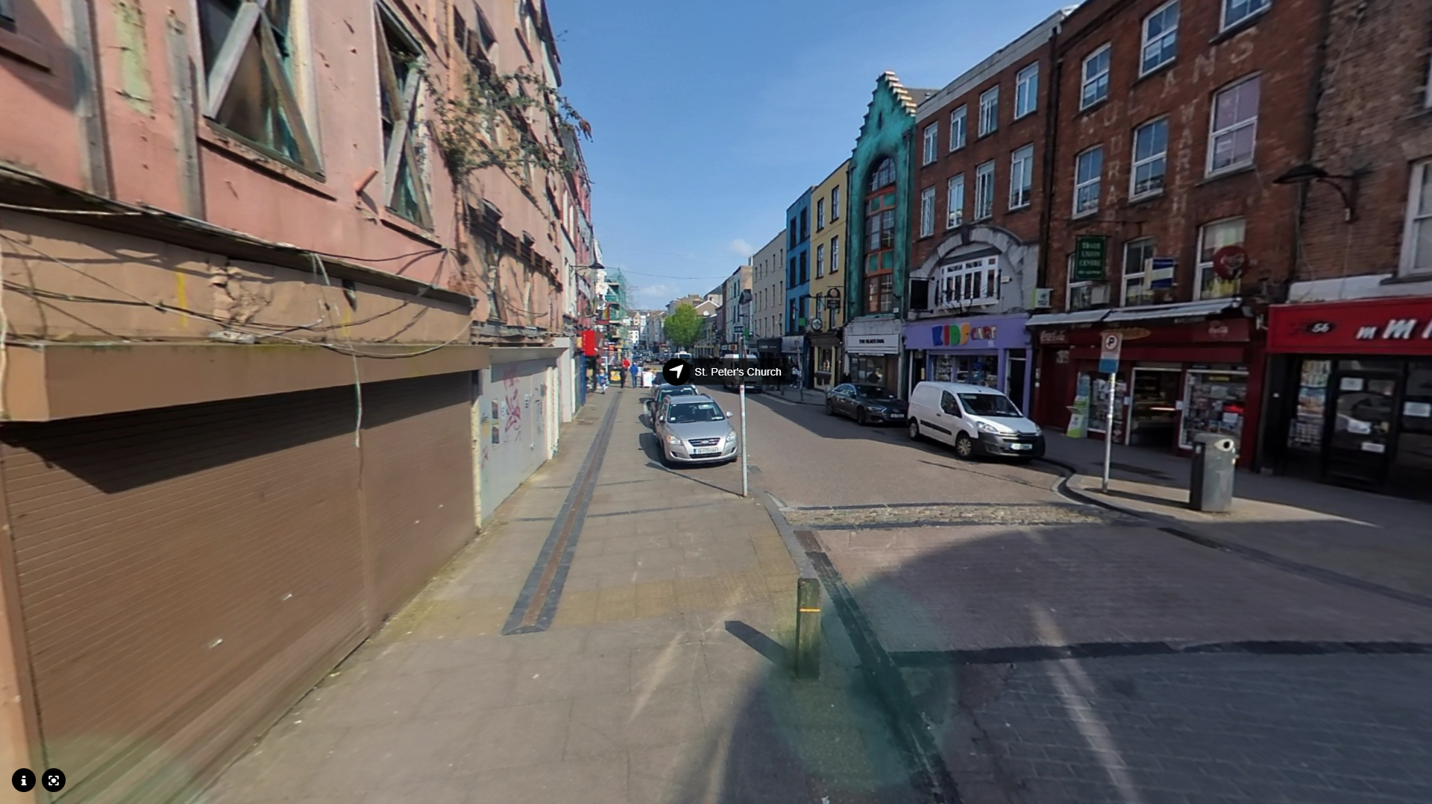

Slide 14
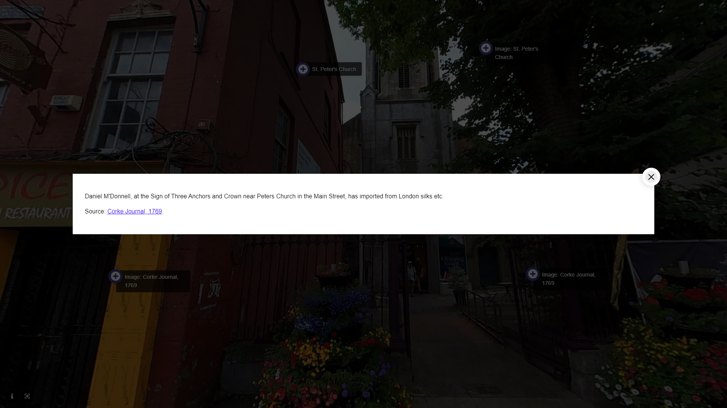

Slide 15
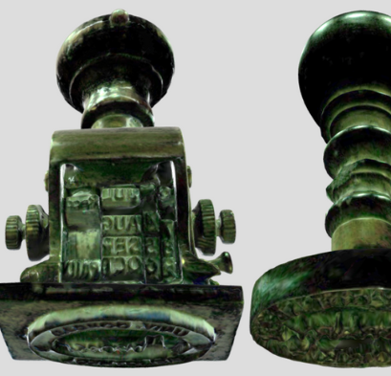
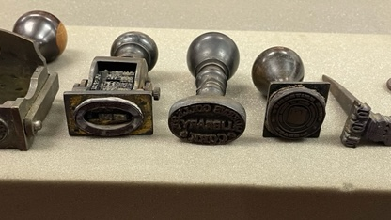
(2) various 3D models of objects

Slide 16
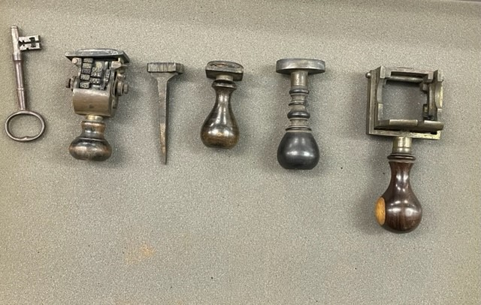

Slide 17
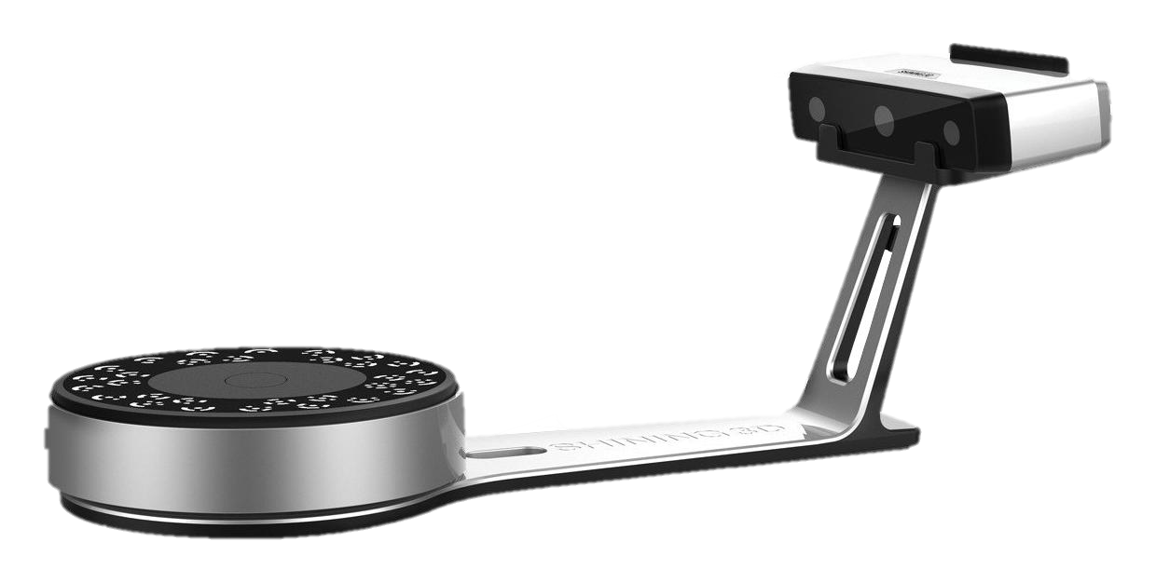
Workflow
EinScan-SP desktop scanner
3D models hosted on SketchFab

Slide 18
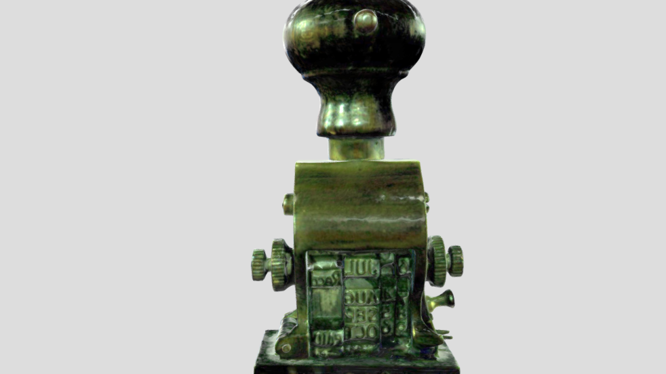
Date Stamp

Slide 19
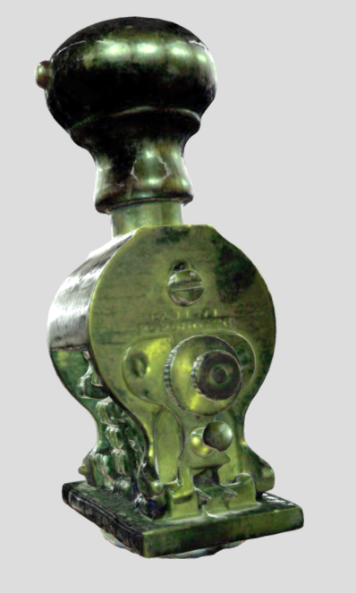
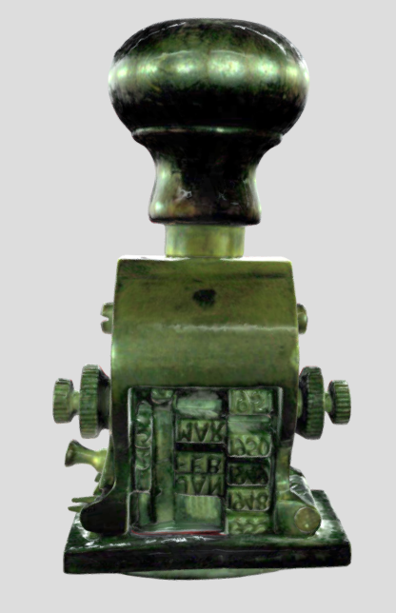
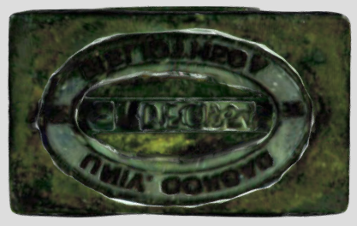
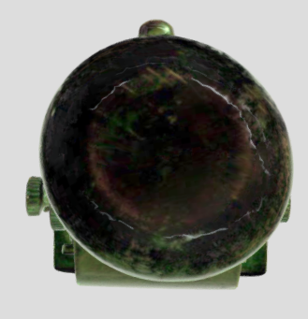

Slide 20
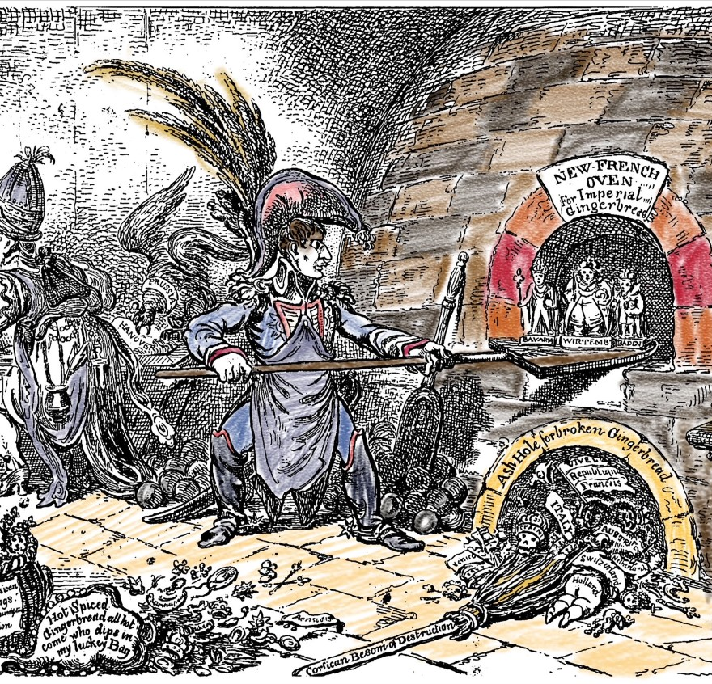
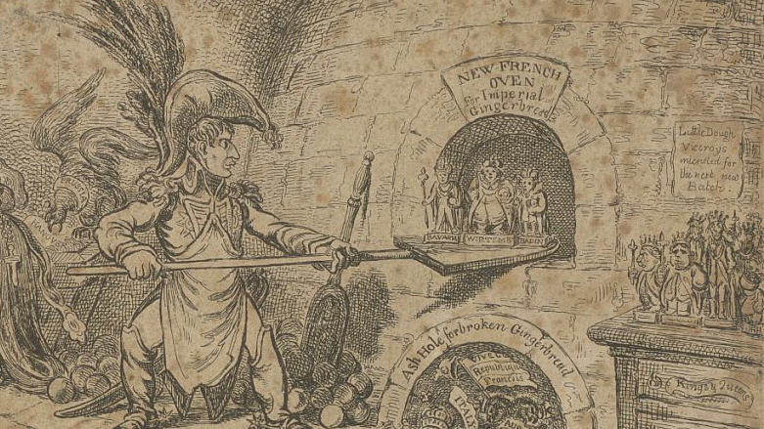
(3) a colouring book published online

Slide 21
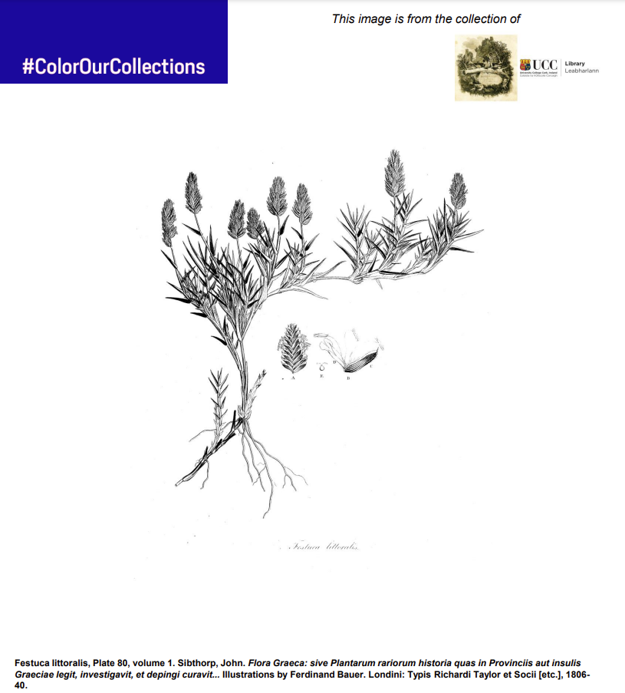
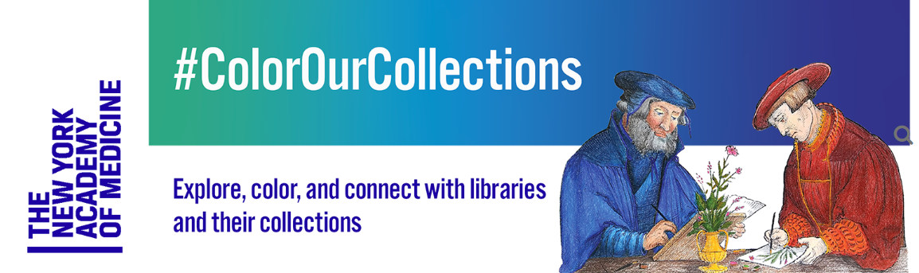

Slide 22
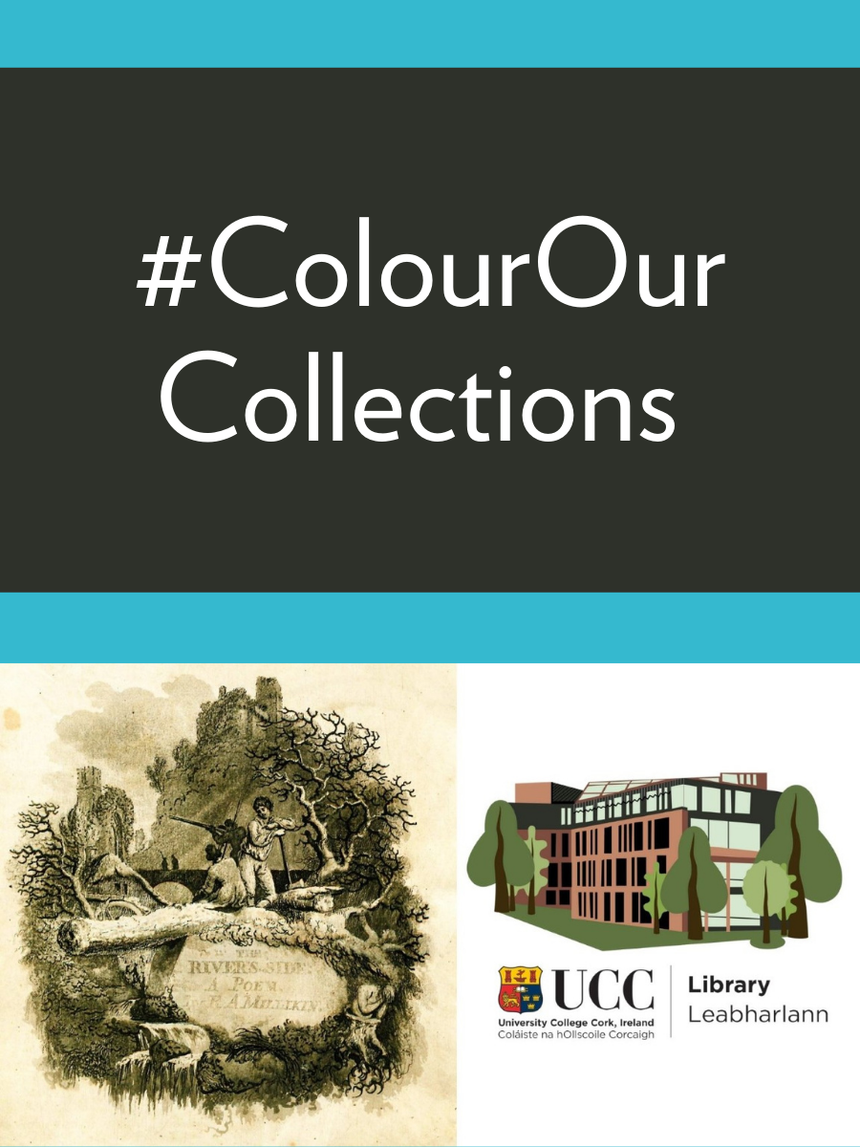
Workflow
PowerPoint
Hosted on Pressbooks

Slide 23
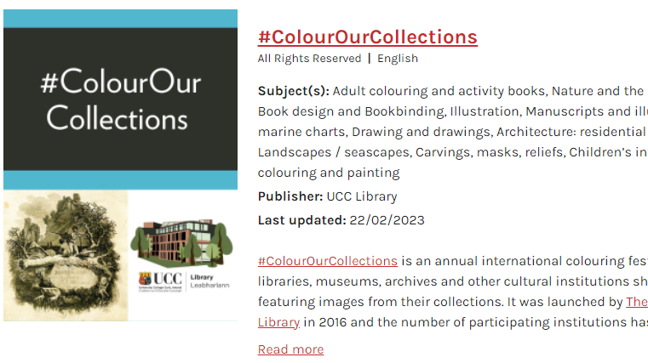
#ColourOurCollections

Slide 24
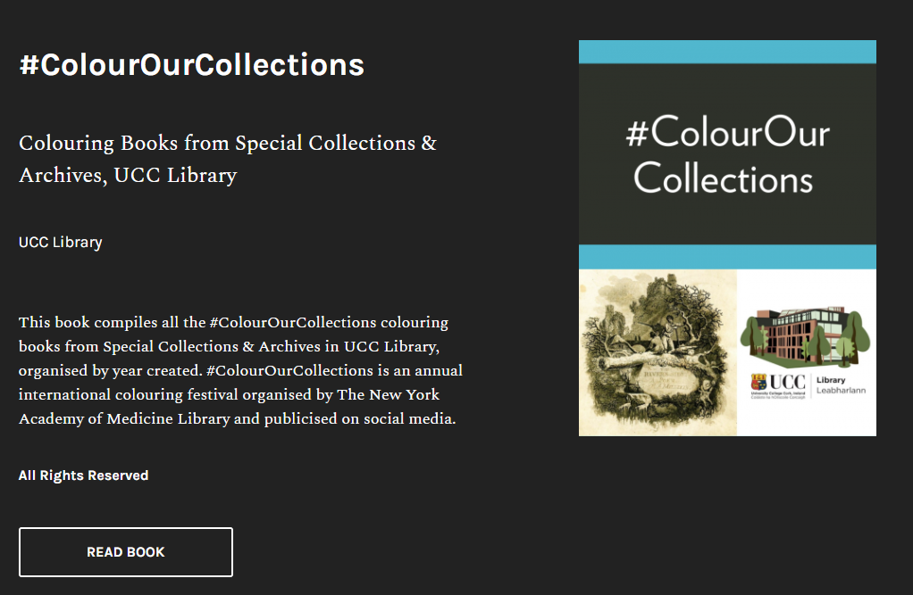

Slide 25
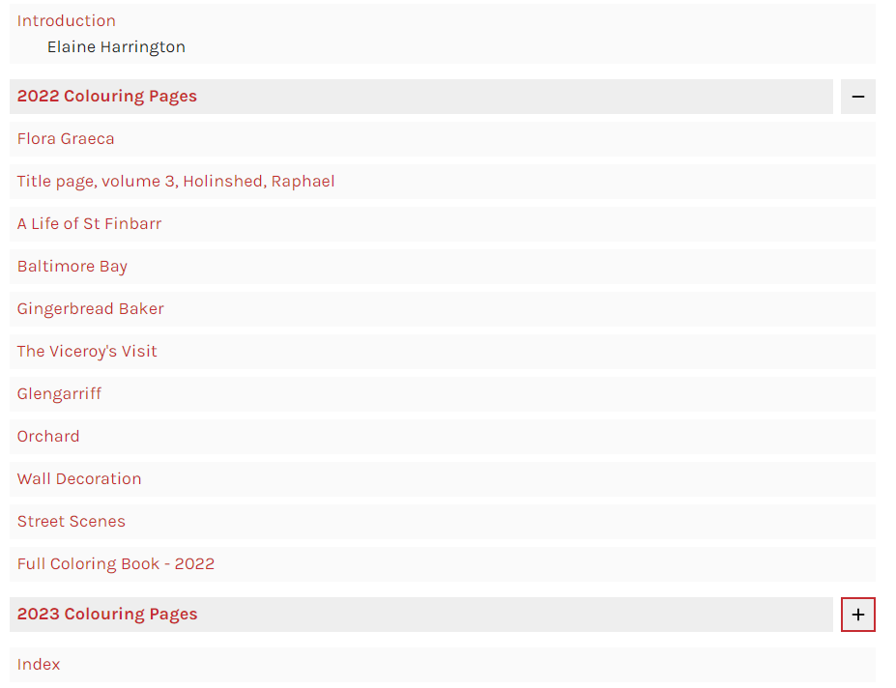

Slide 26
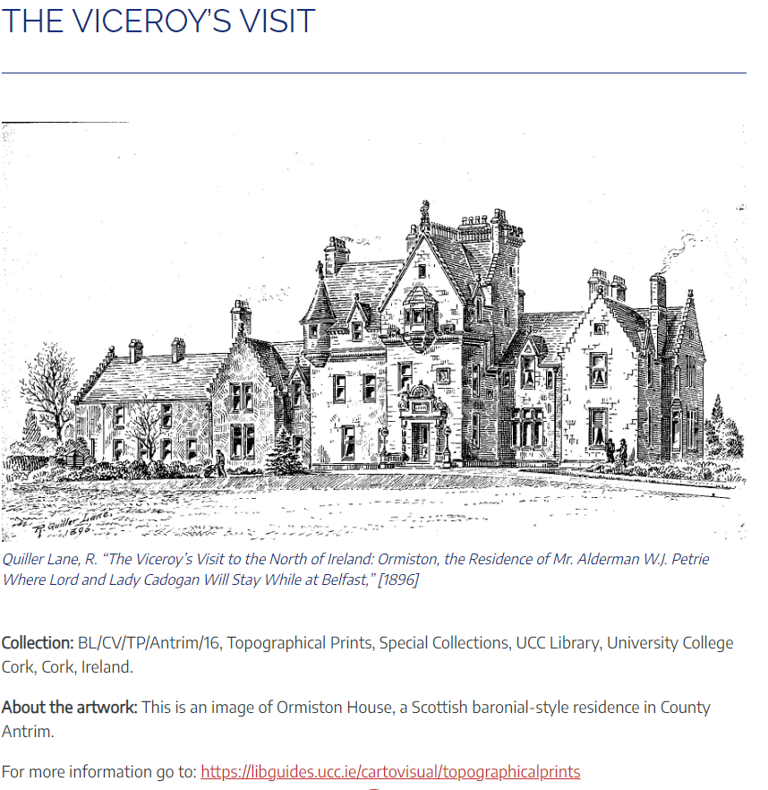

Slide 27
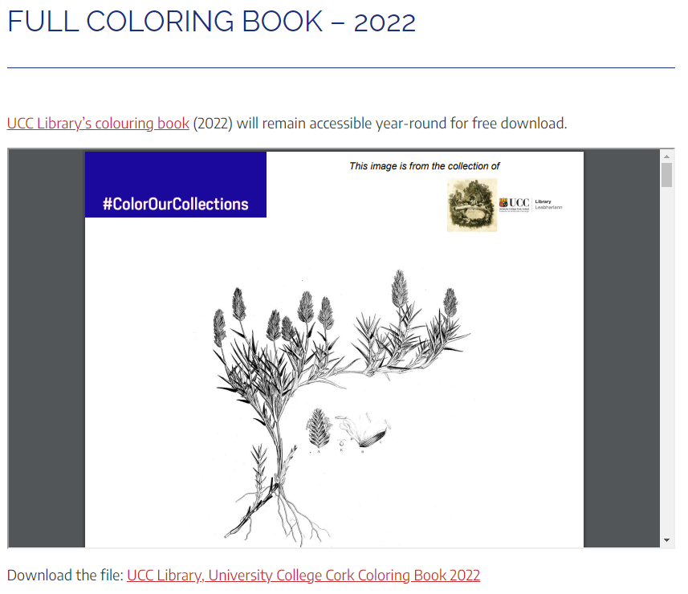

Slide 28
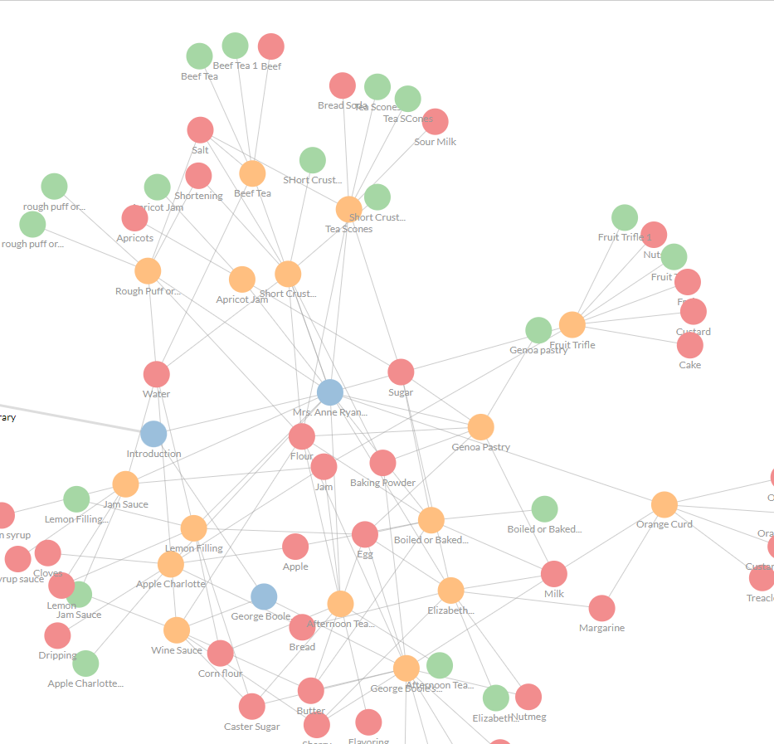
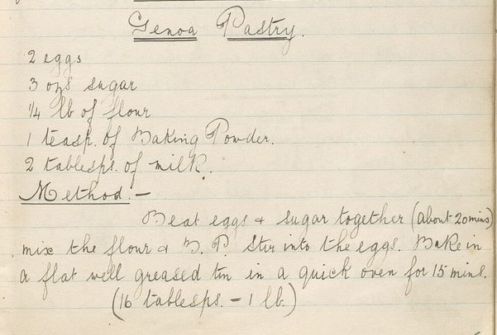
(4) a digital exhibit on historical recipes

Slide 29
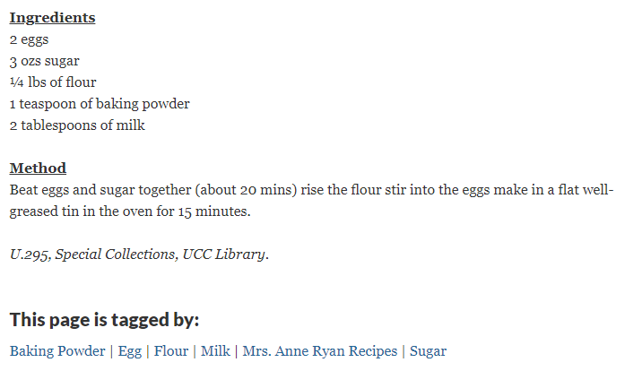

Slide 30
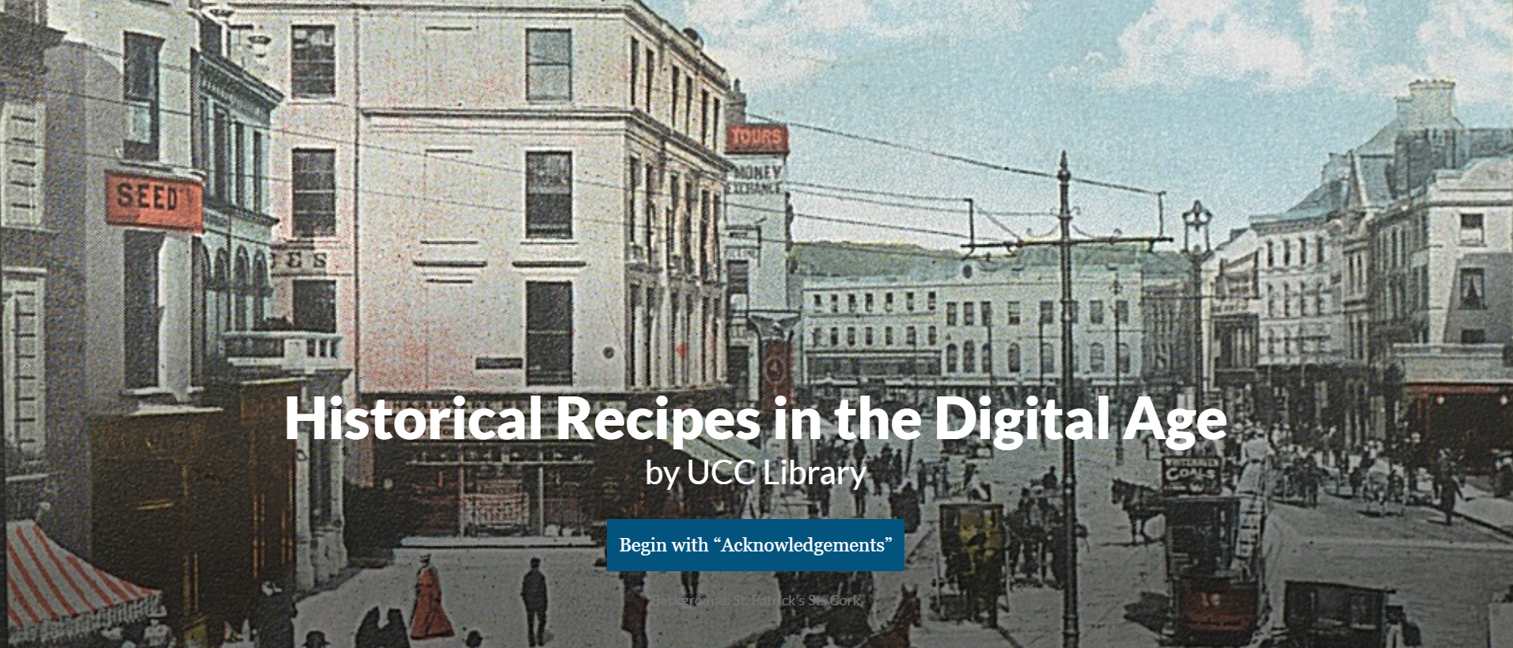
Workflow
Hosted on Scalar

Slide 31
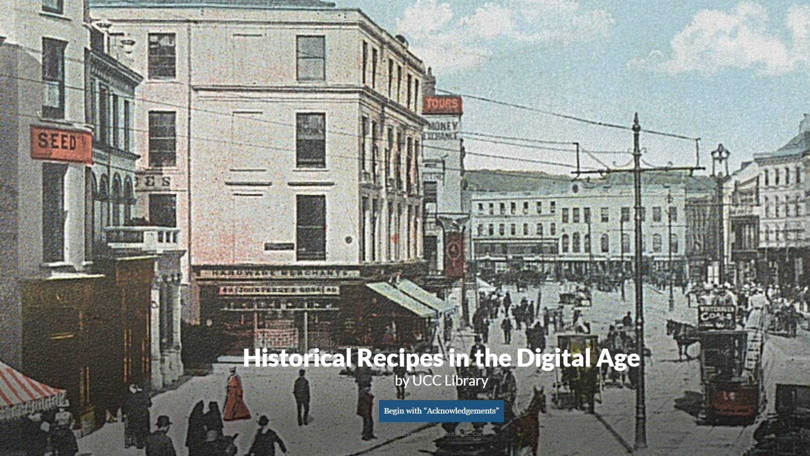
Historical Recipes in the Digital Age

Slide 32
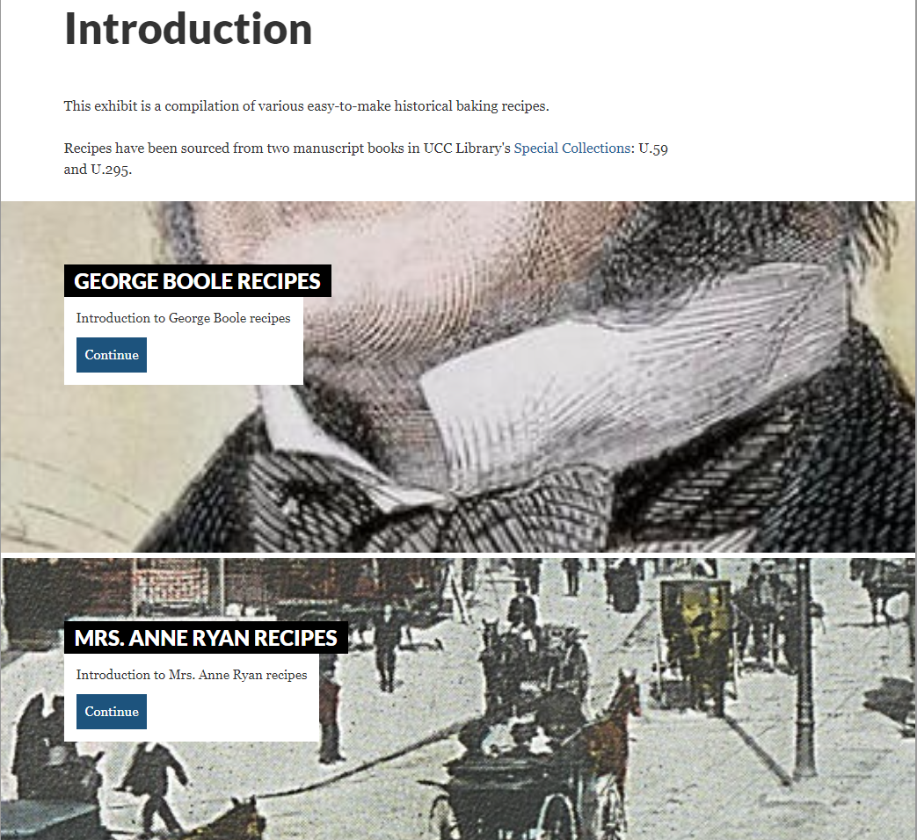

Slide 33
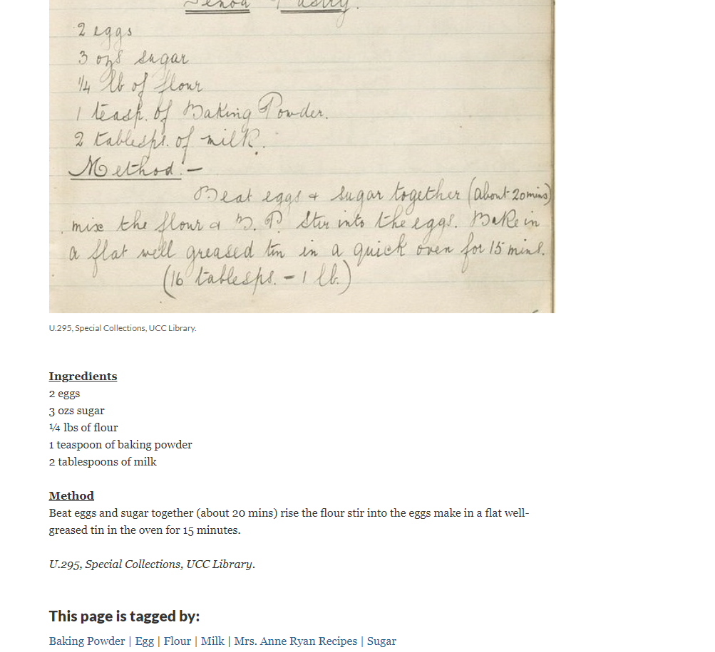

Slide 34
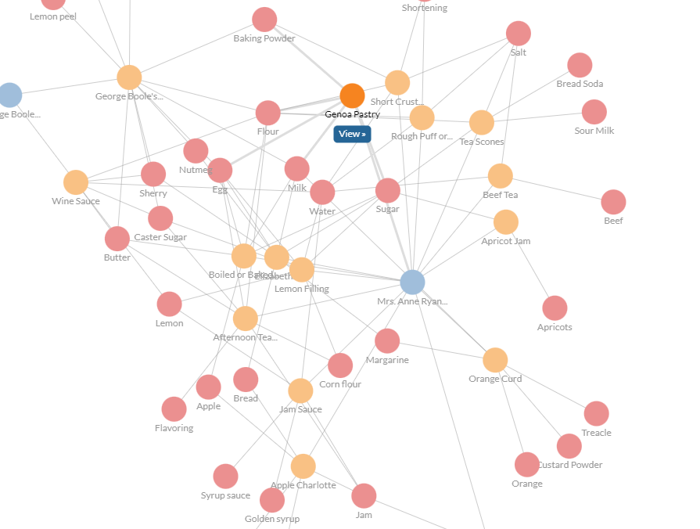

Slide 35
Summary

Slide 36
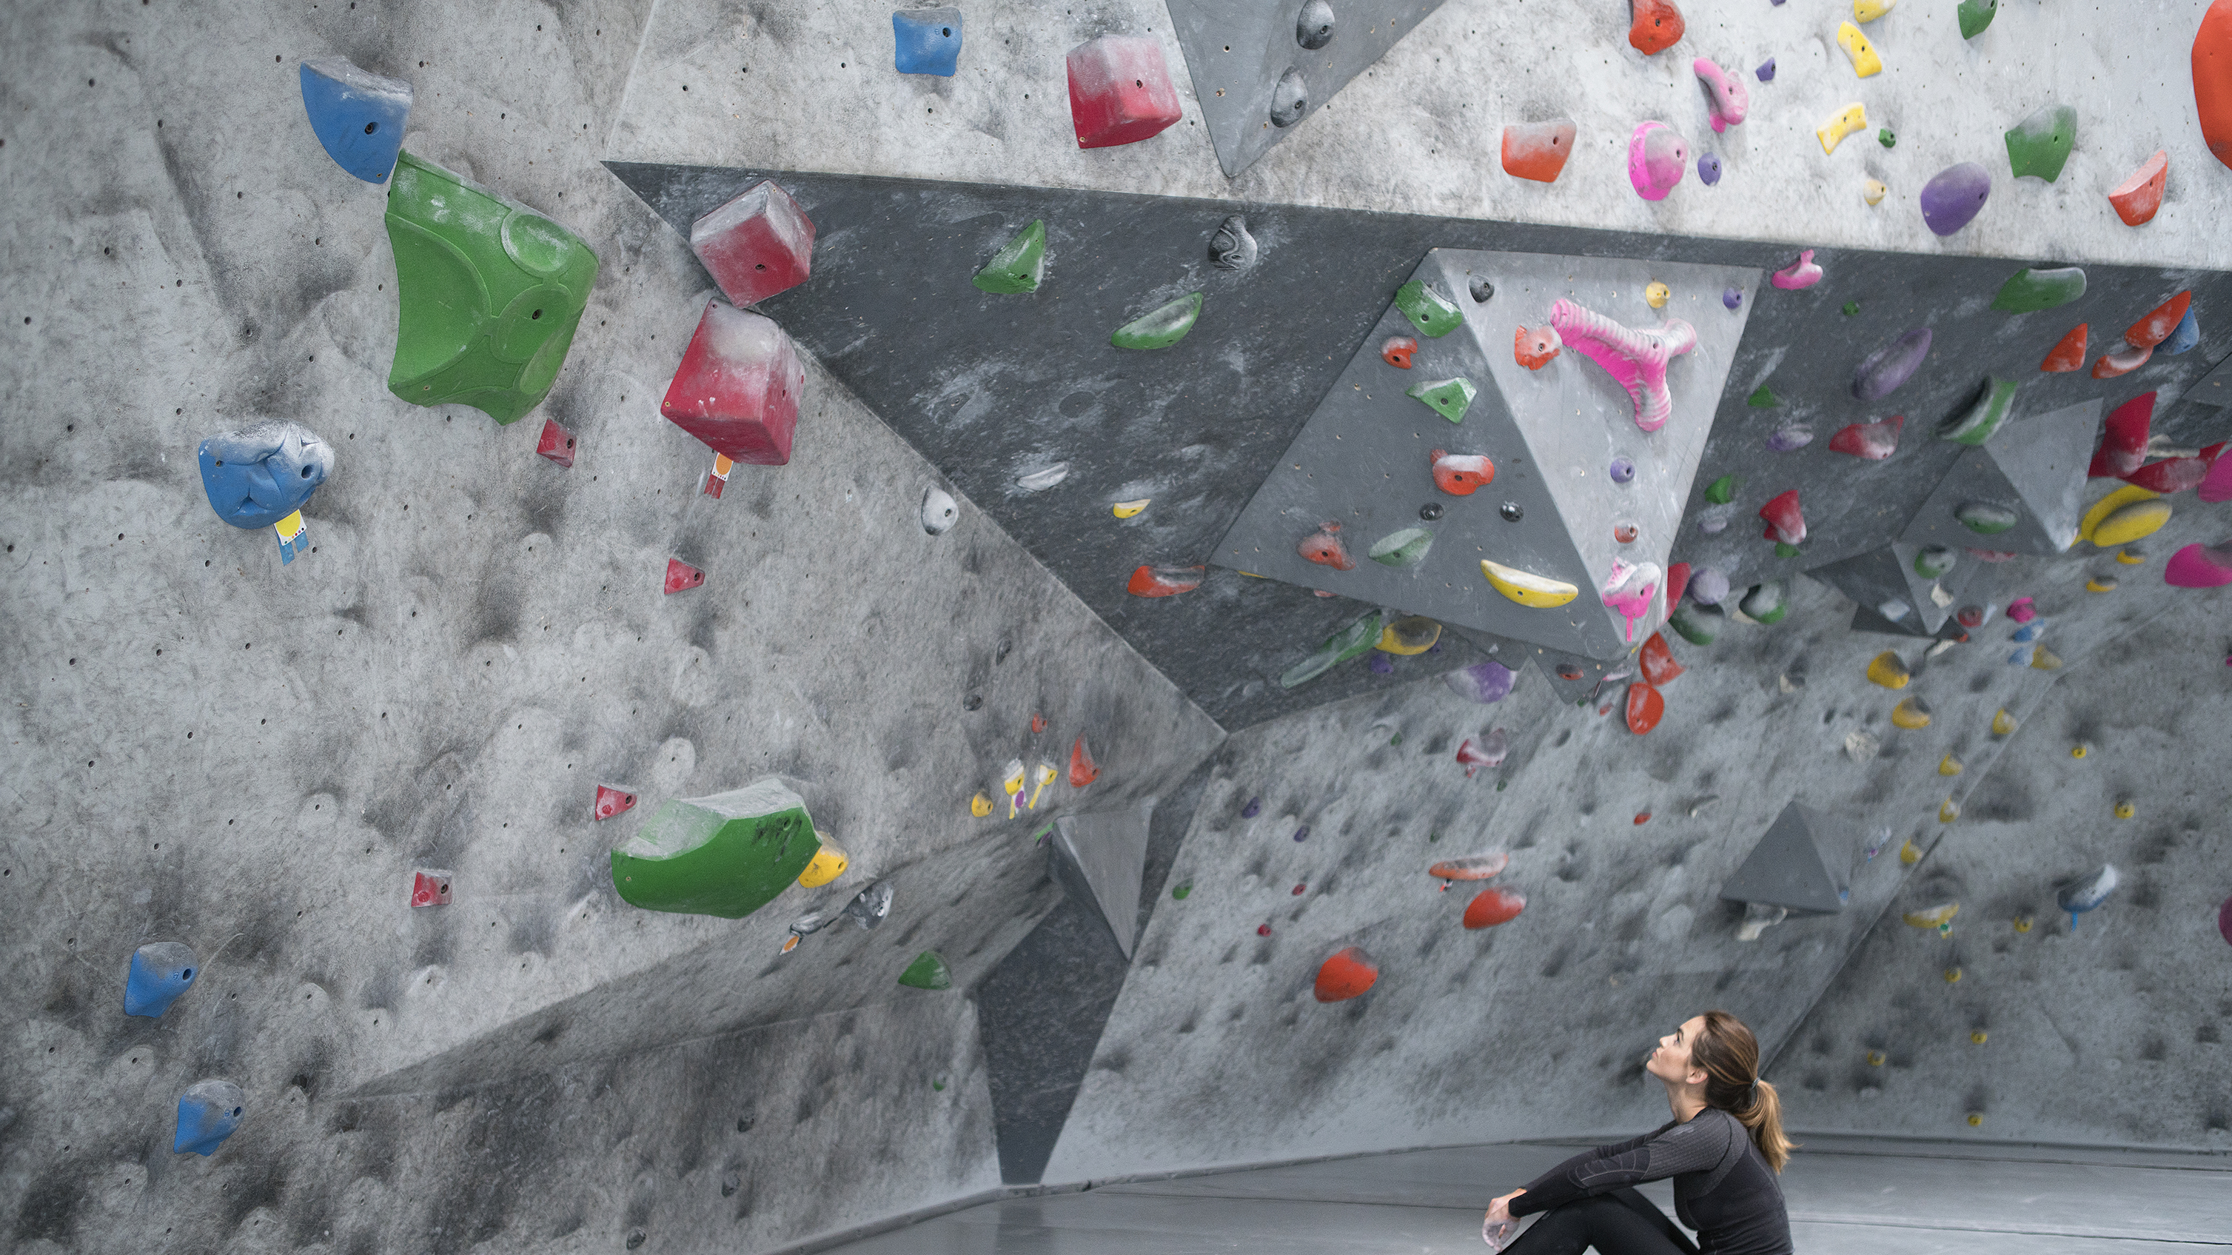
Challenges

Slide 37

Benefits

Slide 38

Recommendations

