Slide 1
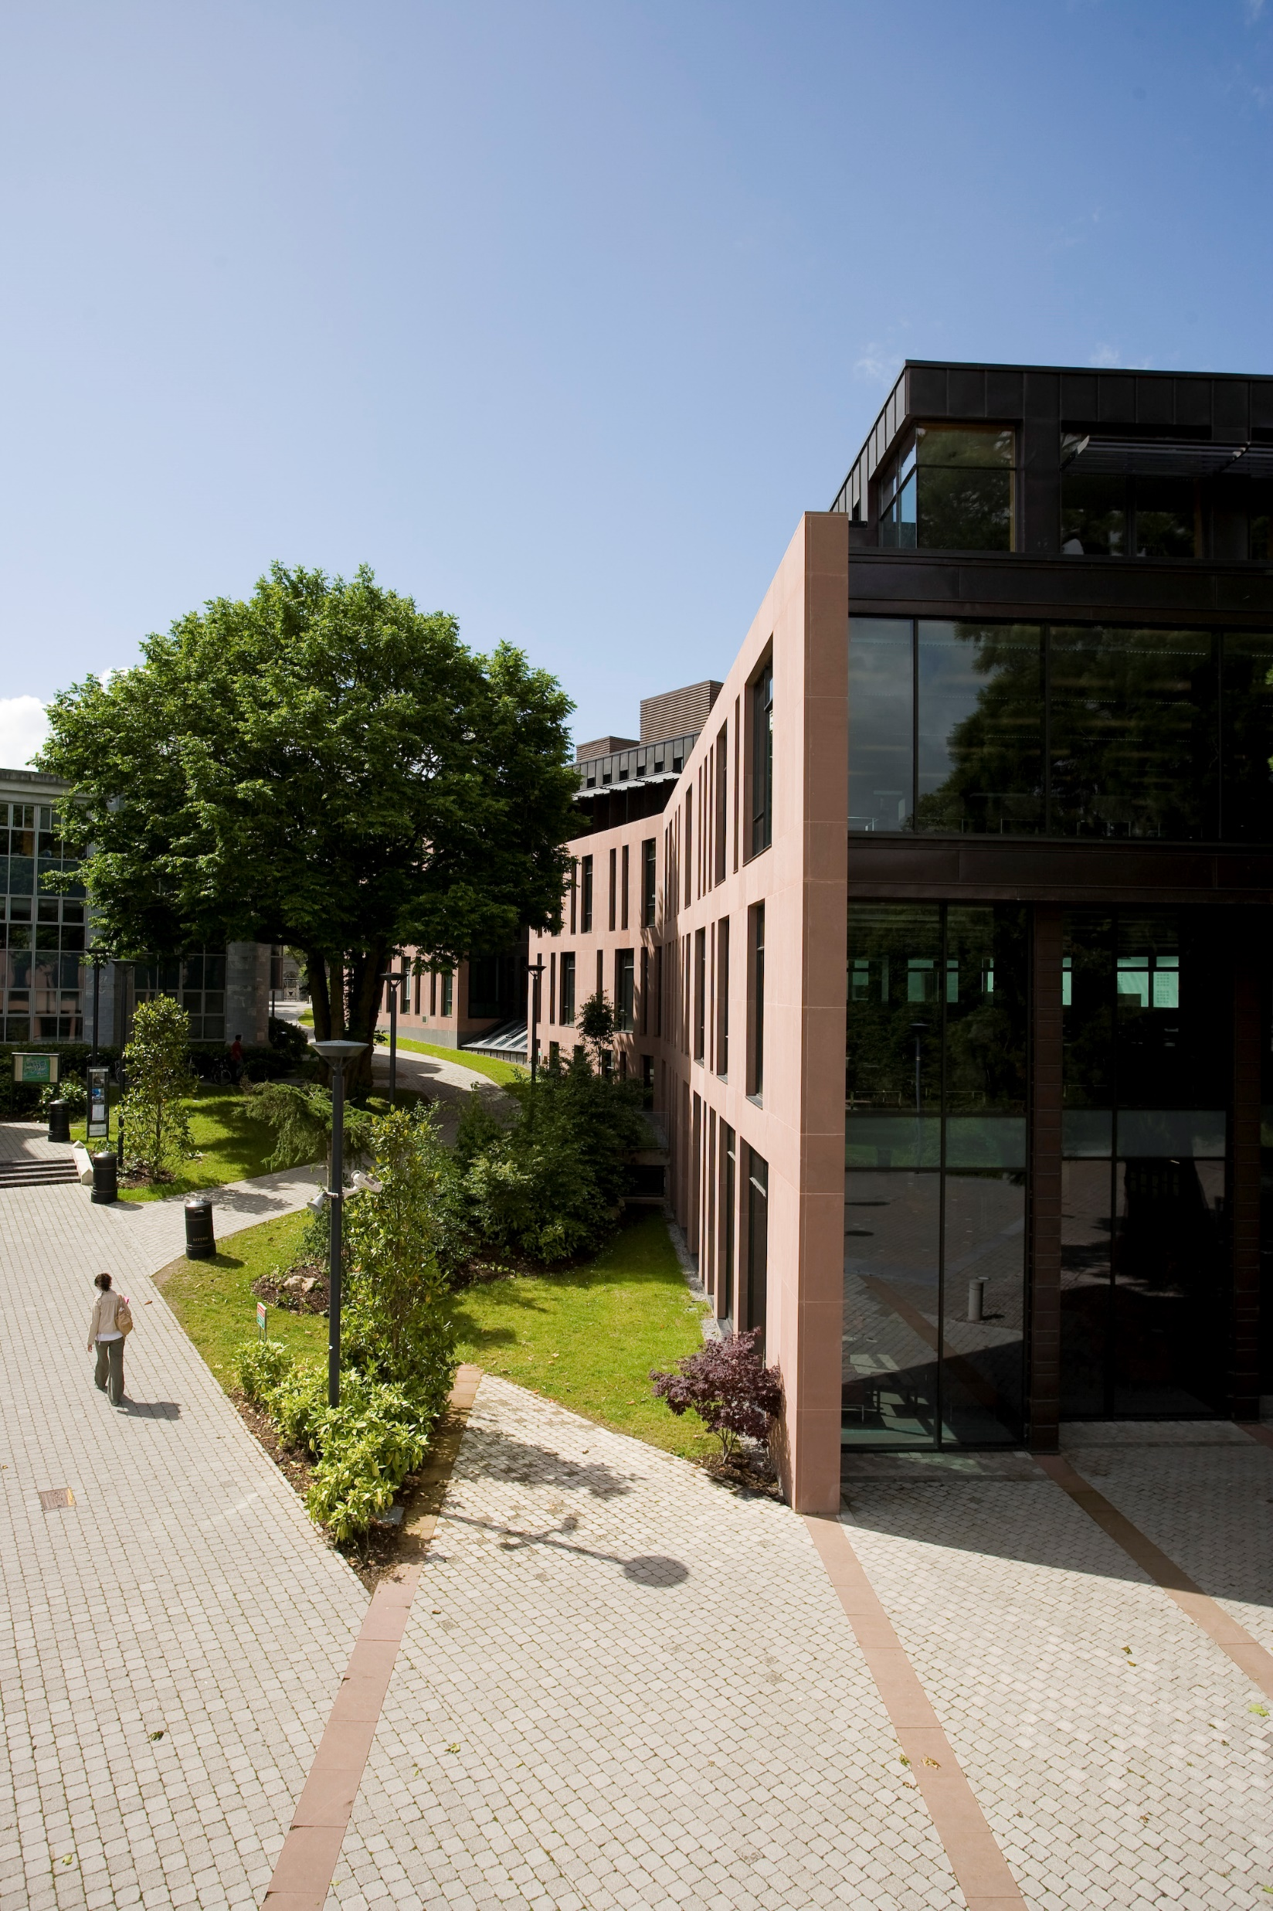

Education for sustainable development
a selection of UCC Library contributions to the UN Sustainability Development Goals
Stephanie Chen, Digital Learning Specialist
@iamstephanie_c

Slide 2
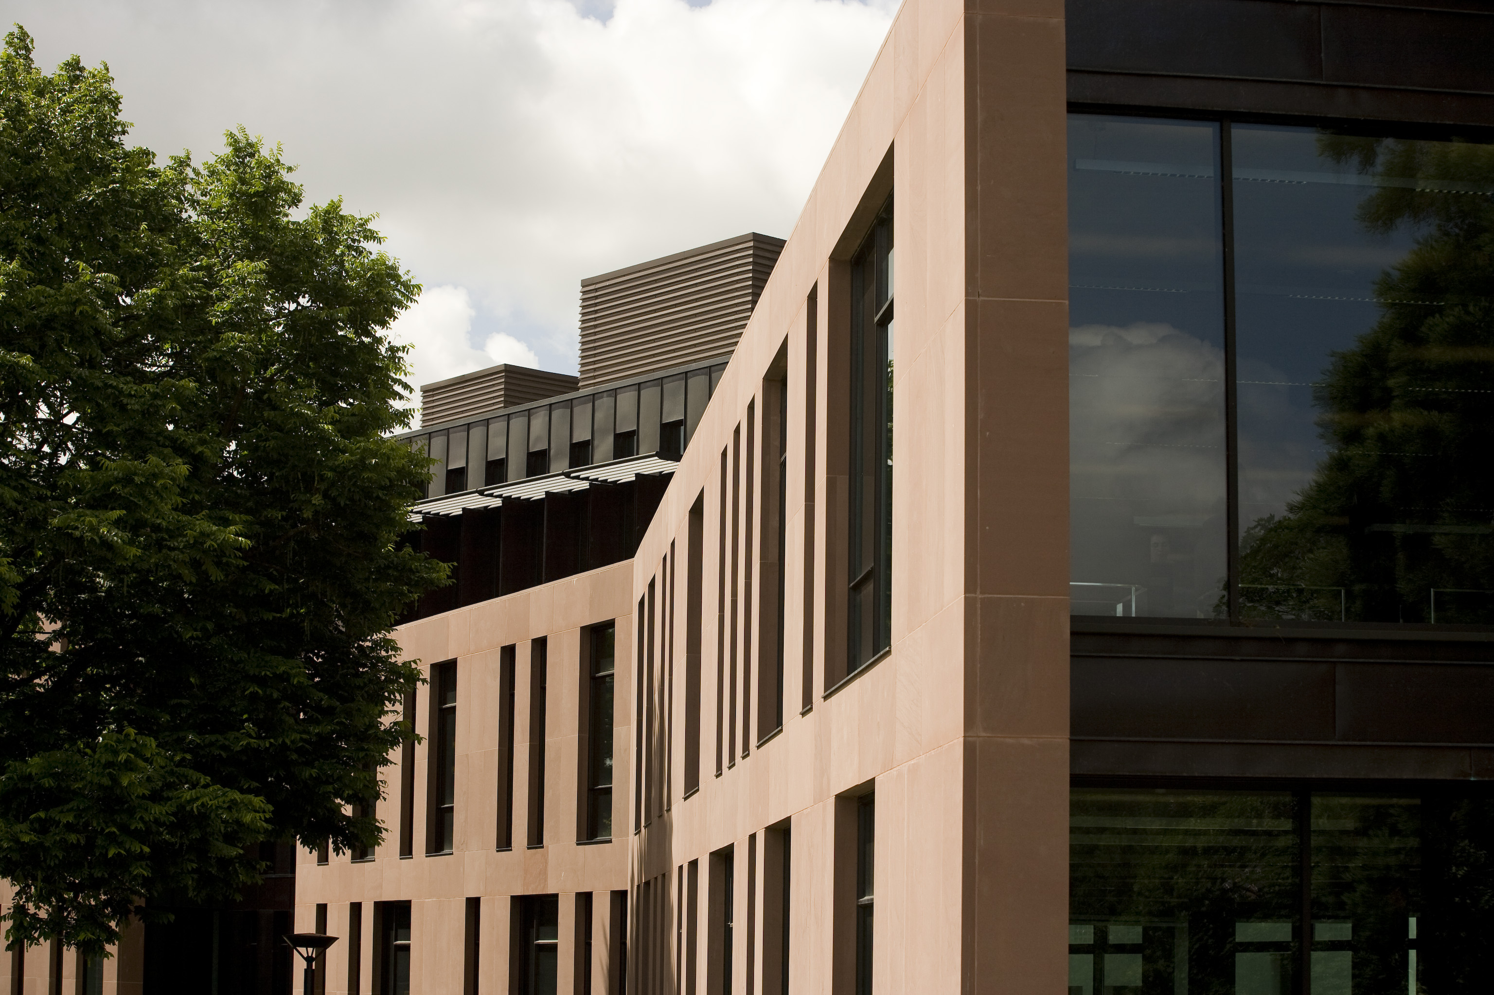
Introduction and Context

Slide 3

UCC Library
UCC Library's Digital Scholarship Studio
Notes:
Presentation will be in the context of digital experiences and digital learning services from UCC Library.
Spaces and services
3D printing and scanning
Equipment loans
Virtual reality
Library studio
Digital Scholarship Studio
OER

Slide 4
Education for Sustainable Development (ESD)
“Education for Sustainable Development allows every human being to acquire the knowledge, skills, attitudes and values necessary to shape a sustainable future.”
University of Plymouth - ESD

Slide 5





UN Sustainable Development Goals (SDGs)
UN SDGs
Notes:
Which ones will be covered?
SDG 1: no poverty
SDG 4: quality education
SDG 8: decent work and economic growth
SDG 9: industry, innovation, and infrastructure

Slide 6
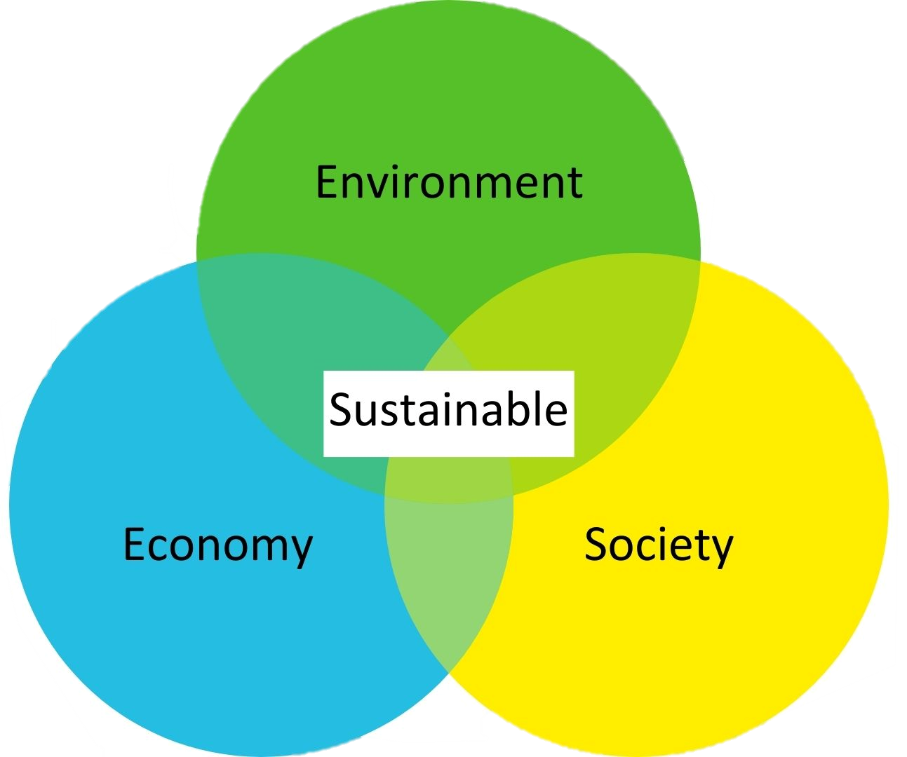
How does it all relate?
Services promote different types of literacies, innovation, creativity
Active, participative, and experiential learning methods (ESD)
Critical reflection
Use of real-world scenarios
Participatory learning
Problem-based learning
Collaborative learning
University of Plymouth - ESD
Notes:
Promoting literacies, digital inclusion, promote innovation, creativity and access
About the environment but also about social and economic development
Recognizing and valuing the link between SDGs and ESD and what libraries are doing
Supporting Pedagogical approaches in ESD
1. Critical reflection – including the more traditional lecture, but also newer approaches such as reflexive accounts, learning journals, and discussion groups.
2. Systemic thinking and analysis – the use of real-world case studies and critical incidents, project-based learning, stimulus activities, and the use of the campus as a learning resource.
3. Participatory learning – with emphasis on group or peer learning, developing dialogue, experiential learning, action research/learning to act, and developing case studies with local community groups and business
4. Thinking creatively for future scenarios – by using role play, real-world inquiry, futures visioning, problem-based learning, and providing space for emergence.
5. Collaborative learning – including contributions from guest speakers, work-based learning, interdisciplinary/ multidisciplinary working, and collaborative learning and co-inquiry.

Slide 7
Examples

Slide 8
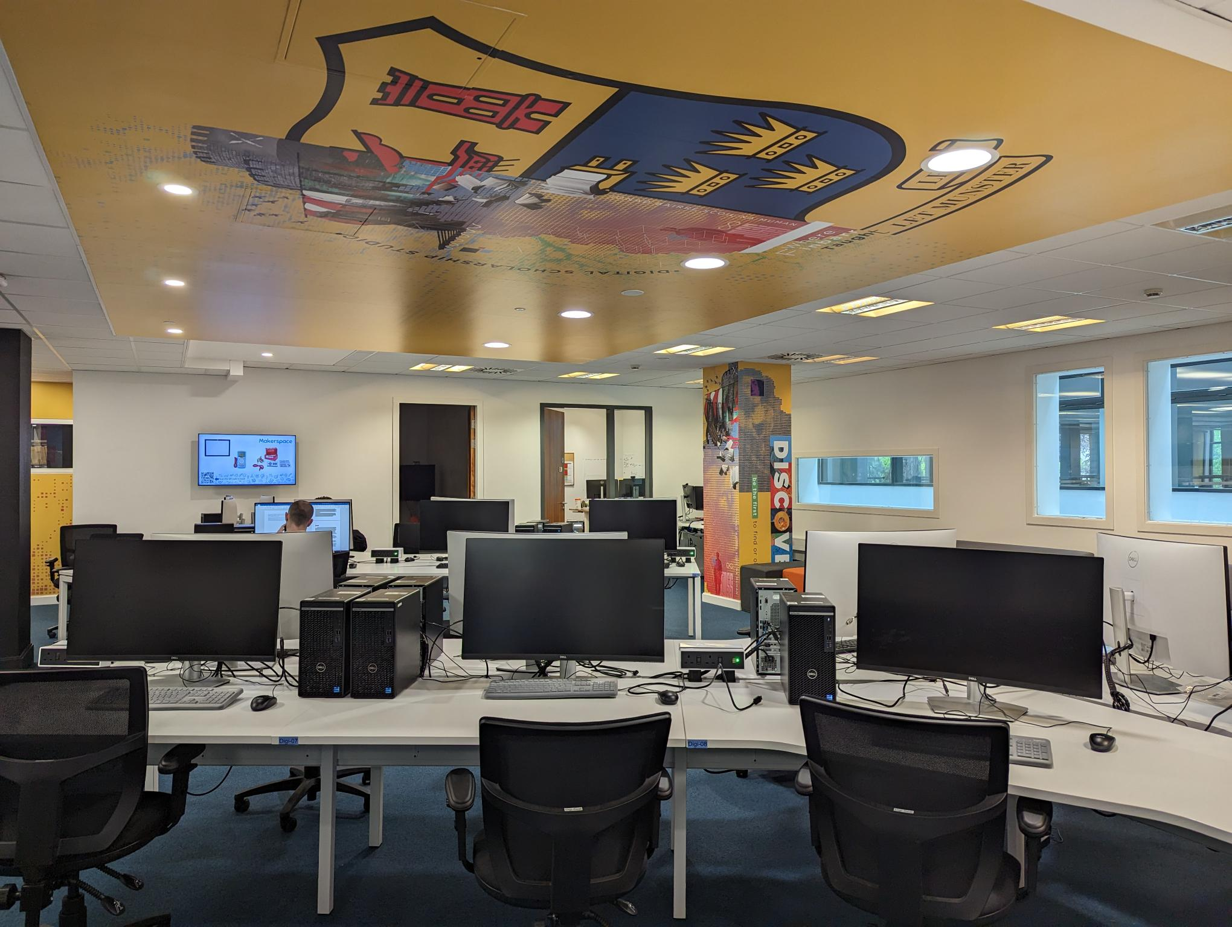
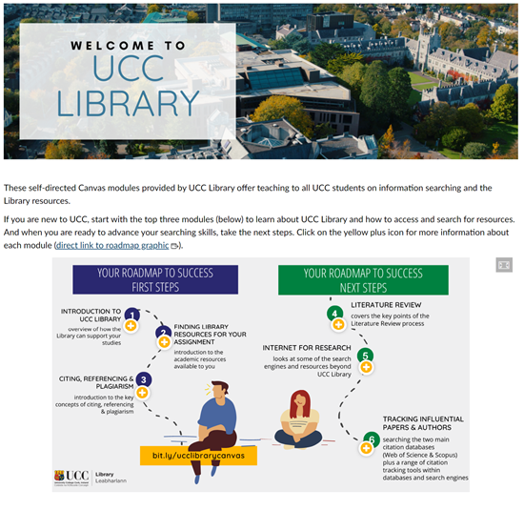
Transforming learning environments
Notes:
Transforming learning environments – both physical and virtual to ensure everyone has access to quality education (SDG 4)

Slide 9
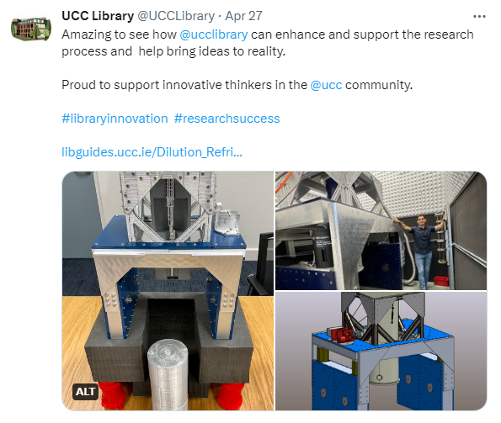
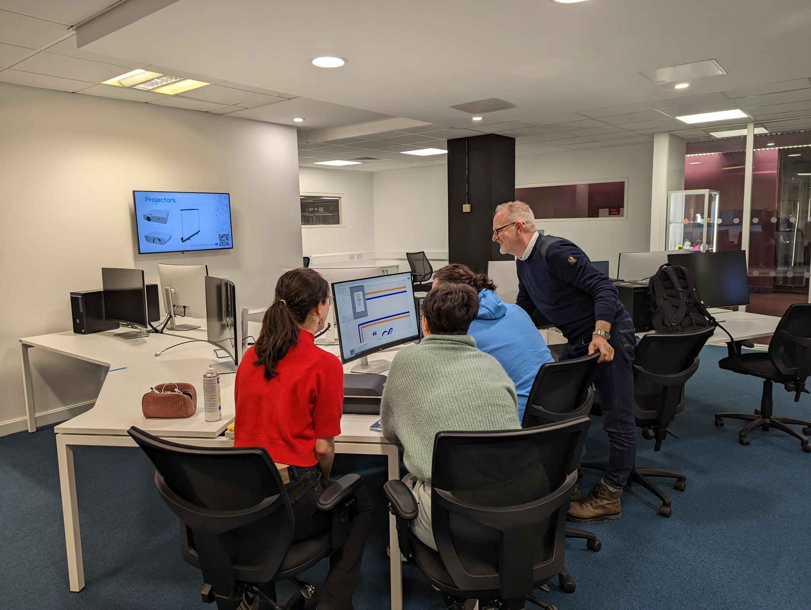
Partner for innovation
Notes:
Partnering for innovation (SDG 9)
Digital Humanities students using Digital Scholarship Studio to scan butter wrappers from the Butter Museum

Slide 10
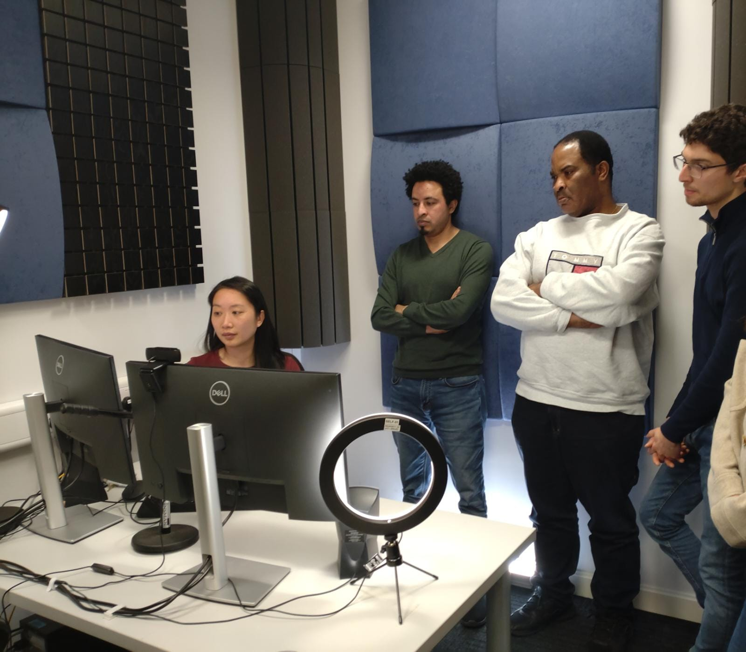
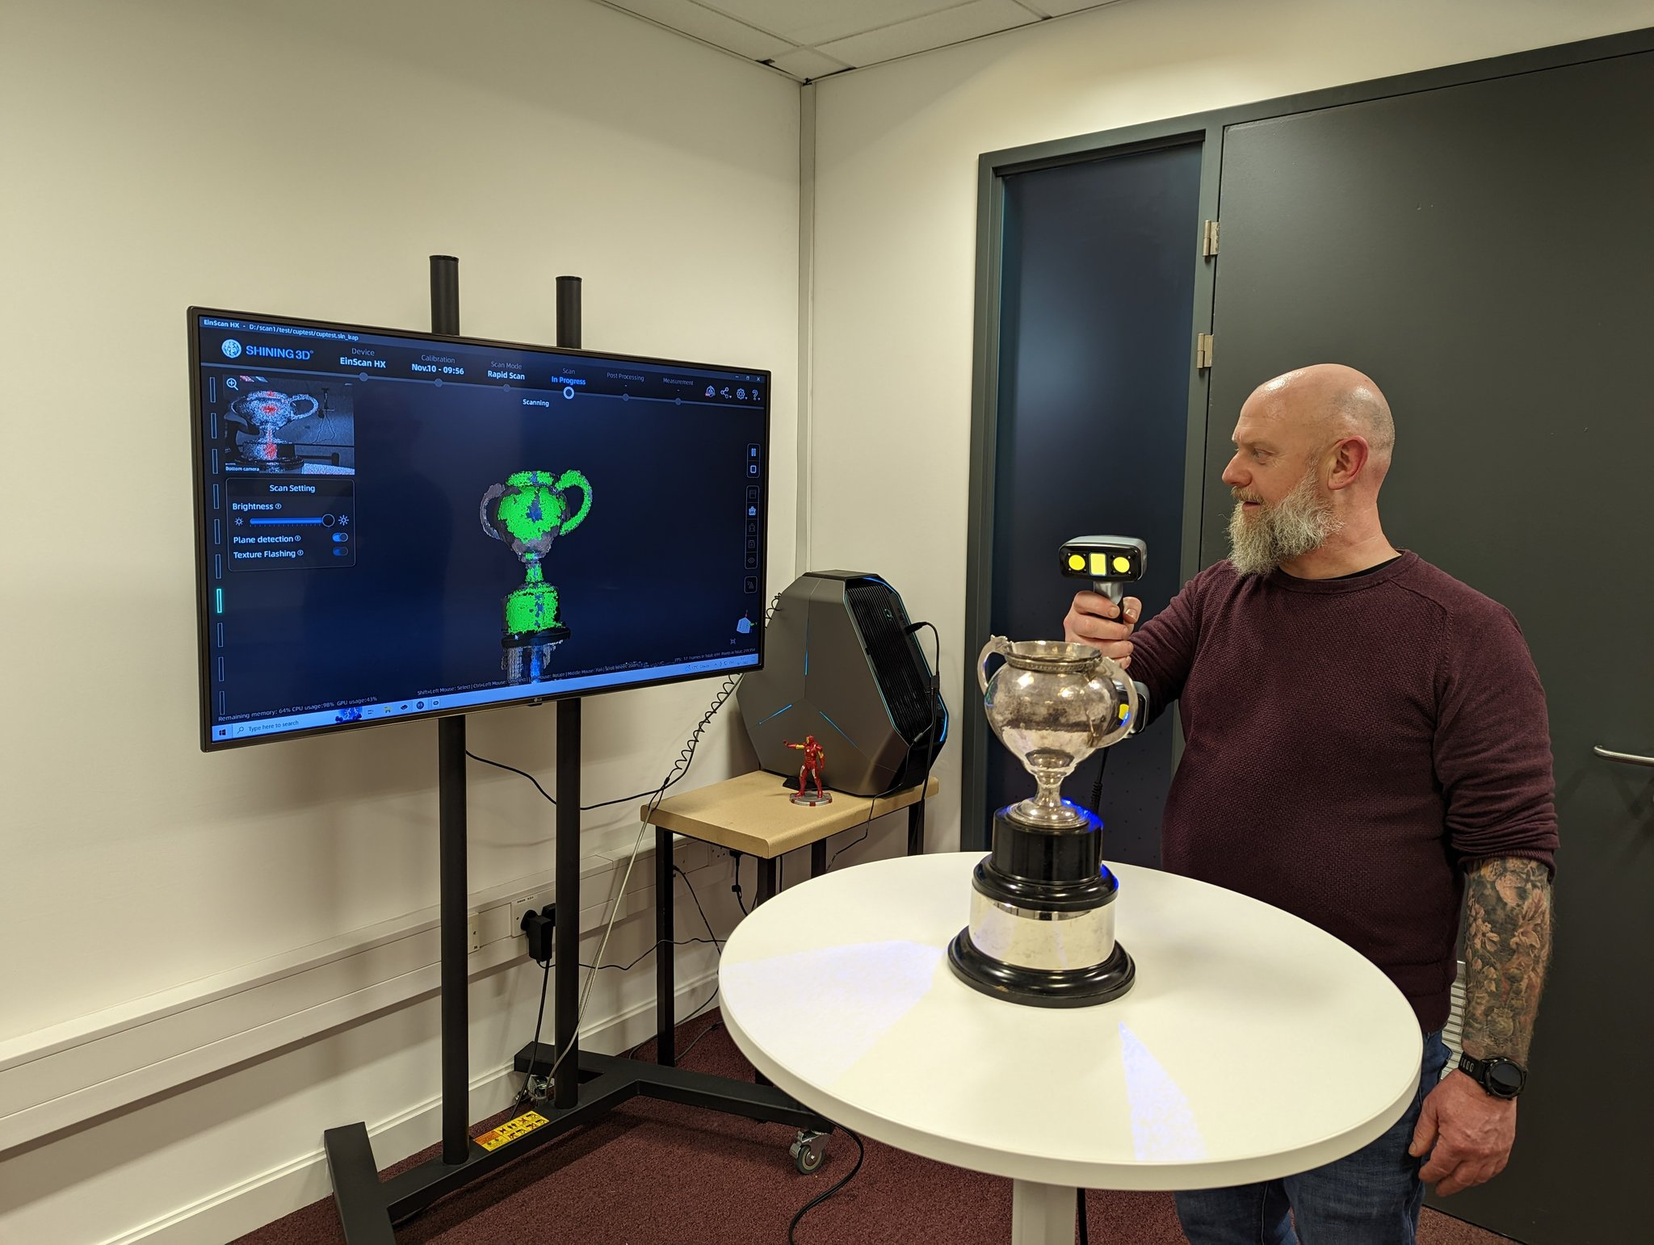
Building digital capacities
Notes:
Building digital capacities – both for our own staff but also outside the library for SDG 8 (decent work and economic growth)

Slide 11
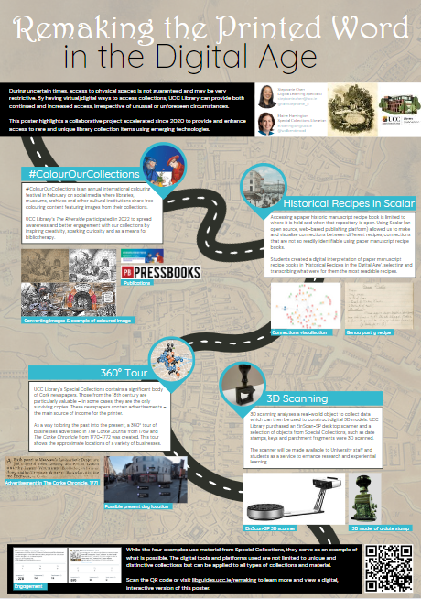
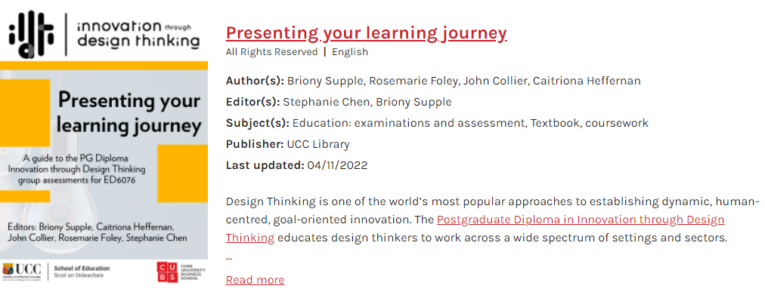
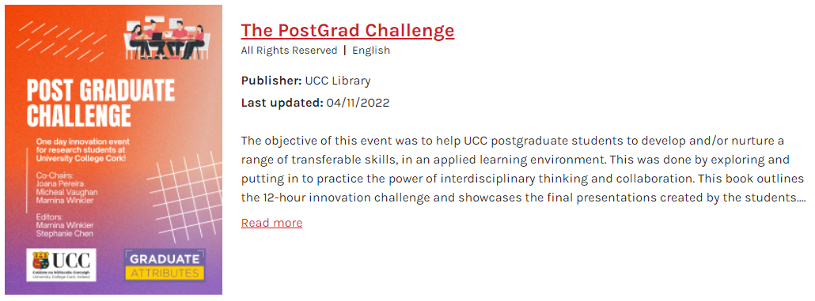
Increasing access
Notes:
Increased access to resources, knowledge and information to support students, staff and researchers to create new knowledge (SDG 4)

Slide 12
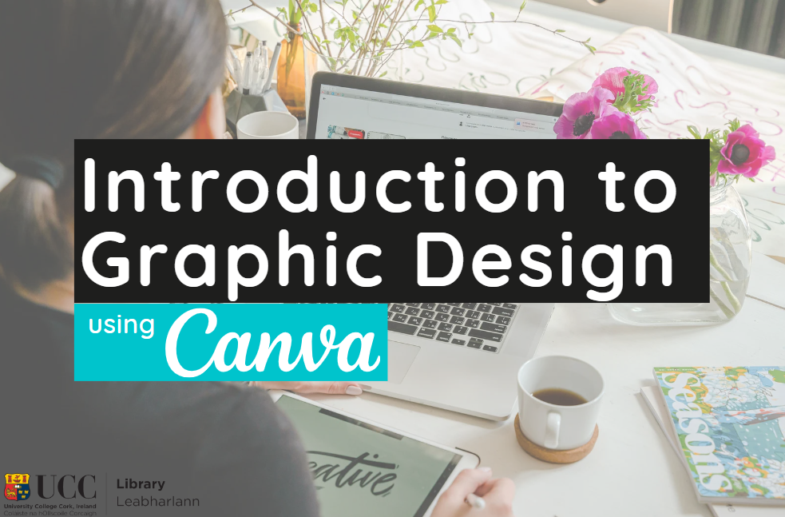
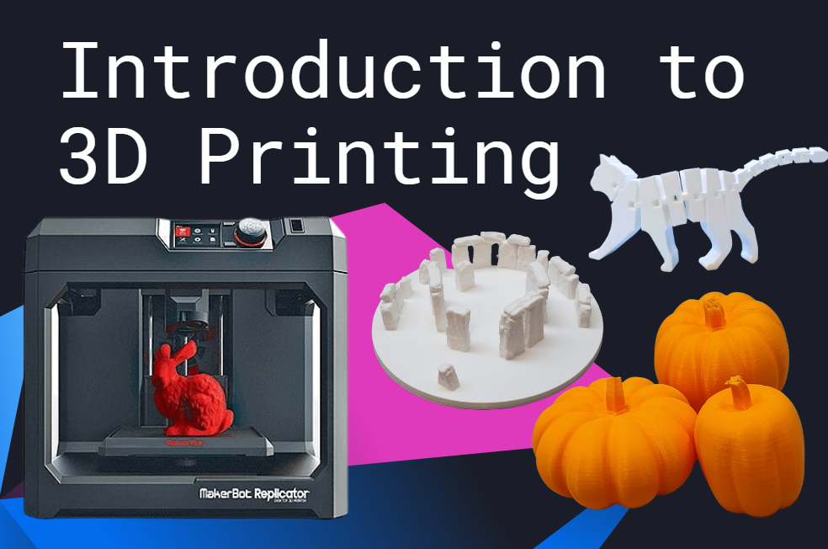
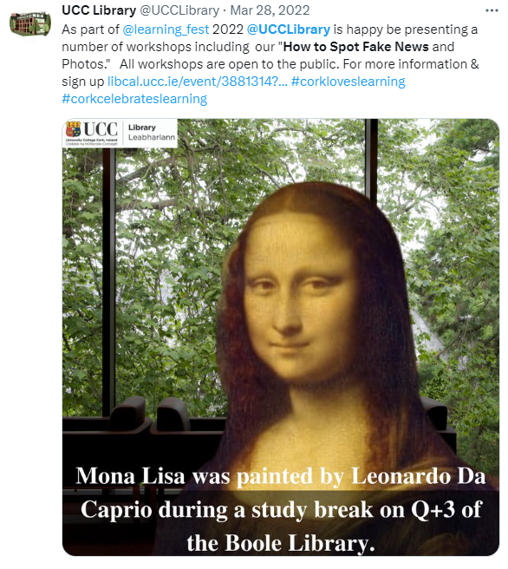
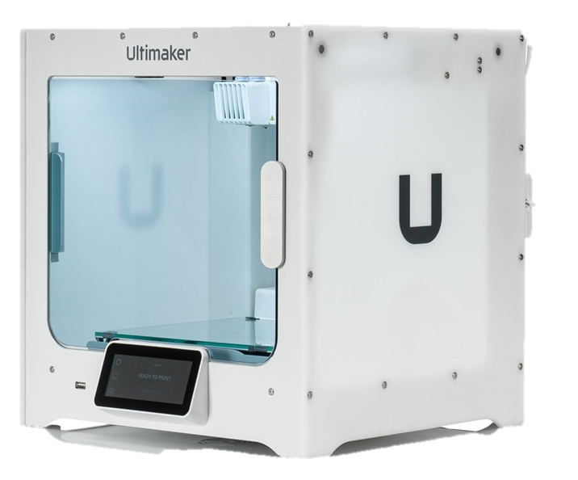
Developing key skills

Slide 13
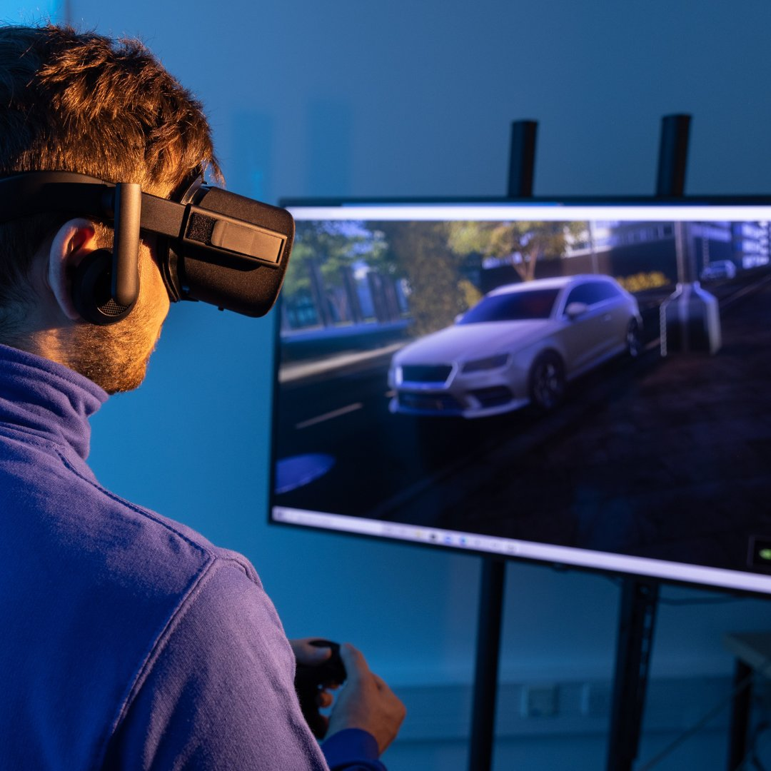

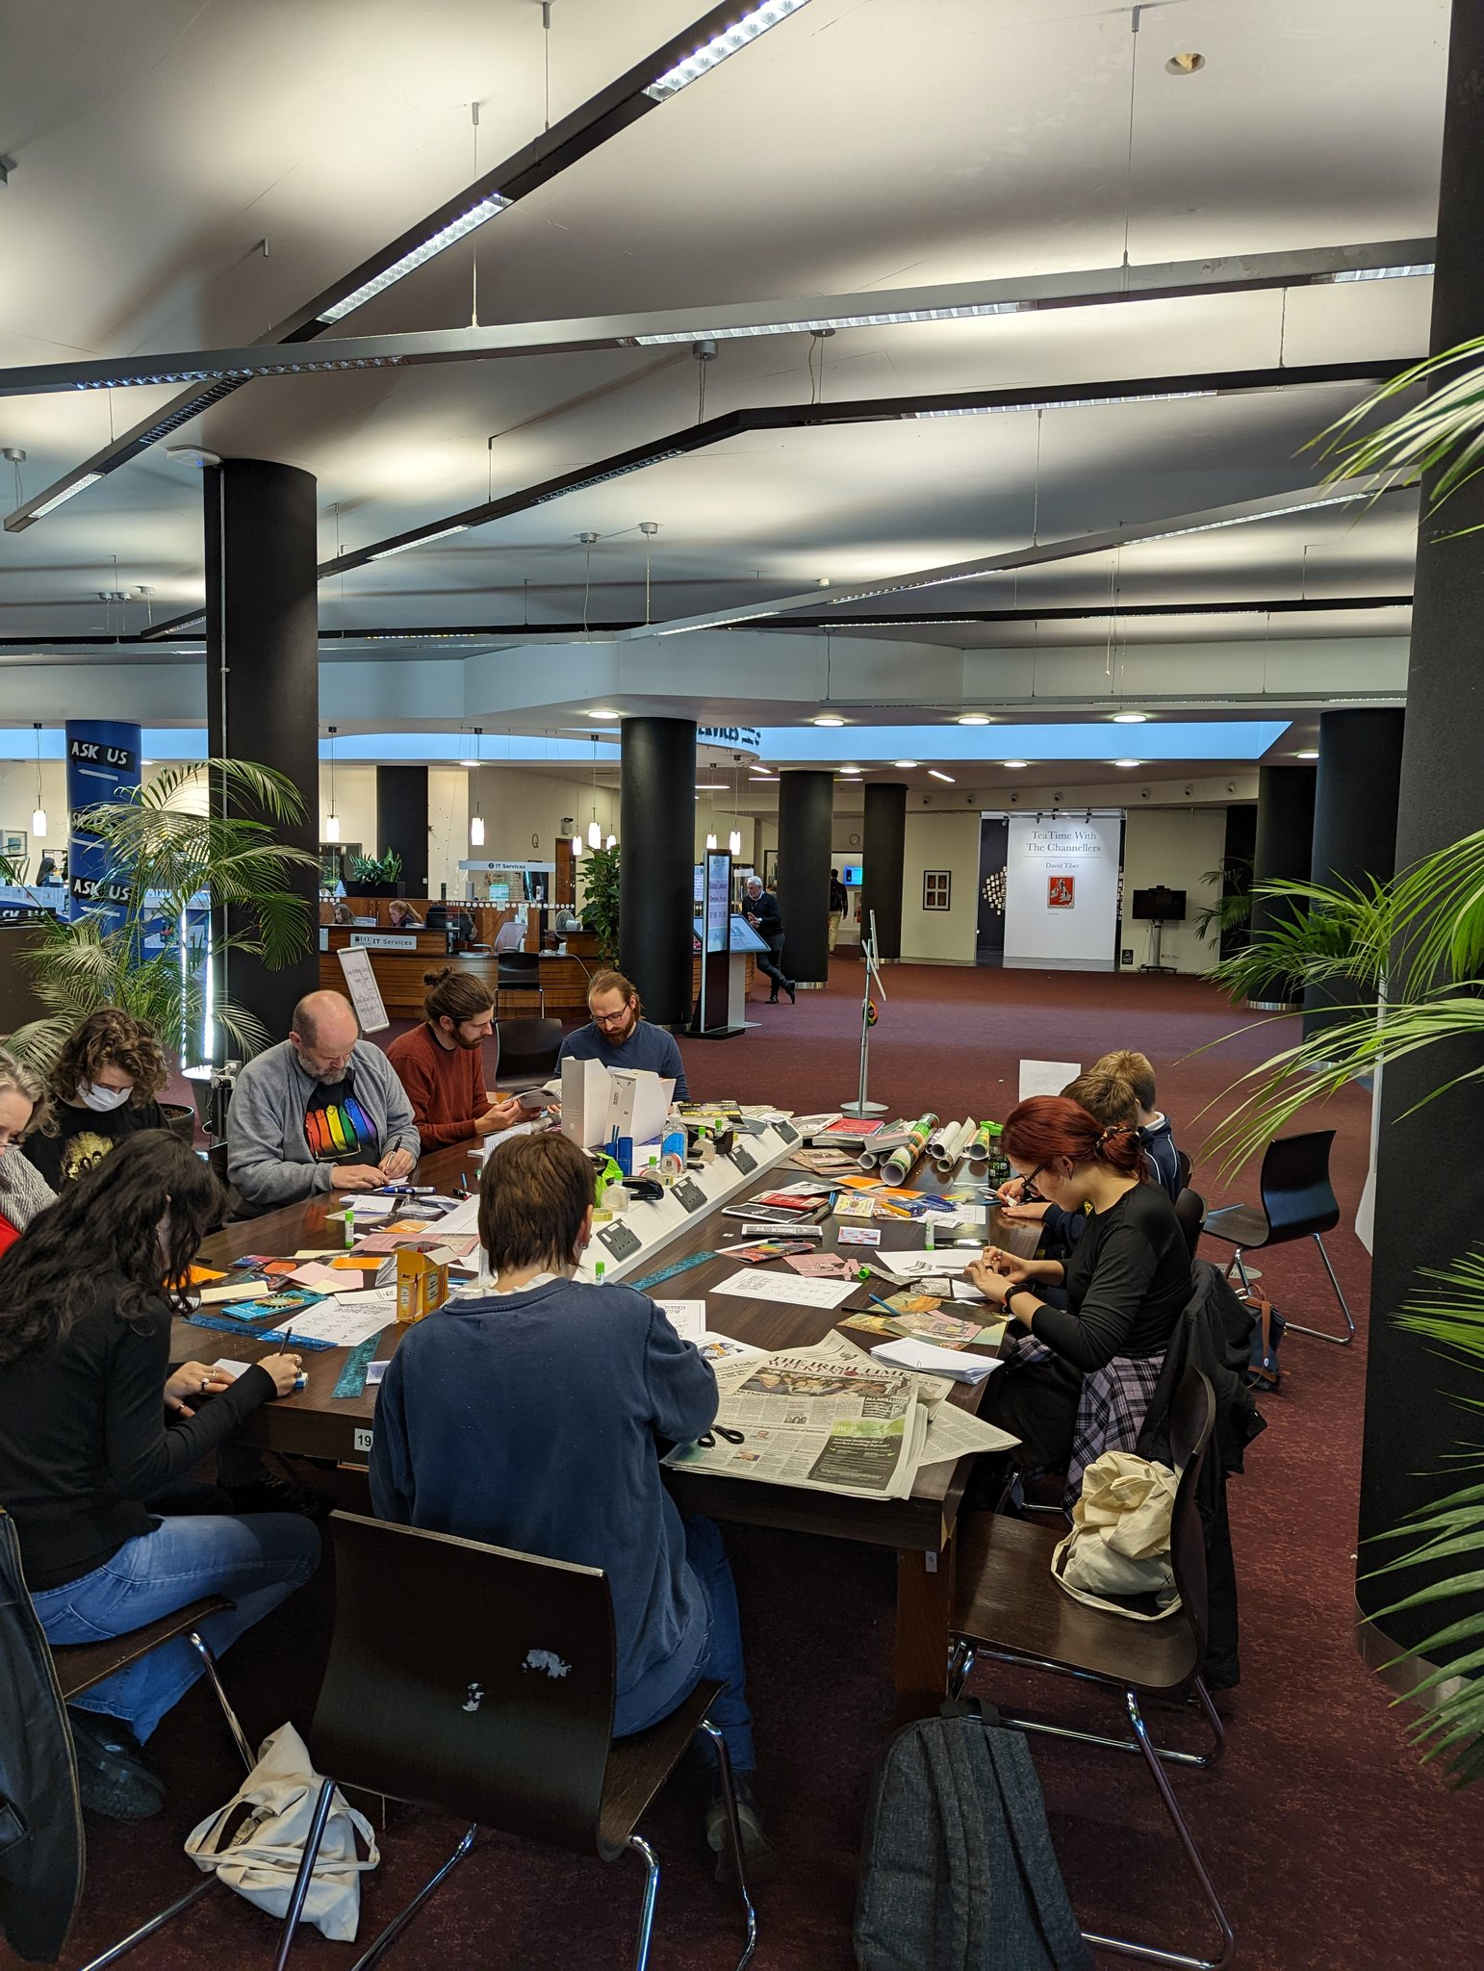
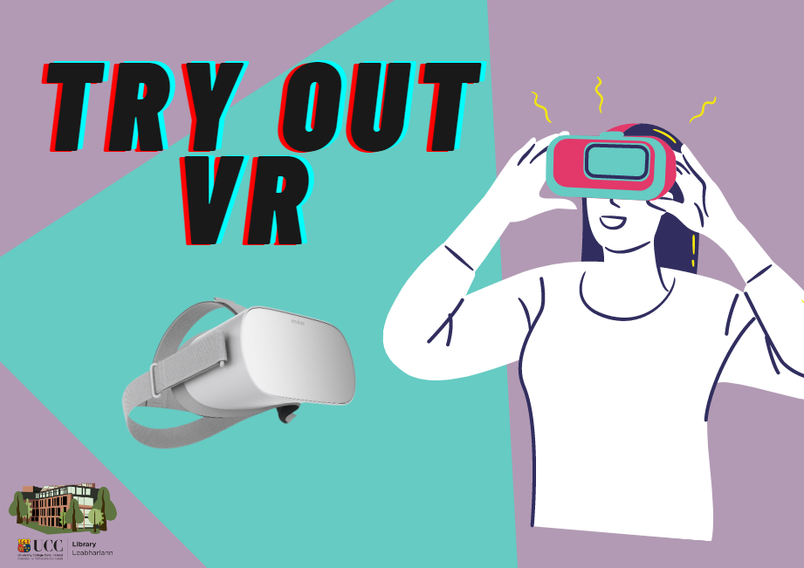
Promoting lifelong learning

Slide 14
Conclusion

Slide 15
Thank you stephanie.chen@ucc.ie

