Slide 1
Prediction of Cesarean Delivery in the Term Nulliparous Woman: Results for the Multi-center Genesis Study
Naomi Burke, Gerry Burke, Michael Turner, Fionnuala Breathnach, Fionnuala McAuliffe,
John J Morrison, Samina Dornan, John Higgins , Amanda Cotter, Michael Geary,
Peter McParland, Sean Daly, Fiona Cody, Pat Dicker, Elizabeth Tully, Fergal Malone
Perinatal Ireland Research Consortium

Slide 2
Primary Analysis to Develop a Mathematical Prediction Model for Cesarean Delivery
Unplanned Cesarean in a Nulliparous Woman
Maternal
Characteristics
Fetal Biometry
Naomi Burke, Gerry Burke, Michael Turner, Fionnuala Breathnach, Fionnuala McAuliffe, John J Morrison, Samina Dornan, John Higgins , Amanda Cotter, Michael Geary,
Peter McParland, Sean Daly, Fiona Cody, Pat Dicker, Elizabeth Tully, Fergal Malone from the Perinatal Ireland Research Consortium Prediction of Cesarean Section AJOG 2017
Notes:
Our hypothesis was that by using maternal demographic details and term fetal biometry that we would be able to predict the need for an unplanned caesarean in a nulliparous women. In this primary analysis of the Genesis study, our objective was to prospectively assess the use of prenatally determined, maternal and fetal, demographic, clinical and ultrasound features to develop a predictive tool for unplanned caesarean delivery in the term nulliparous woman, prior to the onset of labour.

Slide 3

Study Design
Prospective Observational Blinded Study of 2336 women
Seven Perinatal Ireland research sites
Nullipara
39⁺⁰ to 40⁺⁶
Standard fetal biometry
Blinded to the fetal biometry
Standard perinatal and obstetric data
Multivariate analysis to identify best combined predictors for Cesarean Delivery
Development of prediction model and risk assessment tool for clinical use
Naomi Burke, Gerry Burke, Michael Turner, Fionnuala Breathnach, Fionnuala McAuliffe, John J Morrison, Samina Dornan, John Higgins , Amanda Cotter, Michael Geary,
Peter McParland, Sean Daly, Fiona Cody, Pat Dicker, Elizabeth Tully, Fergal Malone from the Perinatal Ireland Research Consortium Prediction of Cesarean Section AJOG 2017
Notes:
This was a prospective observational study carried out by the Perinatal Ireland Research Consortium across 7 clinical sites on the island of Ireland between October 2012 and June 2015. All nulliparous women in an uncomplicated pregnancy between 39 and 40+ 6 weeks’ gestation were invited to participate. A research ultrasound was performed to obtain routine fetal biometry. Clinicians, midwives and participants alike were blinded from the ultrasound derived fetal biometry. Other standard perinatal and obstetric data were collected contemporaneously.

Slide 4
Prediction Model
Demographic Ultrasound Information | Mean | SD | OR Unit | At Initial Booking Visit | At 39+0 to 40+6 weeks
 |  |  |  | OR (95% CI) | OR (95% CI)
Age (years) | 29.9 | 5.07 | + 1 SD | 1.22 (1.10,1.35) | 1.21 (1.09,1.34)
Height (cm) | 165.5 | 6.55 | - 1 SD | 1.59 (1.43,1.78) | 1.72 (1.52,1.93)
BMI (kg/m²) | 24.5 | 4.27 | + 1 SD | 1.32 (1.20,1.46) | 1.29 (1.17,1.43)
Fetal HC (mm) | 337 | 12.9 | + 1 SD | Not applicable | 1.27 (1.14,1.42)
Fetal AC (mm) | 351 | 16 | + 1 SD | Not applicable | 1.23 (1.10,1.38)
Results from a multiple logistic regression of z-scores are displayed.
Odds-ratios (OR) correspond to a +/-1 SD increase in a predictor.
Naomi Burke, Gerry Burke, Michael Turner, Fionnuala Breathnach, Fionnuala McAuliffe, John J Morrison, Samina Dornan, John Higgins , Amanda Cotter, Michael Geary,
Peter McParland, Sean Daly, Fiona Cody, Pat Dicker, Elizabeth Tully, Fergal Malone from the Perinatal Ireland Research Consortium Prediction of Cesarean Section AJOG 2017
Notes:
This was a prospective observational study carried out by the Perinatal Ireland Research Consortium across 7 clinical sites on the island of Ireland between October 2012 and June 2015. All nulliparous women in an uncomplicated pregnancy between 39 and 40+ 6 weeks’ gestation were invited to participate. A research ultrasound was performed to obtain routine fetal biometry. Clinicians, midwives and participants alike were blinded from the ultrasound derived fetal biometry. Other standard perinatal and obstetric data were collected contemporaneously.

Slide 5
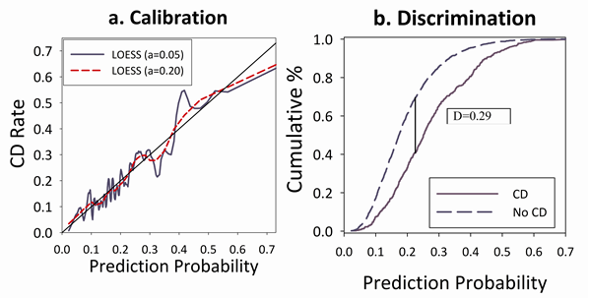
Prediction Model
CD= Cesarean Delivery
D= Discrimination
LOESS= Locally weighted scatterplot smoothing
a=0.05 Large LOESS
a= 0.20 Approximate LOESS
Naomi Burke, Gerry Burke, Michael Turner, Fionnuala Breathnach, Fionnuala McAuliffe, John J Morrison, Samina Dornan, John Higgins , Amanda Cotter, Michael Geary,
Peter McParland, Sean Daly, Fiona Cody, Pat Dicker, Elizabeth Tully, Fergal Malone from the Perinatal Ireland Research Consortium Prediction of Cesarean Section AJOG 2017
Notes:
This was a prospective observational study carried out by the Perinatal Ireland Research Consortium across 7 clinical sites on the island of Ireland between October 2012 and June 2015. All nulliparous women in an uncomplicated pregnancy between 39 and 40+ 6 weeks’ gestation were invited to participate. A research ultrasound was performed to obtain routine fetal biometry. Clinicians, midwives and participants alike were blinded from the ultrasound derived fetal biometry. Other standard perinatal and obstetric data were collected contemporaneously.

Slide 6
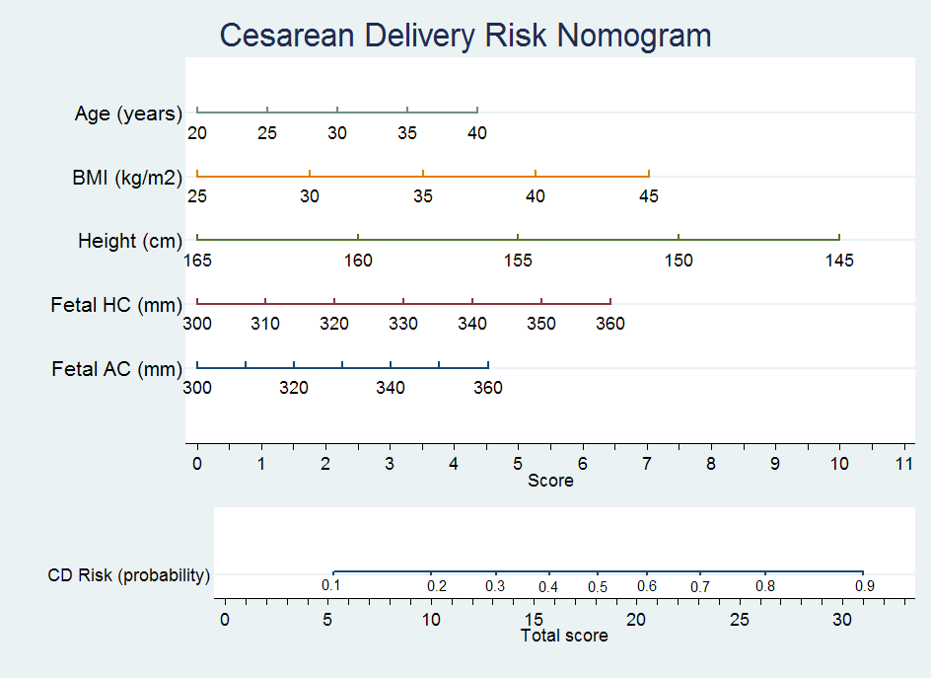
Naomi Burke, Gerry Burke, Michael Turner, Fionnuala Breathnach, Fionnuala McAuliffe, John J Morrison, Samina Dornan, John Higgins , Amanda Cotter, Michael Geary,
Peter McParland, Sean Daly, Fiona Cody, Pat Dicker, Elizabeth Tully, Fergal Malone from the Perinatal Ireland Research Consortium Prediction of Cesarean Section AJOG 2017

Slide 7
Example
35 year old, nulliparous, with a height of 160cm and BMI 35. The fetal HC is 350mm and the fetal AC is 350mm
Risk scores from the nomogram 35 years (3.3), BMI 35 (3.5), height 160cm (2.5), fetal HC 350mm (5.4), fetal AC 350 (3.8). Total score is 18.5 which corresponds to a 51% risk of cesarean delivery.
Naomi Burke, Gerry Burke, Michael Turner, Fionnuala Breathnach, Fionnuala McAuliffe, John J Morrison, Samina Dornan, John Higgins , Amanda Cotter, Michael Geary,
Peter McParland, Sean Daly, Fiona Cody, Pat Dicker, Elizabeth Tully, Fergal Malone from the Perinatal Ireland Research Consortium Prediction of Cesarean Section AJOG 2017

Slide 8
Naomi Burke, Gerry Burke, Michael Turner, Fionnuala Breathnach, Fionnuala McAuliffe, John J Morrison, Samina Dornan, John Higgins , Amanda Cotter, Michael Geary,
Peter McParland, Sean Daly, Fiona Cody, Pat Dicker, Elizabeth Tully, Fergal Malone from the Perinatal Ireland Research Consortium Prediction of Cesarean Section AJOG 2017

Slide 9
Nomogram Variable Division Scores
Age (years) |  | BMI (kg/m²) |  | Height (cm) |  | Fetal HC (mm) |  | Fetal AC (mm)
Value | Score | Value | Score | Value | Score | Value | Score | Value | Score
20 | 0.0 | 25 | 0.0 | 165 | 0.0 | 300 | 0.0 | 300 | 0.0
25 | 1.1 | 30 | 1.8 | 160 | 2.5 | 310 | 1.1 | 310 | 0.8
30 | 2.2 | 35 | 3.5 | 155 | 5.0 | 320 | 2.1 | 320 | 1.5
35 | 3.3 | 40 | 5.3 | 150 | 7.5 | 330 | 3.2 | 330 | 2.3
40 | 4.4 | 45 | 7.0 | 145 | 10.0 | 340 | 4.3 | 340 | 3.0
 |  |  |  |  |  | 350 | 5.4 | 350 | 3.8
 |  |  |  |  |  | 360 | 6.4 | 360 | 4.5
Naomi Burke, Gerry Burke, Michael Turner, Fionnuala Breathnach, Fionnuala McAuliffe, John J Morrison, Samina Dornan, John Higgins , Amanda Cotter, Michael Geary,
Peter McParland, Sean Daly, Fiona Cody, Pat Dicker, Elizabeth Tully, Fergal Malone from the Perinatal Ireland Research Consortium Prediction of Cesarean Section AJOG 2017

