Slide 1

Looking at the Library through the lens of the SDGs
(Sustainable Development Goals)
simple ways to ensure library staff and libraries continue to thrive
Stephanie Chen, Digital Learning Specialist
@iamstephanie_c
Martin O’Connor, Communications Coordinator
@martinoconnor3

Slide 2
Introduction & context

Slide 3
Quote from ALA
“To be truly sustainable, an organization or community must embody practices that are environmentally sound AND economically feasible AND socially equitable.”
Resolution for the adoption of sustainability as a core value of librarianship, ALA, 2019

Slide 4

UN Sustainable Development Goals
Notes:
Relevant ones: 3, 4, 8

Slide 5
Previous research
Report on CPD (Continuing Professional Development) Needs of Librarians and Information Professionals in Ireland
Continuing Professional Development and Irish Libraries: Report of Key Survey Findings
Case Study A: Breaking Barriers: CPD for the 21st Century Academic Librarian
Keeping ahead of the curve: Academic librarians and continuing professional development in Ireland
On your own but not alone: One-person librarians in Ireland and their perceptions of continuing professional development.
Notes:
No previous research focusing specifically on CONUL

Slide 6
Results
And The Obligatory Disclaimer
Notes:
Library Directors
9 responses out of 13 (69%)
Library Staff
126 responses
Don’t know how many total library staff are employed in all CONUL institutions but general figure of 859 = 15%
Disclaimer
Survey results are preliminary and just to get a sample of what the CPD situation in CONUL institutions is like
Not representative of any one institution but of CONUL overall

Slide 7

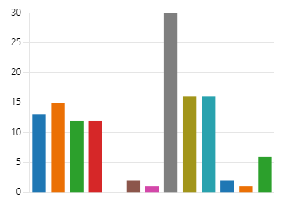
Response Rate by Institution
CONUL Library Directors
CONUL Library Staff
Notes:
Library Directors
9 out of 13 responded
Library staff
At least 1 staff from 12 out of 13 institutions responded (only 1 institution had zero responses)

Slide 8
Role Categories – CONUL Library Staff
Notes:
Two other can be categorized as intermediate managerial or professional

Slide 9
Is CPD mandatory in the Library?
Notes:
Library Directors
8 said not mandatory
Library staff
26 unsure if mandatory or not (20%): highlighting uncertainty around official policy on CPD

Slide 10
Is CPD encouraged in the Library?
Notes:
Library Directors
All said CPD is encouraged
Library staff
Small number said no or unsure if it’s encouraged

Slide 11
Importance of CPD

Slide 12
CPD Offerings from the Library
Notes:
Onboarding induction – staff who’ve been in the library for a long time may not be aware of it, might not know the name or associate what they have as onboarding induction
Other responses:
Informal mentoring and coaching

Slide 13
CPD Supports from the Library
Notes:
Other answers
Job swaps
Study leave

Slide 14
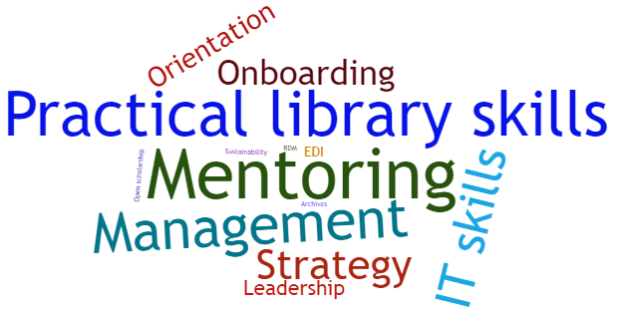
CPD you wish were offered

Slide 15
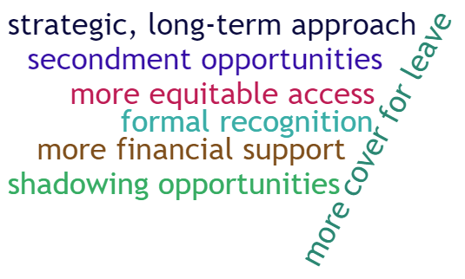
Calls for

Slide 16
Barriers to engagement with CPD
Notes:
Other
Pathway or mapping of relevant CPD to role
Lack of recognition
Hierarchy, grade barriers
Lack of time

Slide 17
Suggestions

Slide 18

SDG 3
Work-life balance
Supportive networks
Positive work environment
Notes:
SDG 3: promote wellbeing for all at all ages

Slide 19

SDG 4
Lifelong learning
Professional development
Notes:
SDG 4: inclusive and equitable quality education and promote lifelong learning opportunities for all

Slide 20

SDG 8
Career advancement
Recognition and rewards
Strong advocacy and community support
Notes:
SDG 8: full and productive employment and decent work for all

Slide 21
Conclusion

Slide 22

Future directions
More research?
Shared summary of relevant findings to CONUL Training & Development
Notes:
Disclaimer: Not representative of individual institutions but CONUL overall

Slide 23

Selection of quotes – CONUL library staff
It's less opportunities that are lacking per se rather than transparency and equitable processes in terms of how resources are allocated when it comes to CPD
I wish there was more opportunities for Grade III and Grade IV staff, a lot of interesting stuff is for higher grades only
I've been here a year and have yet to be trained in on the basics of my role never mind CPD

Slide 24
Selection of quotes – CONUL library staff
I think we are offered a lot, it's up to me to avail of existing opportunities
It would be good to get an annual update on courses available and funding / study time available
The library does a great job of circulating opportunities (…) it would be useful if there was say 1 or 2 dedicated CPD sessions per year focused on a specific topic that the Library has identified as a key strategic development opportunity for all staff in line with Library or institutional objectives
I am happy with the CPD on offer

Slide 25
Quote – CONUL Library director
We (…) are always willing to listen if staff have particular requests/suggestions

Slide 26
Thank you
stephanie.chen@ucc.ie
martin.oconnor@ucc.ie

