Slide 1
*
*
10⁷
*
10⁶
10⁵
Average radiance [p/s/cm²/sr]
10⁴
10³
10²
0
CTRL
430
500
600
670
830
V/cm
Supplementary material 1. Optimization of the surface EP V/cm parameter for pLuc expression in pig skin in vivo. pLuc (100 µg) was injected intradermally in pig skin followed by surface EP (6 pulses, 10 ms per pulse with 90 ms intervals). Different voltages per cm pulses were applied. After 48 hours, the site of surface EP was harvested and processed to measure the luciferase activity (p/s/cm²/sr). Skin control was harvested. The luciferase activity of the skin biopsies treated at different V/cm from a given pig is represented by the same symbol and 5 pigs have been used in total (2308 , 2327 , 2254 ① , 2307 ② , 73 ). The luciferase activity mean obtained at a given V/cm from different pig is shown as a horizontal bar. Significant differences between the injected sites and control sites were determined with the non-parametric Mann-Whitney test (*, p < 0.05).
Notes:
EP_Patch-Feb-April-June 2016.pzf
T-test unpaired use non parametric one-side
Rond : 2308
Carré : 2327
Triangle haut : 2254
Triangle bas : 2307
Losange : 73
Taille mise en largeur : 8.6 cm

Slide 2
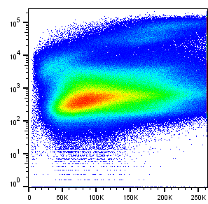
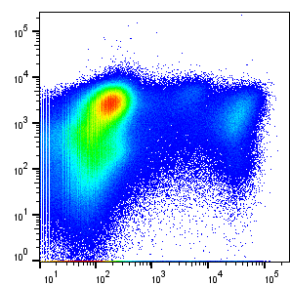
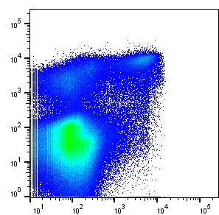
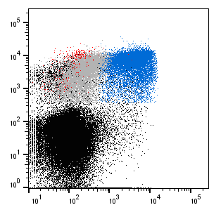
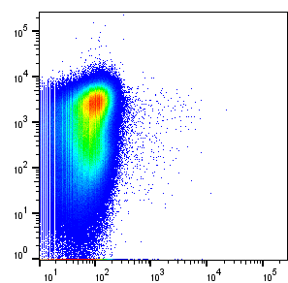
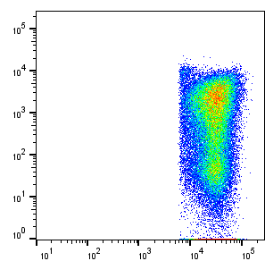
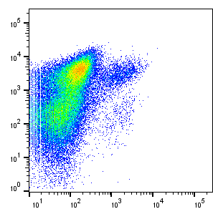
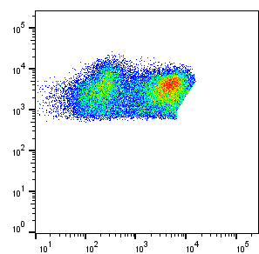
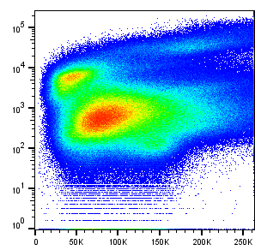
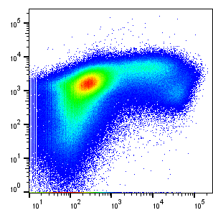
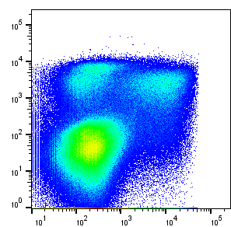
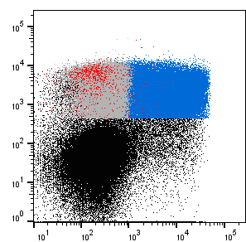
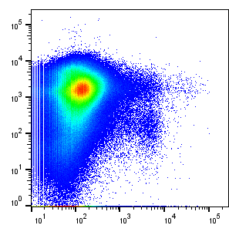
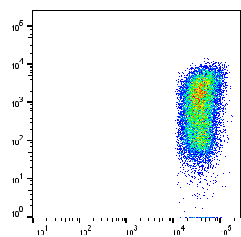
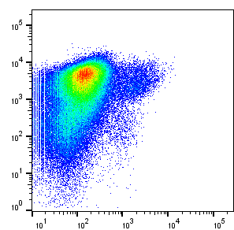
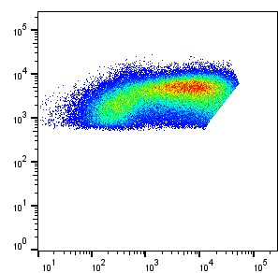
A
CD163^{hi}
4.7%
MHC class II^{pos} 5.0%
CD16^{3int} (mainly cDC2)
CD163^{neg} (mainly LC)
Live/Dead
CD172a
MHC class II
cDC1
MHC class II
Supplementary material 2. Myeloid cell subset identification in pig skin. Cells were collected from an overnight enzymatic digestion of skin biopsies, which had been harvested 24 hours after pLuc+pGM-CSF injection followed by EP and from the control zone. (A). From control skin, live cells (live/dead staining) were gated according to their labeling with an anti-granulocyte (6D10 mAb), anti-CD172A (74-22-15a mAb) and anti-CD163 (clone 2A10/11), based on our previous published works [29, 42]. The CD163high cells were further separated into MHC class IIneg (CD163high-MP) and MHC class II+ cells (CD163high-DDC). The CD163int/neg cells were selected for MHC class IIpos cells in which CD13posCD172neg cells represent cDC1 [43]. MHC class IIpos CD172pos cells were separated into CD163neg and CD163int subsets. The expression of langerin in these 2 subsets is analyzed in supplementary material 3. The cDC1, CD163neg and CD163int subsets were back-gated on their grand-parental MHC class II / CD163 dot plot (top right panel). (B). An example of the same staining and gating of skin cells obtained following EP, is provided. Note that the MHC2 class IIhigh cells cannot be easily distinguished, at the difference with in A.
Control
CD163
CD163
CD163
FSC
CD163^{hi} DDC
2.7%
CD172a
MHC class II
CD172a
CD172a
CD163^{int}
3.0%
cDC1
0.09%
CD163^{neg}
1.4%
Granu.
0.05%
CD163^{hi} MP
1.2%
Granulocytes
CD163
CD13
CD163
B
CD163^{hi}
2.6%
MHC class II^{pos} 12.8%
CD163^{int}
CD163^{neg}
Live/Dead
cDC1
CD172a
MHC class II
MHC class II
FSC
CD163
CD163
CD163
Electroporation
CD163^{hi} DDC
2.0%
CD172a
MHC class II
CD172a
CD172a
CD163^{int}
6.6%
cDC1
0.1%
CD163^{neg}
2.7%
Granu.
0.8%
CD163^{hi} MP
0.8%
Granulocytes
CD163
CD13
CD163
Notes:
% par rapport aux vivantes, identiques au graphes FACS

Slide 3
A. Control skin
CD163^{neg}
CD163^{int}
Langerin
Langerin
B. Electroporation
CD163^{neg}
CD163^{int}
Langerin
Langerin
Supplementary material 3. Langerin expression in pig skin MHC class II^{pos} CD172^{pos} CD163^{neg} and CD163^{int} subsets. Control (A) and EP (B) skin cells were labelled and analyzed similarly as in supplementary material 2 except that the anti-CD13 mAb was not used. The labeled cells were fixed and permealised for langerin detection (see material and methods). The expression of langerin in MHC class II^{pos} CD172^{pos} CD163^{neg} and CD163^{int} subsets (grey) was overlaid on the histogram obtained with a rat IgG2a biotinylated control (dotted lines).

Slide 4
A
B
Granulocytes
Group 1
100
1.0
Pig n°4829
80
0.8
Pig n°896
EP
ID
Pig n°758
60
0.6
% living cells
% living cells
Group 3
40
0.4
Pig n°878
20
0.2
Pig n°866
0
0.0
Pig n°925
EP
CtI
ID
CtD
EP
CtI
ID
CtD
CtE
EP+NP
ID+NP
Patch
CtE
EP+NP
ID+NP
Patch
Patch
Patch+NP
Patch+NP
MP-CD163^{hi}
DDC-CD163^{hi}
CD163^{int/neg} MHC class II^{pos}
2.0
5
30
1.5
4
3
20
1.0
2
10
0.5
1
0.0
0
EP
CtI
ID
CtD
0
CtI
ID
CtD
CtE
EP
EP
CtI
ID
CtD
EP+NP
Patch
CtE
EP+NP
Patch
CtE
EP+NP
ID+NP
Patch
ID+NP
Patch+NP
ID+NP
Patch+NP
% living cells
Patch+NP
CD163^{int}
CD163^{neg}
cDC1
15
15
0.20
10
10
0.15
0.10
5
5
0.05
0
0
0.00
EP
CtI
ID
CtD
EP
CtI
ID
CtD
EP
CtI
ID
CtD
CtE
EP+NP
ID+NP
Patch
CtE
EP+NP
ID+NP
Patch
CtE
EP+NP
ID+NP
Patch
Patch+NP
Patch+NP
Patch+NP
Supplementary material 4. Myeloid cell mobilization (% representation) upon administration of pLuc and pGM-CSF delivered in skin using surface EP, ID and patch applications. (A). Large White pigs (Group 1: #4829, 896, 758 and Group 3: #878, 866 and 925) were anesthetized. Group 1 received pLuc + pGM-CSF with EP and ID administration, Group 3 received pLuc + pGM-CSF with patches. Each pig is represented by a distinct symbol (see legend on the figure). For this experiment, pGM-CSF was combined to pLuc (20 µg pGM-CSF + 80 µg pLuc in EP and 80 µg pGM-CSF + 320 µg pLuc in patches). (B). Six EP and ID sites were pooled per condition and 6 biopsies were pooled from patch sites and the biopsies were processed to skin cell isolation as described in the material and methods. The % live cell number from the 6 biopsies, obtained with the Guava ViaCount assay, are reported. The representation of each subset among live cells (%) are reported for the biopsies of the different administration methods. No statistical test was conducted due to the < 5 values per condition; however 6 biopsies were used to generate each value, with pairs between treatments and controls. Similar results were obtained in an independent experiment.

Slide 5
200 µm
A
B
200 µm
200 µm
C
D
200 µm
200 µm
Supplementary material 5: histological examination of skin biopsies. Skin-biopsy sections from control skin (A) and from skin 24 hours after administration of DNA with EP (B), patch (C) and EP+NP (D) were stained with hematoxylin‐eosin‐saffron (HES) and photographed using the Caseviewer software. The empty arrows point to inflammatory cell accumulation in the epidermis and the long black arrows point to inflammatory cell accumulation in the dermis. Three sections per biopsy were done from 3 different pigs for each treatment. One representative section per treatment is shown.

Slide 6
A
IL-8
**
10⁵
**
Group 2
Pig n°829
pg/mL
Pig n°850
10⁴
Pig n°910
10³
CtE
EP
CtD
Patch
EP+NP
Patch+NP
B
IL-1β
C
IL-17
15000
**
250
**
*
200
10000
150
pg/mL
pg/mL
5000
100
50
0
0
CtE
EP
CtD
Patch
CE
EP
CtD
Patch
EP+NP
Patch+NP
EP+NP
Patch+NP
Supplementary material 6. Inflammatory cytokine secretion upon administration of pLuc delivered in skin using surface EP and patch application. pLuc plasmid (without pGM-CSF) was administered as described in Figure 2 for group 2 (100 µg pLuc in EP and 400 µg pLuc in patches). Twenty-four hours after, skin biopsies were aseptically collected, washed in PBS and placed in RPMI + 10% FCS + 1 % antibiotic/antimycotic cocktail for 24h. Cytokines were detected using a multiplex cytometric bead assay and the cytokine concentration was evaluated using a standard curve with recombinant cytokines. Significant differences between the injected sites and control sites were determined with a non-parametric Mann-Whitney test (*, p < 0.05; **, p < 0.01). (A). IL-8. (B). IL-1b. (C). IL-17.

