Slide 1
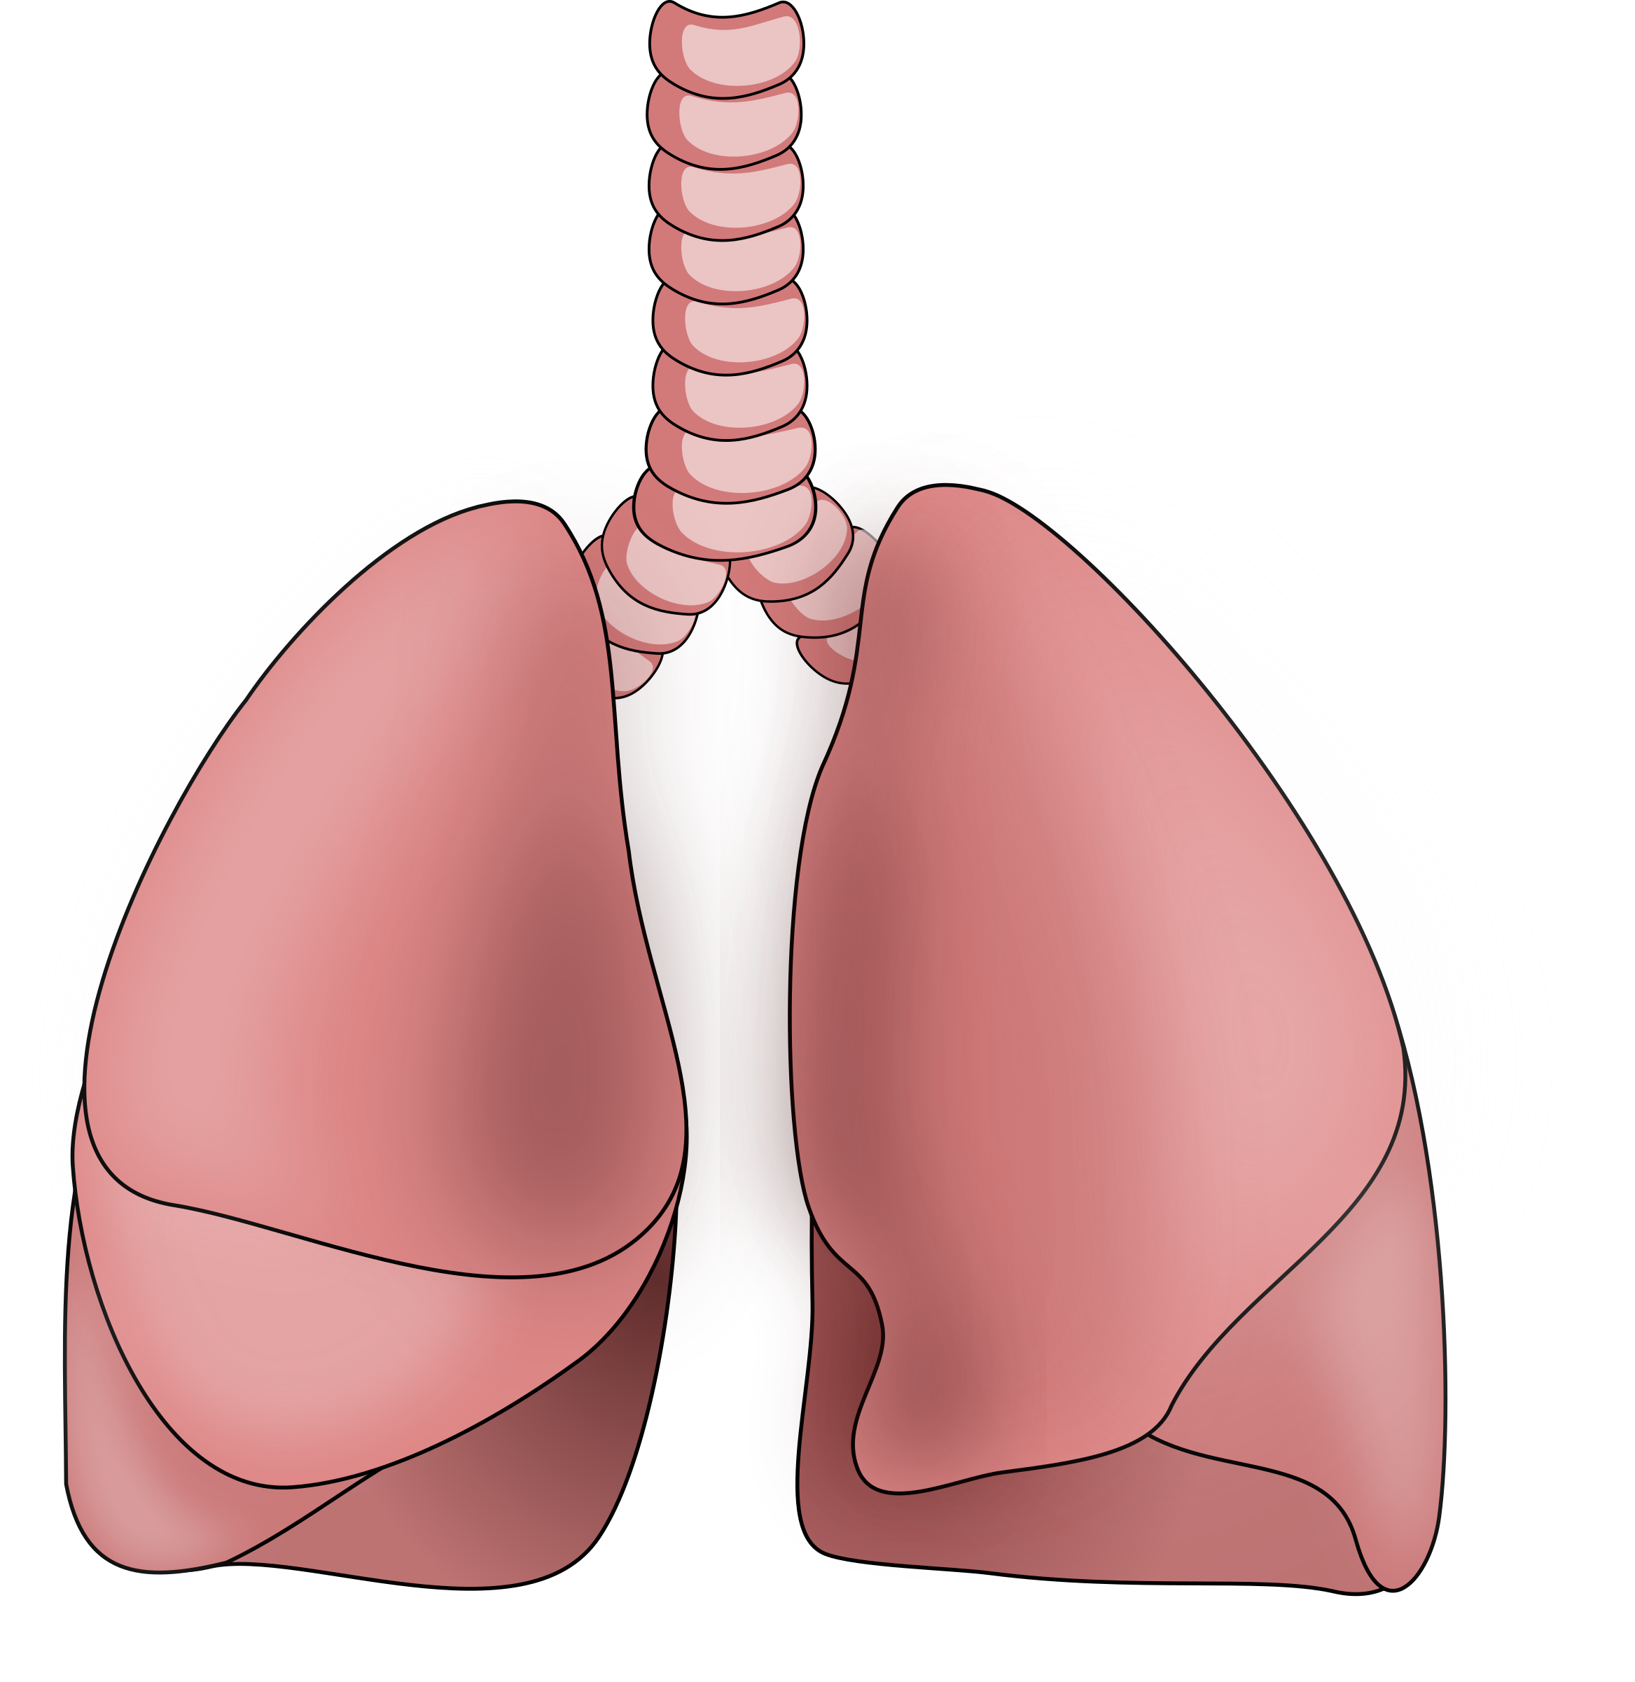
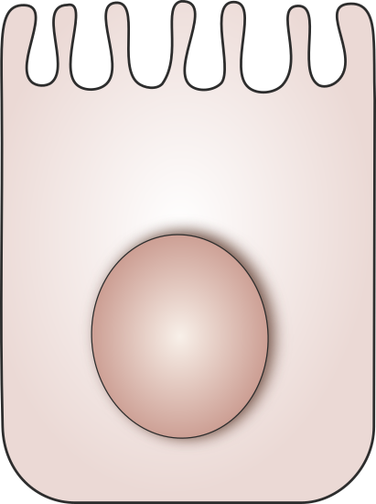
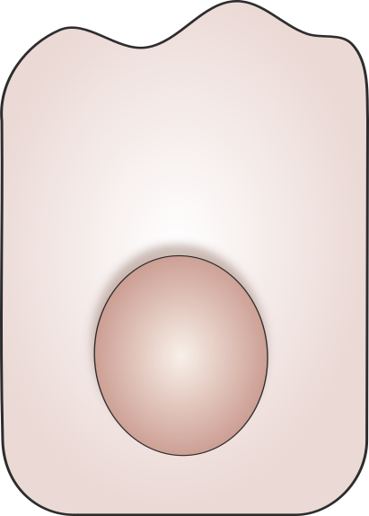
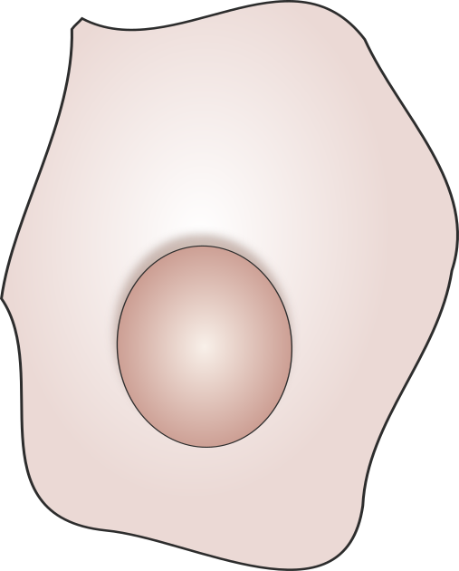
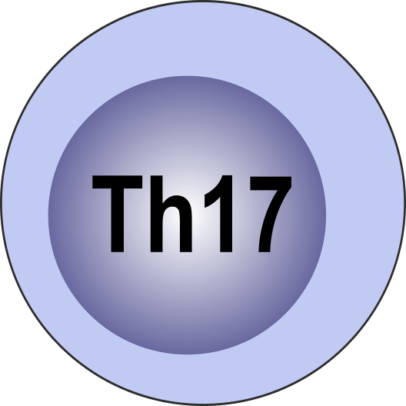
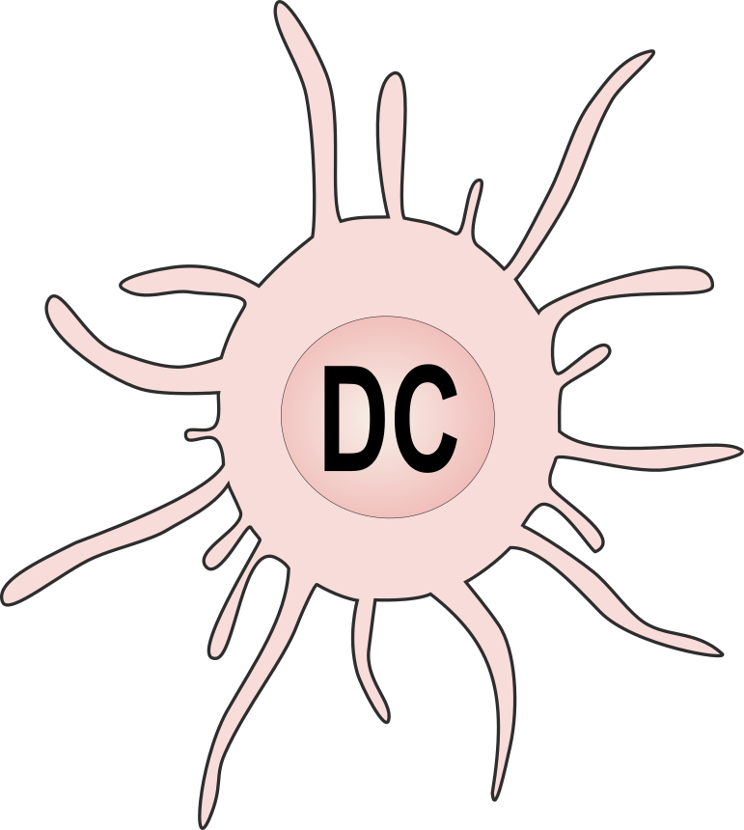
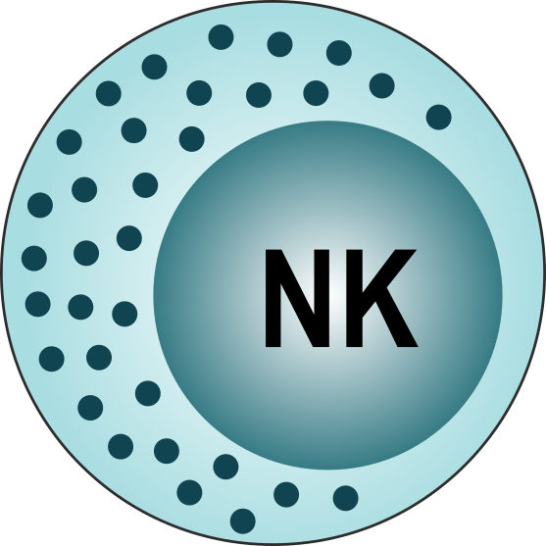
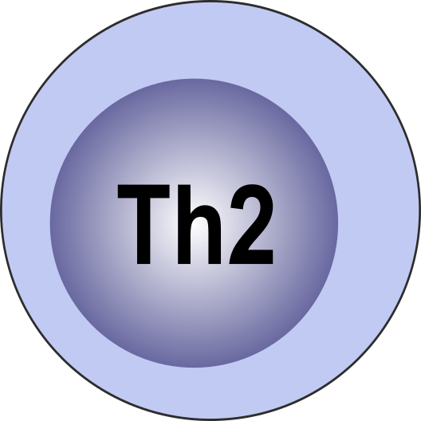



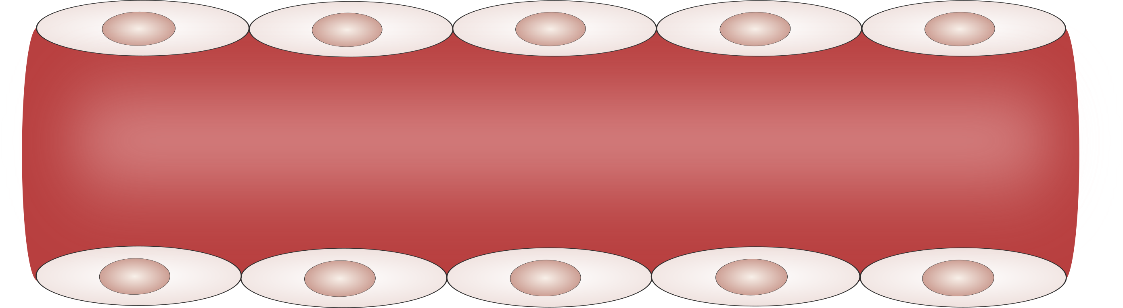
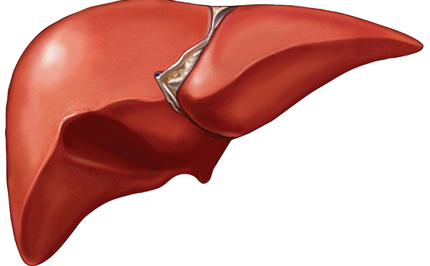
Damaged Epithelial Cells
T_{H}17 Polarisation
Innate Activation
TSLP
T_{H}2 Polarisation
IL-12/23
p40
IL-4
IL-16
IL-6
IL-17A
IL-6, MCP-1, MCP-4
IL-1RA, IL-15
IL-8
MIP-3α
MDC
CRP
SAA
Vasculature Remodeling & Angiogenesis
VEGF-A, sTie-2, sICAM-1, bFGF

