Slide 1
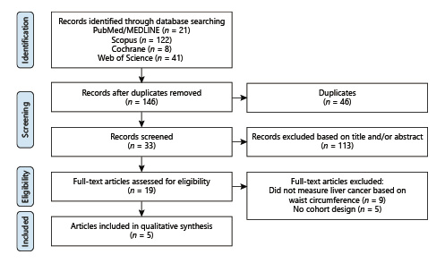

Waist Circumference and Risk of Liver Cancer: A Systematic Review and Meta-Analysis of over 2 Million Cohort Study Participants
Liver Cancer - DOI:10.1159/000502478
© 2019 The Author(s)Published by S. Karger AG, Basel - CC BY-NC-ND 4.0
Notes:
Fig. 1.Fig

Slide 2
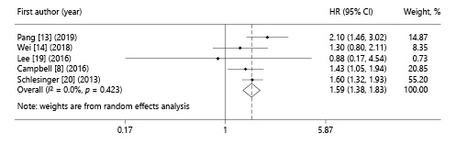
Waist Circumference and Risk of Liver Cancer: A Systematic Review and Meta-Analysis of over 2 Million Cohort Study Participants
Liver Cancer - DOI:10.1159/000502478
© 2019 The Author(s)Published by S. Karger AG, Basel - CC BY-NC-ND 4.0
Notes:
Fig. 2.Fig

Slide 3
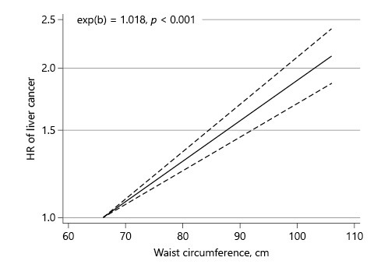
Waist Circumference and Risk of Liver Cancer: A Systematic Review and Meta-Analysis of over 2 Million Cohort Study Participants
Liver Cancer - DOI:10.1159/000502478
© 2019 The Author(s)Published by S. Karger AG, Basel - CC BY-NC-ND 4.0
Notes:
Fig. 3.Fig

Slide 4
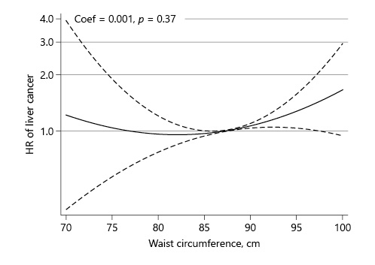
Waist Circumference and Risk of Liver Cancer: A Systematic Review and Meta-Analysis of over 2 Million Cohort Study Participants
Liver Cancer - DOI:10.1159/000502478
© 2019 The Author(s)Published by S. Karger AG, Basel - CC BY-NC-ND 4.0
Notes:
Fig. 4.Fig

Slide 5
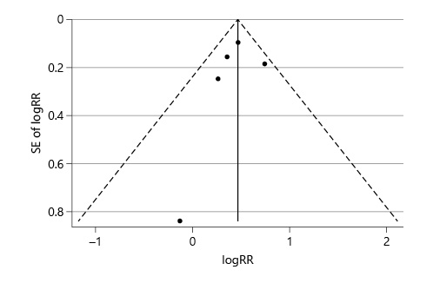
Waist Circumference and Risk of Liver Cancer: A Systematic Review and Meta-Analysis of over 2 Million Cohort Study Participants
Liver Cancer - DOI:10.1159/000502478
© 2019 The Author(s)Published by S. Karger AG, Basel - CC BY-NC-ND 4.0
Notes:
Fig. 5.Fig

