Slide 1
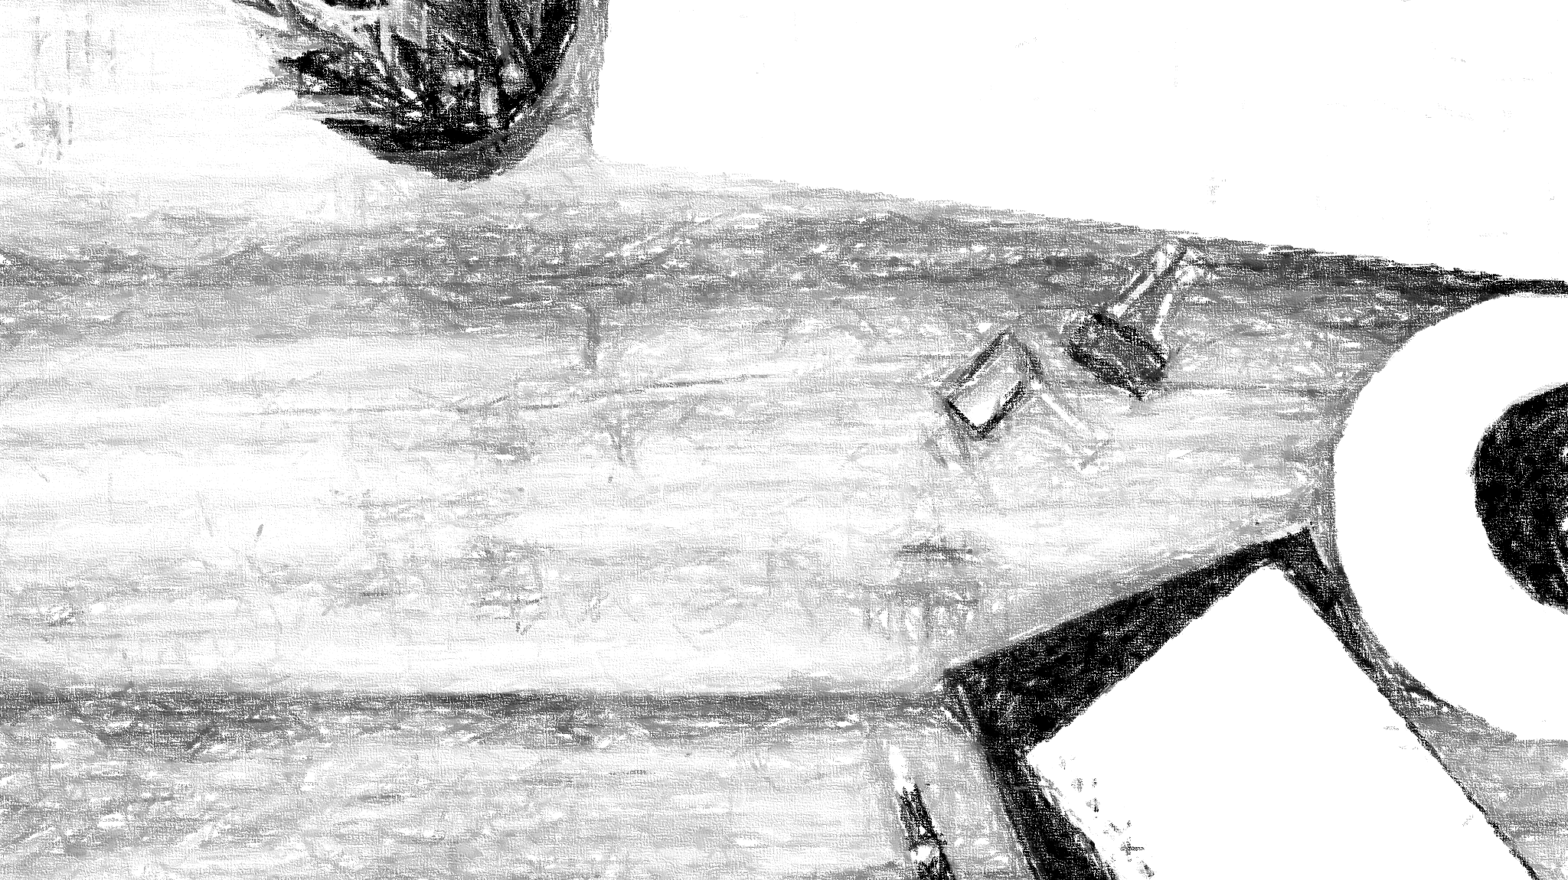

Facilitating knowledge creation
running a sustainable zine making event
Stephanie Chen, Digital Learning Specialist
@iamstephanie_c

Slide 2
What are zines?
Notes:
A zine (short for magazine or fanzine) is a small-circulation self-published work of original or appropriated texts and images (Wikipedia). Zines are often part of a DIY (do it yourself) culture which often includes people from marginalized communities or those who don’t have access to more mainstream publishing options (zinelibraries.info).

Slide 3
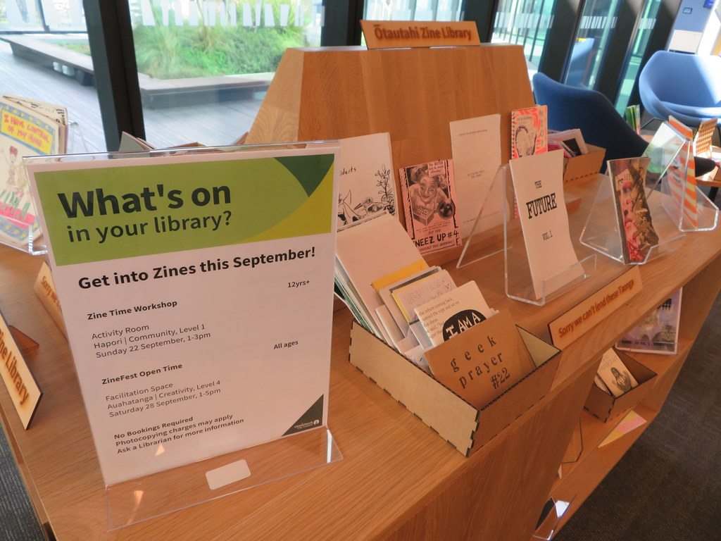

Zines and libraries?
Resources
Zinelibraries.info
Gisonny, K. and Freedman, J. (2006), "Zines in libraries: how, what and why?", Collection Building, Vol. 25 No. 1, pp. 26-30.
Zine Kits at Vassar College Libraries
9 Tips for Zine-Making Workshops
Zine Making 101 Mini-Guide
Ōtautahi Zine Library, Tūranga (CC BY-NC-ND 2.0)

Slide 4


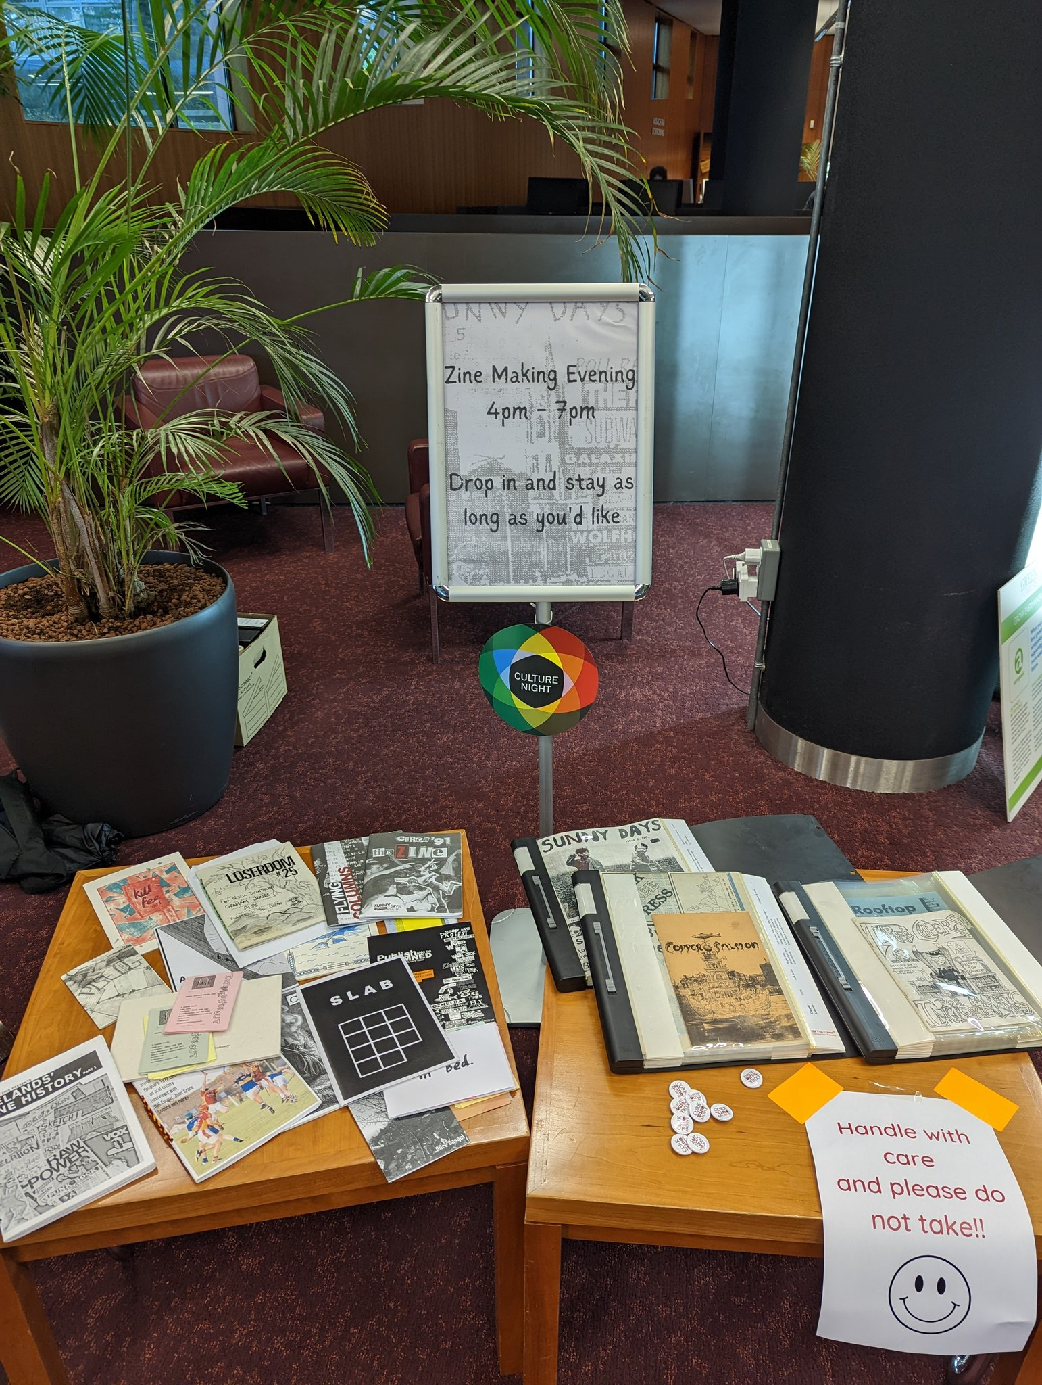
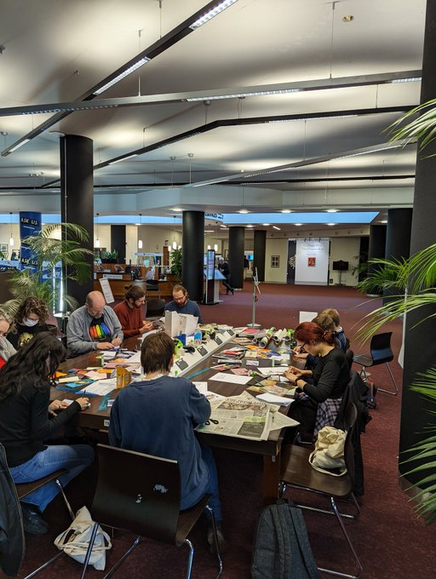
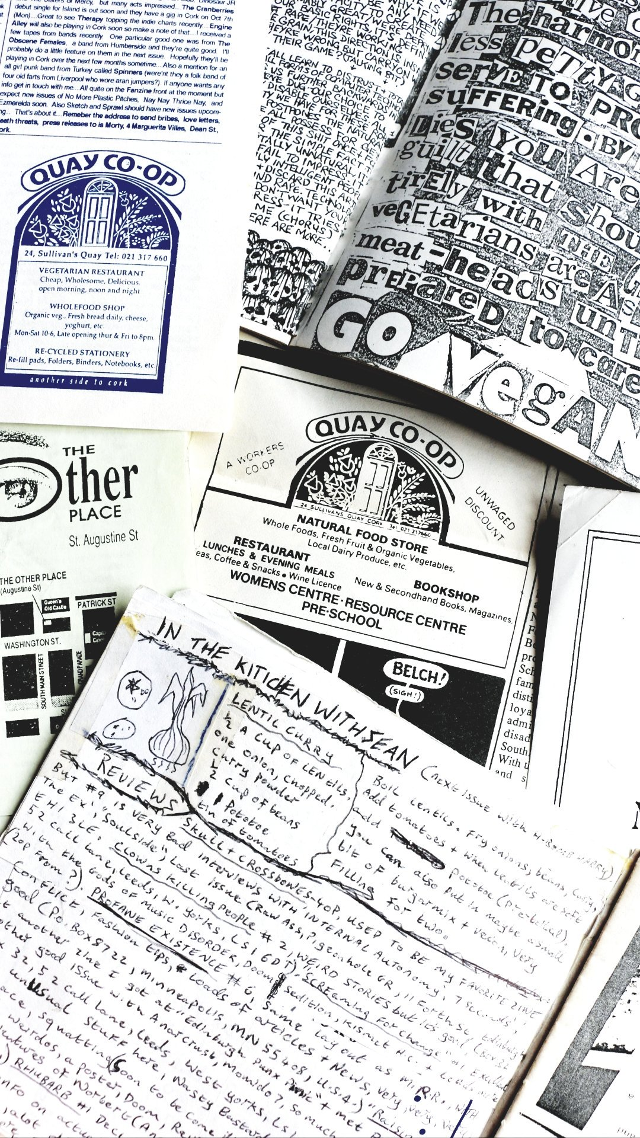
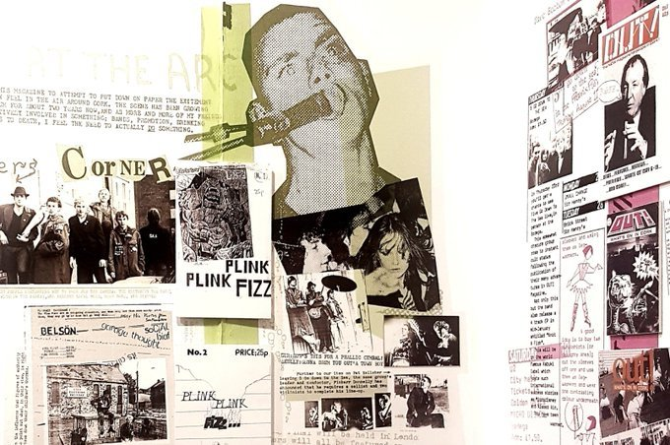
UCC Library and zines
Publish and Be Damned
Notes:
Culture Night 2022: Zine Making Evening from 4pm – 7pm; 25 total attendees
Publish and Be Damned: Exhibit from July to October 2019 with the Cork Zine Archive
Small selection of zines in Special Collections and Archives

Slide 5


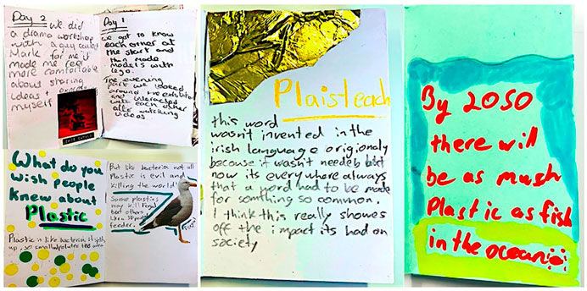
Zines and sustainability?
A sample of zine pages created during STEAM workshops at Science Gallery Dublin.
Notes:
SDG 3: safe and welcoming space for participants to create and communicate their knowledge, zines as reflective tools
SDG 4: active contributors to knowledge creation, increased participation, amplify diverse voices, knowledge and learning experiences
Anyone can make zines
Zine pedagogy = empower learners to participate by becoming critics, creators, experts in their own communities of knowledge

Slide 6
Tips
Sourcing materials
Space
Provide examples
Provide prompts and templates

Slide 7
Your Turn

Slide 8
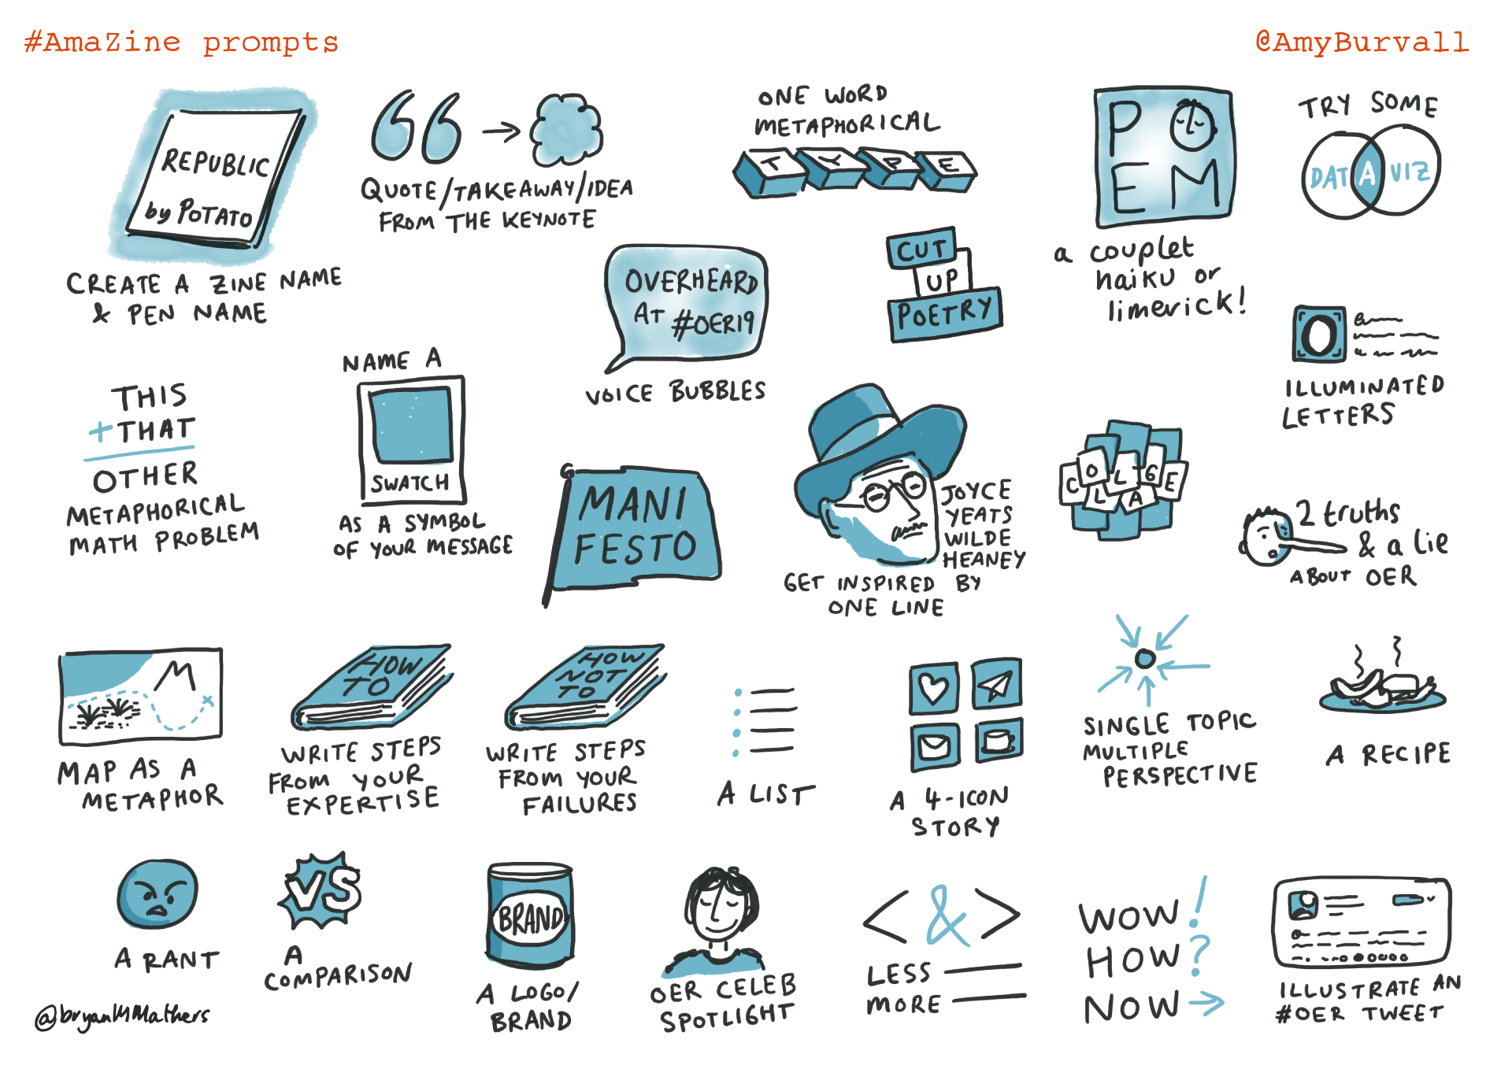
Create your own mini-zine
Prompts
What does a sustainable future look like to you?
What are your hopes and fears around climate change?
What’s one thing you’ll take away from CONUL?
Ama-Zine Prompts by @bryanMMathers is licenced under CC-BY-ND

Slide 9
Thank you
stephanie.chen@ucc.ie

